Slide 1
Microsoft Copilot for Sales
Adoption Planning Workbook
Date 01-22-19
© Copyright Microsoft Corporation. All rights reserved.

Slide 2
The age of AI
AI will break the world out of its stagnant productivity cycle – and set the stage for a new era of innovation.

Slide 3
Era of Copilots
AI as a real-time collaborator…
…that generates content
…that sparks creativity
…that automates cognitive tasks
…that completes work

Slide 4
Mundane tasks keep sellers from their customers
Researching prospects
Preparation and planning
Amount of time sellers spend on administrative and non-selling duties¹
Generating quotes/proposals
70%
Manually entering sales data
Administrative tasks
Prioritizing leads/opportunities
Internal meetings/trainings
¹Microsoft-sponsored Futurum Research 2022.

Slide 5
The AI advantage
Surveys show that employees want AI to help them:
89 percent of workers with access to automation and AI-powered tools feel more fulfilled because they can spend time on work that truly matters¹
Save time
Be more agile
Automate daily tasks
Make information more accessible
¹2023 Microsoft Business Trends Survey of 4,500 business decision makers (BDMs) in the United States, the United Kingdom, and Japan
.

Slide 6
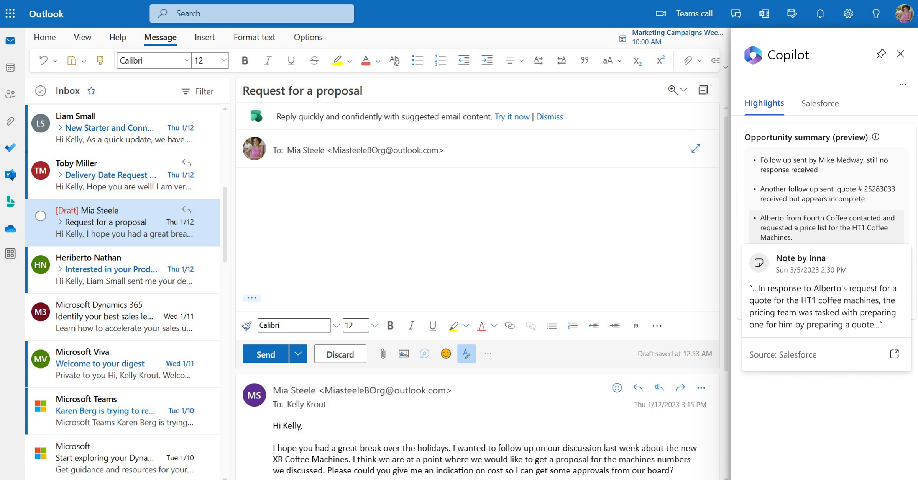
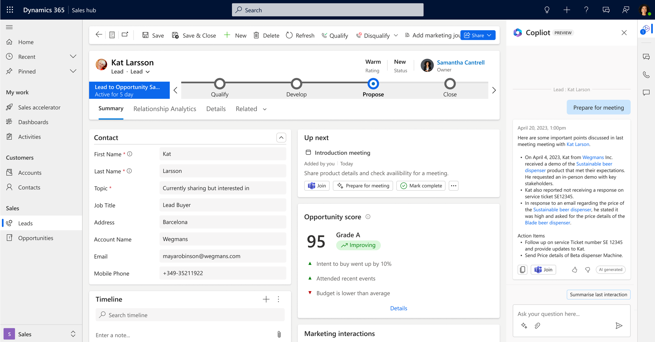
Copilot for Sales
Sales Copilot
Microsoft 365 Connects to Salesforce or Dynamics 365 Sales
and
Dynamics 365 Sales
Improve productivity
and close more deals
with the AI-based
Copilot designed for sellers
Sales Copilot
Copilot for Sales is experienced within Dynamics 365 Sales and Microsoft 365 and connects to other CRMs like Salesforce

Slide 7
Microsoft Copilot for Sales
Unlock sales productivity
Personalize customer interactions
Stay in the flow of work
AI-support across all communication channels
AI-assistance to prepare, engage, and close deals
Seamless data access
across M365 apps and
your CRM
AI-generated email summaries in Outlook
AI-assisted email replies
Sales conversation AI
360-view account and opportunity summaries
Real-time tips and suggestions
AI-assisted customer meeting follow-up
Collaboration spaces in Teams
AI-assisted CRM updates in Outlook and Teams
/mentions to surface relevant information

Slide 8
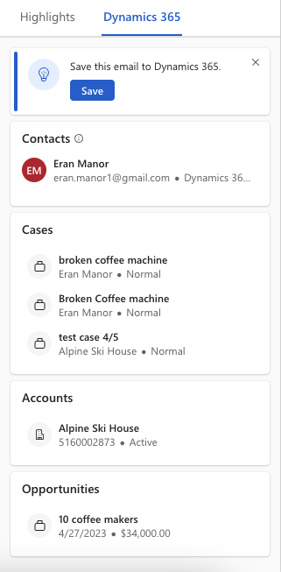
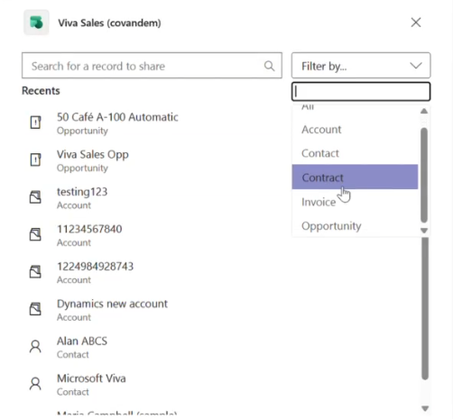
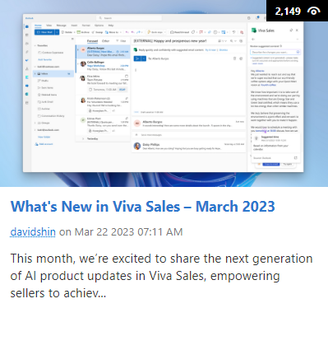
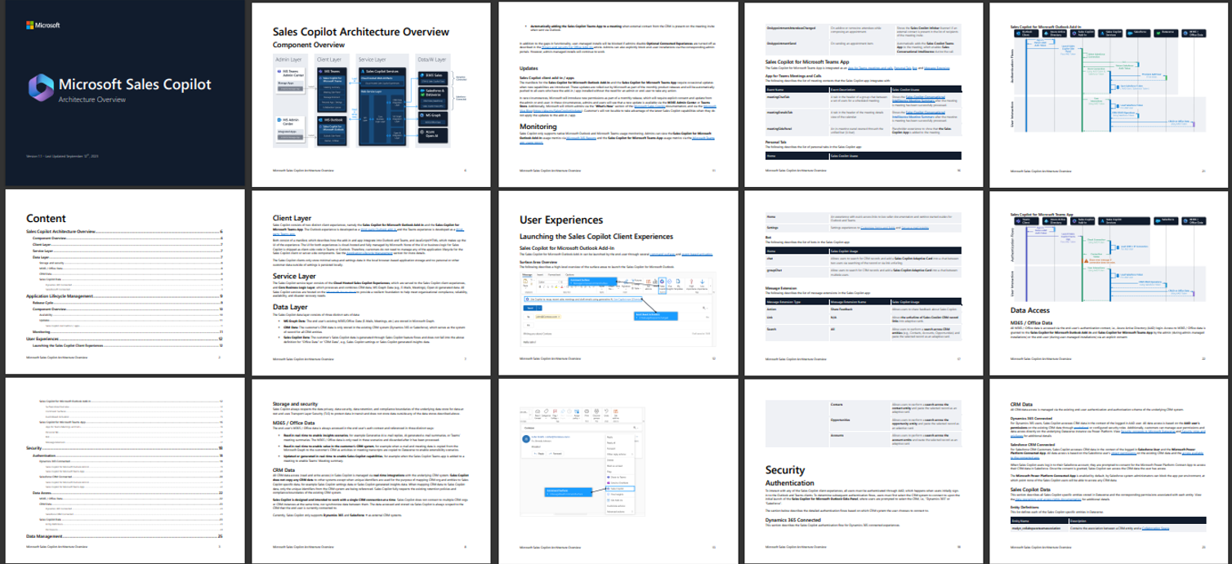
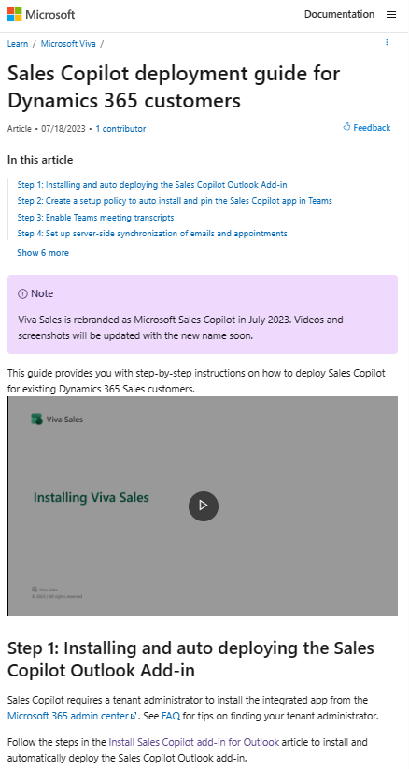
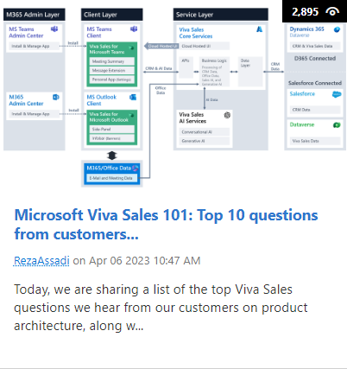
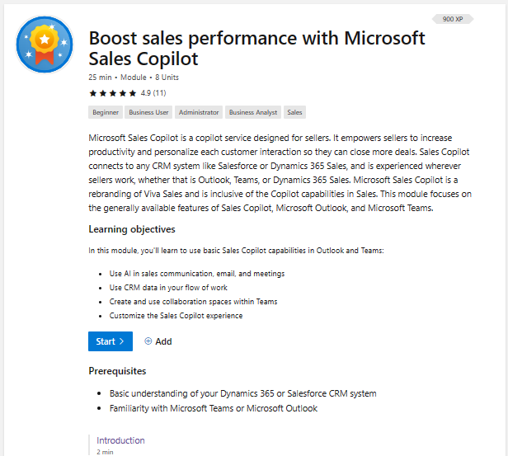
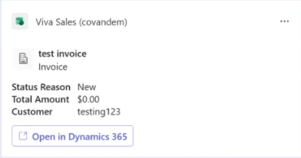
M365 Admin Center
Microsoft Docs
Getting Started
Teams
Microsoft Admin
Center Installation Guides
CRM Admin
Forms Customizations
Monthly Release Notes & Blog
Admin & User
Documentation
Step-by-step installation guides for D365 and SFDC
Configure what CRM fields and entities sellers can see and edit
Monthly release notes and ‘What’s new in Copilot for Sales’ blog
Learn about the architecture, and find learn content to get started
Copilot for Sales deployment guide for Dynamics 365 customers
Copilot for Sales deployment guide for Salesforce CRM customers
Administration Settings | Microsoft Learn
aka.ms/SalesCopilotUpdates
Copilot for Sales Architecture | Microsoft Learn
Admin Intro | Microsoft Learn
Seller training | Boost sales performance with Microsoft Sales Copilot
Teams ME advanced search
Adaptive Cards for custom entities

Slide 9
Copilot for Sales Architecture Document
Https://aka.ms/SalesCopilot/Architecture
This article contains links to download Copilot for Sales architecture document and top 10 most frequently asked questions about Copilot for Sales architecture.
The architecture document provides an in-depth view of the Microsoft Copilot for Sales architecture. It includes topics such as security, compliance, data residency/management, AI integration points, application lifecycle management, and more.
The purpose of this article is to help admins, IT professionals, and developers understand how Microsoft Copilot for Sales integrates with their CRM and the broader Microsoft 365 ecosystem.
Document | Last update | Last updated release
Download Copilot for Sales architecture document | September 13, 2023 | September 2023
Download Copilot for Sales architecture related frequently asked questions | September 13, 2023 | September 2023

Slide 10
Our Adoption Planning Workbook will guide you through the adoption planning process
Assess readiness
Assemble your team
Onboard employees
Partner with your team to clearly outline business strategy and key success metrics. Align business and technical needs to maximize outcomes.
Determine the overall organizational readiness including leadership alignment, user groups, technical, governance, support and feedback channels.
Tap into the technical and business change agents. Recruit multi-disciplinary teams of executive sponsors, technical talent, core stakeholders, change agents and champions.
Plan the rollout cadence based on early adopter pilot program, Champion readiness and planned scope of change.
Build awareness, deployment, training and feedback collection into the plan to continuously drive engagement and usage.
Define strategy and scenarios
Build plan

Slide 11
Assemble your team
We have identified four key teams that are critical to a successful adoption effort. Each stakeholder group has a specific role in the implementation and should be engaged early and often. The next few pages will outline the specific role these stakeholders will have in your adoption process.
1) Executive Sponsors
2) Success Owner
3) Early Adopters
4) Champions
Use the following slides to identify key stakeholders and others involved in the adoption effort.

Slide 12
Identify your team members
Key roles | Role | Responsibilities | Department | Team Member Identified for Role
 | Executive Sponsor | Send Microsoft Launch announcement. Help identify and prioritize top HR needs. Connect monthly with HR and IT leaders across the organization. Actively participate in and use the Microsoft Copilot for Sales capabilities to help drive and reinforce adoption | VP, HR | Jane Doe
 | Success Owner
 | Program Manager
 | Champions
 | Training Lead
 | Department Leads (Stakeholders)
 | IT Specialists
 | Communication Lead
 | HR Manager
 | Community Manager

Slide 13
Identify and prioritize your Scenarios
Use the following slides to identify the business scenarios you plan to enable with Microsoft Copilot for Sales, then work through the prioritization exercise.
Leverage this content to develop key messaging in your Awareness and Training engagements.

Slide 14
Explore the Productivity Library
Search by role, department, or tool to find out how other organizations have solved their business challenges. Identify the different roles and personas in the target audience.
Scenario identified
Be productive on the road.
How it applies to my organization
Provides field sales teams ways to easily store, share, and update files from any device during travel.

Slide 15
Meet with your team members
Host a workshop…
to delve deeper into current challenges, strategies and goals. Include department leads, lines of business, IT and other stakeholders who can help brainstorm how Microsoft Copilot for Sales can be used in your organization. Leverage your Productivity Library examples in the conversation.
Questions to drive the conversation
What are some of our organization’s challenges or pain points?
What are the areas in which our organization would like to improve?
What are our strategic initiatives or current transformation projects that Microsoft Copilot for Sales can support?
What is our current process for Sales?
Feedback from key stakeholders
Important documents and document updates are lost in email. Unable to track versions and effectively collaborate.

Slide 16
Organize and document each scenario
Consider using the framework below to document business scenarios for each department
As someone in… (Team)
I want to….
(Description of
what I want to do)
Using…
(Specific application
of the technology)
I’ll know this is
successful when…. (Solutions success measure)
As someone in
Sales Management
I want to
Quickly create customer contacts in CRM
Using
Outlook
I’ll know this is successful when
My contacts are in CRM aligned in the correct customer account and I see opportunity information where I am working e.g. Outlook

Slide 17
Establish KPI benchmarks and reporting plan
Capture each expected business value of Microsoft Copilot for Sales along with the Key Performance Indicators and targets for each business scenario.
Identify how you will measure and report against KPIs to gauge adoption.

Slide 18
Definitions to help build your success criteria
KPI Measure / Name
A high-level summary for the measure. For example, the number of employees that are members of Teams.
KPI Reporting Frequency
The cadence that reporting runs on for this metric.
KPI Formula
The details of the calculation ensuring it’s connected to the data sources and instruments below.
Data Sources
Details on exactly where the data is coming from. How many people? Which groups? Which systems?
Data Gathering, Transformation, & Analysis Process
How is the data being pulled from the data sources? For example, is this a dynamic pull at 7 a.m. the first Monday of the quarter, or is this an extract from a static file that is always two weeks old? If this is people, for example, are we surveying them using a specific instrument delivered in a specific way?
Data Gathering Instruments
Do we need to create any instruments (surveys, feedback forms) or create guides on data transformation to collect the data we want?
Data Gathering Owner
State which person, or group of people, is assigned to each part of the data gathering, transformation, and analysis process.

Slide 19
Establish KPI benchmarks
Use the framework below to define your own success criteria. Remember to make them specific, measurable, attainable, relevant and timely.
Reduced operating costs Improve quality and hygiene of customer contact information | Quantitative Microsoft Copilot for Sales reporting | Contact hygiene reports from CRM Improved customer contactability -> productivity gain
 | Finance/accounting reports Travel and phone expense reports
Success criteria
Method
Goal

Slide 20
Success criteria scorecard example
Goal |  |  | Measurement
Business Value | Type of Value | Business Owner | KPI Measure | Data Source | KPI Formula | KPI Baseline | KPI Target
Enabling additional customer engagement through improved contact information | Increase sales | Alexandra Jay | Number of meetings set up and conducted | Teams | Number of meetings online/number of meetings | 5% | 55%
Unlock Sales productivity | Increase Sales | Alexandra jay | Number of AI-generated email summaries in Outlook | Outlook | Number of email drafts created using Microsoft Copilot for Sales | 35% | 60%

Slide 21
Define your success criteria details
KPI Measure / Name
Unlock Sales productivity
KPI Reporting Frequency
Monthly
KPI Formula
Number of email drafts created using Copilot
Data Sources
Outlook & Copilot for Sales
Data Gathering, Transformation, & Analysis Process
PowerBi report
Data Gathering Instruments
Application analytics
Data Gathering Owner
Alexandra Jay

Slide 22
Document your approach to reporting success
Microsoft Copilot for Sales Steering Committee
Who will you report success to?
How often?
Monthly meetings
Share success scorecard during live meeting and post to Teams channel after monthly meeting for access by all key stakeholders
In what format?
PowerPoint
Using which vehicles?

Slide 23
Assess technical and organizational readiness
Key factors that will tell you how ready your team members are for the transition to Microsoft Copilot for Sales
Clear vision for the organization to adopt
Clear vision for the individual to adopt
Level of overall change
Executive alignment
Use the following technical readiness checklist and organizational readiness tools to assess the willingness and preparedness of your users and your organization to move to Microsoft Copilot for Sales.

Slide 24
Complete the technical readiness checklist
Technical Readiness is key to ensuring your organization is ready for launch. Use the checklist to identify items that need to be completed before go-live. Need help? Review the Technical Readiness and Governance Guide.
Readiness Item | Complete? Y/N | Plan to Complete
Complete legal & security review
Review service capabilities with legal & security teams
Determine provisioning policies and process
Review Microsoft Copilot for Sales Admin reporting
Prepare help desk
Notes:
Request FastTrack assistance Complete O365 Secure Score Quiz (optional) Enable service(s) Guest access Bandwidth planning Client Requirements Technical readiness complete

Slide 25
Assess organizational factors
Think about a time when your organization adopted a new technology. What made that adoption successful or not successful?
Moved file storage to the cloud two years ago using OneDrive. Employees shared that they knew ahead of time the change was coming and were told specifically how it would impact their role. In some cases, the impact was minimal, which reduced anxiety.
Employees may not be able to focus on Microsoft Copilot for Sales if they are focused on other changes. Are there key initiatives taking place during the Microsoft Copilot for Sales rollout that should be considered in your planning?
What type of internal resources exist within your organization that can be leveraged for the adoption effort? This includes communications channels, change network, training cadence and leadership events.
What are the perceived risks and benefits of the Microsoft Copilot for Sales implementation? How can you highlight benefits? How can you mitigate risks?

Slide 26
Understand your “why”
When planning for adoption, users need to understand why the change is occurring for the organization and how Microsoft Copilot for Sales will help individual employees achieve more. This includes ensuring they understand why the change is happening, what’s in it for them, and why they’re being asked to change. Capture these reasons below and use this content to build your communications and engagement content.
Unlock sales productivity
Personalize customer interactions
Stay in the flow of work
Draft customer emails saving time and providing inspiration
How will Microsoft Copilot for Sales benefit your organization?
How will Microsoft Copilot for Sales benefit employees?

Slide 27
Identify key changes for each team
Create a list of things that will change for your team members with the implementation of Microsoft Copilot for Sales. This includes the new technology as well as new ways of working and engaging. Make sure to incorporate these key changes in your Awareness and Training plans.
Team: Sales
Employees will have an AI generated recap of calls providing highlights, tasks and sentiment analysis

Slide 28
Identify areas of alignment
To ensure that leaders demonstrate support, there must be alignment on key project goals, timelines and objectives. Use this worksheet to capture areas of alignment and misalignment and the implications of both.
Increasing Sales productivity and revenue is a perpetual aim of the Sales organisation
Executive alignment
Each area / organization has differing priorities when allocating time to change managers for different changes
Executive misalignment
Consider current change climate for each business group and plan user readiness activities accordingly. Communicate adoption and usage risks to Program Manager.
Key implications

Slide 29
Build your awareness strategy
Before building your Awareness Plan, take time to understand who needs to be informed, key messages to convey, and preferences for communication channels.

Slide 30
Who needs to be informed?
Groups impacted by the Microsoft Copilot for Sales Implementation
Audiences who will drive the change forward
Support Organizations
Sales team
Managers
IT operations

Slide 31
What do they need to know?
For the Transition State
In the Future State
Features and benefits
Product Roadmap
Readiness and education opportunities
How it impacts their role
New process skills/knowledge

Slide 32
How do they like to communicate?
Email: Use company email to connect individually, through distribution lists, or company-wide
Social: Leverage social networking sites to push out helpful project updates and engage with employees
In-Person: Town Halls, Focus Groups and 1:1 conversations provide leadership an opportunity to answer questions and interact with the team
Recommended Modalities
Incorporate all content into employee-preferred all-company memos, current viva engage groups and during C-Suite Town Halls.
Preferred Modalities
Include in weekly all-company memo because of high readership
Ideal Timing
Microsoft Copilot for Sales scenario videos in Productivity Library
Helpful Resources

Slide 33
Which content will be helpful for your communication plan?
After exploring Microsoft resources, hyperlink and track content below.
Microsoft Copilot for Sales – AI Sales Tools| Microsoft
Welcome to Microsoft Copilot for Sales | Microsoft Learn
Microsoft Copilot for Sales Discussion - Microsoft Community Hub

Slide 34
Build your training strategy
Before building your training plan, take time to understand the groups who require training, topics to cover, and audience learning preferences.

Slide 35
Document key training considerations
When you are putting together your training plan, you will need to take into consideration:
Teams
Outlook
D365
Employees in general are very comfortable with technology. Exception is operations team, which does not rely on technology to complete day-to-day tasks.
Current Sales Copilot apps
Technology literacy
Regular training academies, other programs or specific changes.
Short, on-line, easily accessible training modules
In person
Virtual training and office hours
Current change programs
Training preferences

Slide 36
Who needs to be trained?
Sales
Marketing
IT
Operations
Microsoft Copilot for Sales Early Adopters
Microsoft Copilot for Sales Champions
Exec Sponsor
Steering Committee
IT Help Desk
Groups impacted by the Microsoft Copilot for Sales Implementation
Audiences who will drive the change forward
Support Organizations

Slide 37
What do they need to learn?
For the Transition State
In the Future State
Product Features and how to get the best from the solution
Roadmap
New process skills/knowledge

Slide 38
How do they prefer to learn?
In person / virtual training – Sponsors (1 hour), Ambassadors Training (1 hour), Change Champions (1 hour), Manager (1 hour)
Web-based training – On-demand webinars, videos, Online Training (OLT) for Sales Copilot training
Self-paced training – On demand videos and readiness. Frequently Asked Questions (FAQ) sheets
Recommended Modalities
Incorporate web-based training modules into Company Training portal for easy navigation
Preferred Modalities
Avoid scheduling during end of month/quarter/year for sales team
Ideal Timing
Copilot for Sales Training Materials
Helpful Resources

Slide 39
Which content will be helpful for your training plan?
Hyperlink and list the content below for future reference
Microsoft Support Desk contact information

Slide 40
Build your Early Adopter and Champions programs

Slide 41
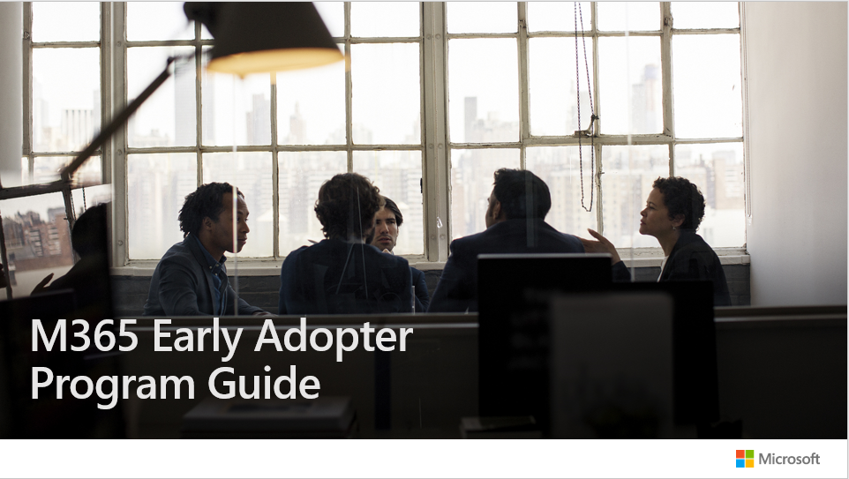
Launch your Early Adopter Program
Use Microsoft’s Early Adopter Guide to build and launch your Early Adopter Program.
The guide includes:
Program timelines
Communications and training samples
Survey templates

Slide 42
Champions Program planning checklist
Find enthusiastic Champions who can commit time and effort.
Build a Yammer group for Champions to share updates and successes.
Provide materials ready to support their work with teams and individuals (e.g., brown bag sessions).
Ensure a regular rhythm for discussions with the Champions on what’s working and what’s not.
Design a program to engage and recognize their effort, such as providing privileged access to relevant events or speaking engagements.
Communicate to individuals about the Champions' role and how to find them – remember, Champions are not IT support, but business representatives.
Incorporate Microsoft Copilot for Sales resources and custom learning into your own internal training site.
Create a contest (e.g. scavenger hunts and giveaways) between departments to encourage people to interact with Microsoft Copilot for Sales.

Slide 43
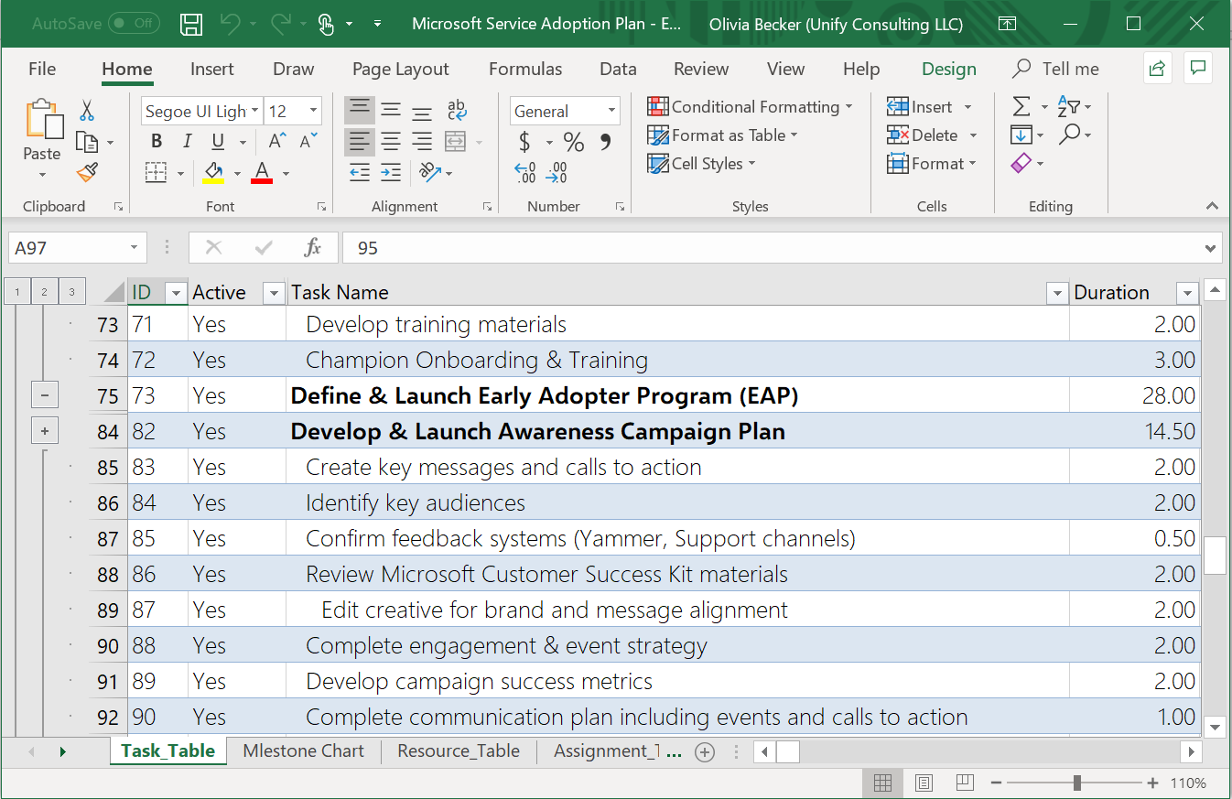
Capture your plans with sample timelines and templates
Jumpstart your implementation with pre-defined rollout timelines and plans.
Use in Microsoft Project or save to Excel or Visual Studio Team Services for easy management.

Slide 44
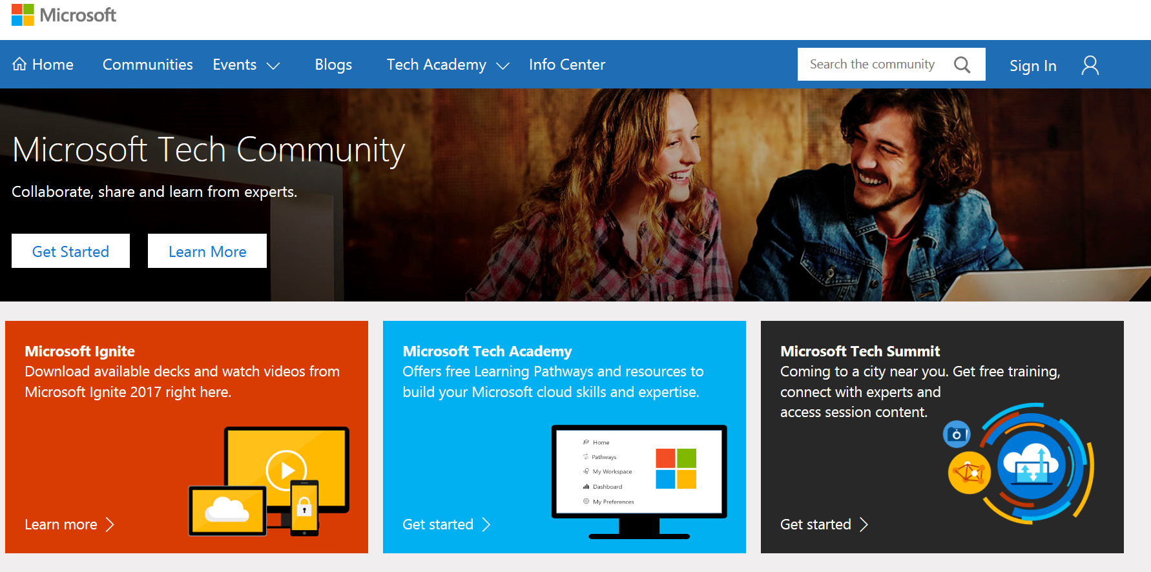
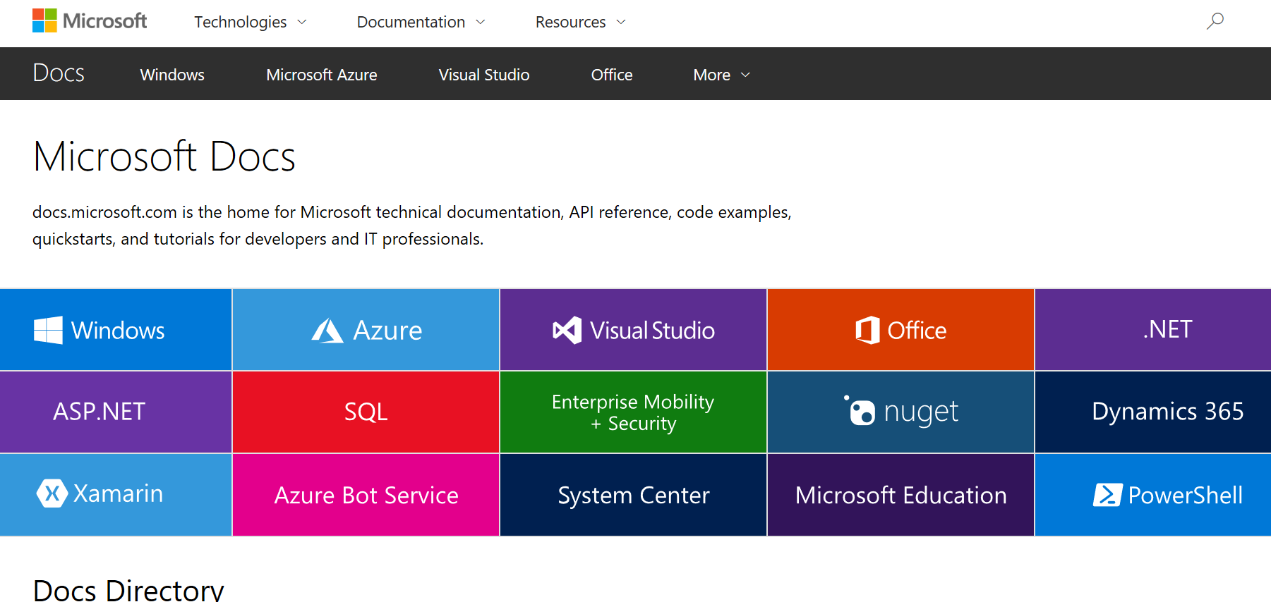
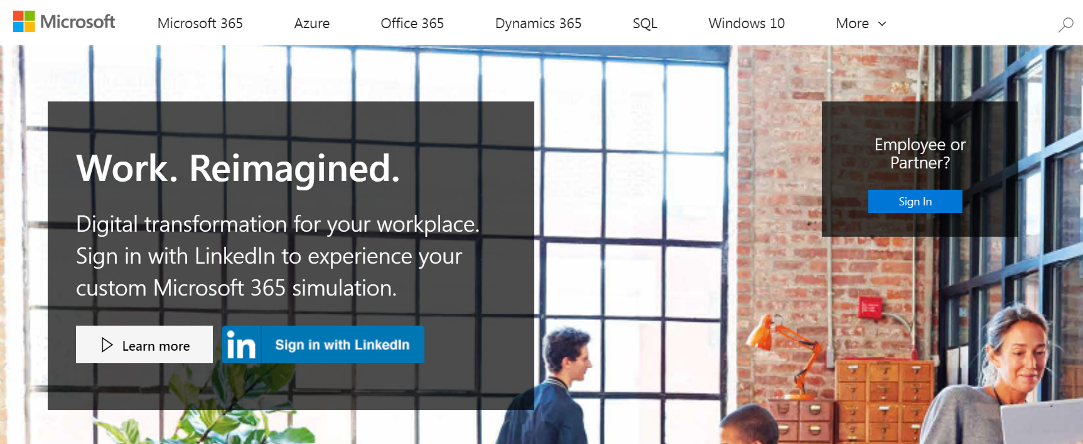
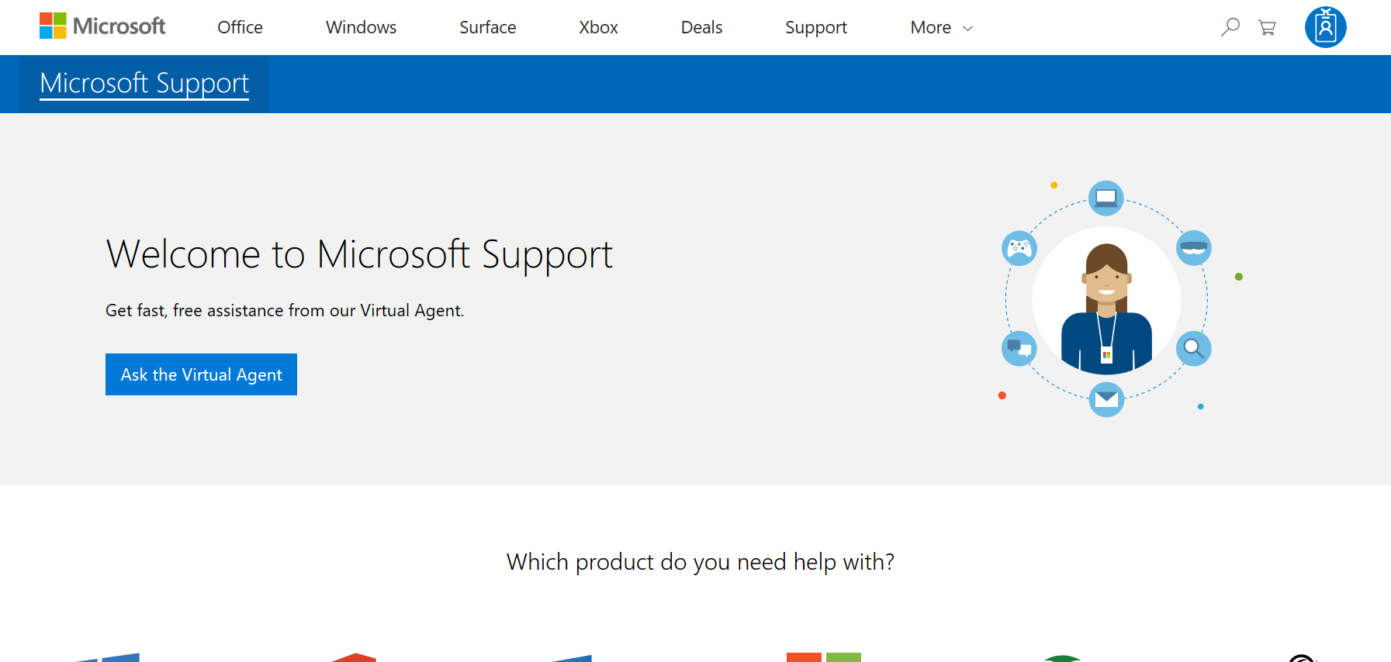
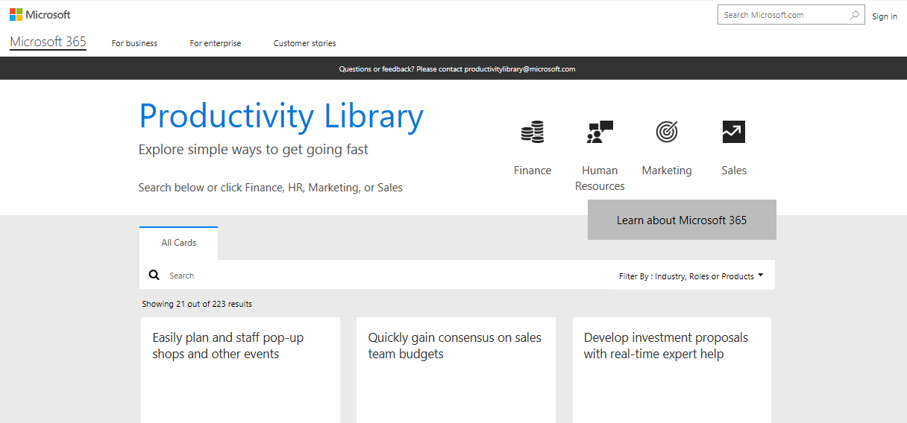
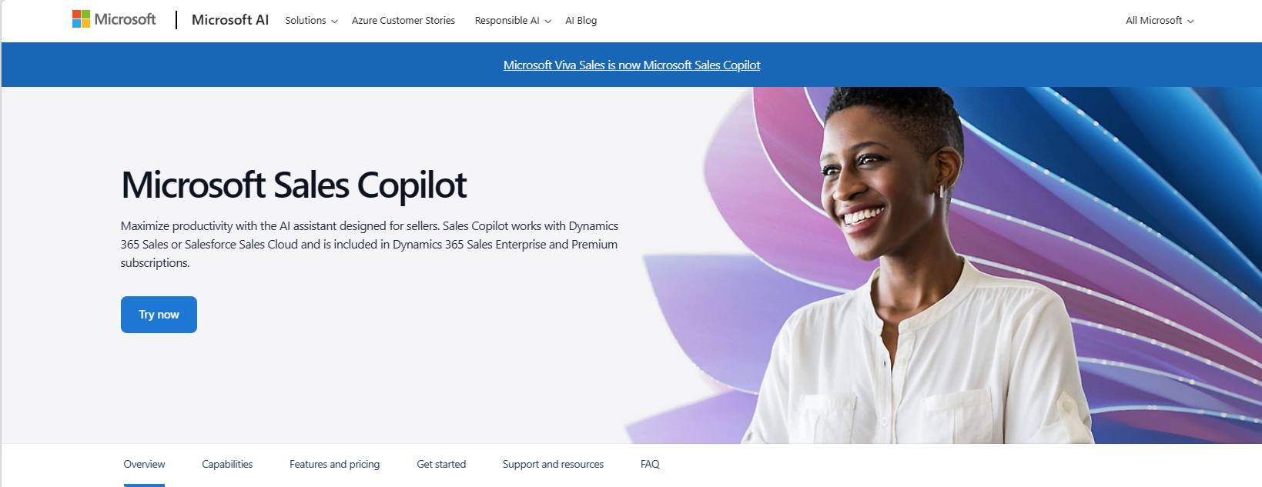
Bookmark Microsoft adoption resources
Join Driving Adoption Tech Community
Microsoft Docs
Transform.microsoft.com
https://techcommunity.microsoft.com
Collaborate, share, and learn from experts
https://docs.microsoft.com
Technical documentation for developers and IT professionals
https://transform.microsoft.com
Resources to help you plan your transformation
Microsoft Support
Productivity Library
Product Websites
http://support.microsoft.com
Access FAQ and support documentation
http://aka.ms/productivitylibrary
Library of scenarios with assets and training
Microsoft Sales Copilot – AI Sales Tools
Product specific websites for additional details

