Slide 1
Microsoft Power Platform Adoption Planning Workbook

Slide 2
What’s inside
The purpose of the deck is to help accelerate your adoption of Microsoft Power Platform within your organization.

Slide 3
Outline
Envision
Onboard
Scale
Get started
Project team
Executive Sponsorship
Adoption strategy and vision
Success Criteria
Resistance Management
Readiness
Training strategy
Champions
Community
Rewards and Recognition
Communication Plan
Awareness
Ongoing Engagement
Center of Excellence
Adoption maturity
Operational Plan
Success tracking
Activity calendar

Slide 4
Our Adoption Planning Workbook will guide you through the adoption planning process
Assess readiness
Assemble your team
Onboard employees
Partner with your team to clearly outline business strategy and key success metrics. Align business and technical needs to maximize outcomes.
Determine the overall organizational readiness including leadership alignment, user groups, and technical, governance, support, and feedback channels.
Tap into the technical and business change agents. Recruit multi-disciplinary teams of executive sponsors, technical talent, core stakeholders, change agents, and champions.
Plan the rollout cadence based on early adopter pilot program, Champion readiness, and planned scope of change.
Build awareness, deployment, training, and feedback collection into the plan to continuously drive engagement and usage.
Define strategy and scenarios
Build plan

Slide 5
Envision
Microsoft Power Platform enables everyone to digitize their business processes. In this phase, you will gather your initial team, define your adoption scope, assess your readiness, and capture what success looks like for your organization.

Slide 6
Get started
By driving adoption of Microsoft Power Platform, you can deliver an excellent user experience and increased business value inside your company.
Driving adoption and cultivating a low code culture is about more than implementing technology features. Technology can assist an organization in making the greatest impact, but a healthy low code culture involves a lot of considerations across the spectrum of people, processes, and technology.
Our goal is to get you up and running quickly so that you can begin your journey with Microsoft Power Platform.

Slide 7
Assemble your team
We have identified key stakeholders who are critical to a successful adoption effort.
Each stakeholder group has a specific role in the implementation and should be engaged early and often.
The next few pages outline the specific roles these stakeholders will have in your adoption process. Use them to identify key stakeholders and others involved in the adoption effort.

Slide 8
Assemble your team
Fill this section out
Any successful project begins by bringing the right team together. Your project stakeholders should include representatives across your organization who have accountability for project success.
Role | Responsibilities | Department | Who?
Executive Sponsor | Communicate high-level vision and values of the Microsoft Power Platform to the company | Executive Leadership | [Enter Name Here]
Success Owner | Ensure the business goals are realized from the adoption process | Any department | [Enter Name Here]
Champions | Help evangelize Power Platform. Create a circle of influence and can feed back to the Adoption team what works/what doesn't work. | Multiple departments | [Enter your Champions Lead here]
Training Lead | Manage and communicate training content about Power Platform – can be internal or external vendor | IT or other | [Enter Name Here]
Department Leads (Stakeholders) | Identify how specific departments will use the Power Platform and encourage engagement | Any department (management) | [Enter Name Here]
Communication Lead | Oversee company-wide communications about the Power Platform | Corp Communications, IT or other | [Enter Name Here]
Power Platform Admin Team | Responsible for establishing an environment strategy, setting up data loss prevention (DLP) policies, and managing users, capacity, and licensing. They also make data available to makers through connectors, integration, or migration. | IT | [Enter your Admin Lead Here]
Power Platform Nurture Team | Organizes app-in-a-day events and hackathons, provides mentorship to makers, ensures new makers get off to a good start, and generally evangelizes the platform. Provide business change management. | Multiple departments | [Enter your Nurture Lead Here]
Note: Though we recommend having each of these roles fulfilled, in smaller organizations some of these roles may be carried out by the same person.

Slide 9
Executive sponsor
When planning to advance the adoption of Power Platform, it's crucial to have executive support. Having an executive sponsor is imperative because adopting Power Platform is far more than just a technology project.
Although some successes can be achieved by a few determined individuals, you will be in a better position when a senior leader is engaged, supportive, informed, and available to assist with activities such as:
Formulating a strategic vision and priorities for Power Platform and low-code
Leading by example by using Power Platform in a way that's consistent with adoption goals
Allocating staffing and prioritizing resources
Approving funding (for example, Power Apps Per User licenses or AI Builder credits)
Communicating announcements that are of critical importance
Decision-making, particularly for strategic-level governance decisions
Resistance resolution (for issues that cannot be resolved by operational or tactical personnel)
Supporting organizational changes (for example, creating or expanding the Center of Excellence)
To gain buy-in from your leadership team, demonstrate the impact of your Power Platform solutions, share other customer success stories, or direct them to the Total Economic Impact report of Power Apps, conducted by Forrester, which outlines the time, cost and productivity savings of Power Apps.

Slide 10
Get buy-in
Citizen developers will come from all parts of your organization and will not traditionally sit in IT. As these people have “day jobs,” they will report to people who will need to buy in to the transformation you are bringing using Power Platform. You may need to empower people to take time from their “day jobs” to be involved in making apps, flows, and chatbots.
Consider how you will get executive buy-in, manager buy-in, and individual buy-in. An effective way to gain buy-in is to highlight the positive impact Power Platform could have for different stakeholders. For example, you might show an executive projections for cost reductions, a manager might be more motivated by the time that solution may save, and an individual may be excited by the learning opportunity.
Culture change can take time, and it is important to address people’s concerns and how it may impact their part of the organization both in the short term and the long term.

Slide 11
Identify an executive sponsor
There are multiple ways to identify an executive sponsor.
Top down | Bottom up
An executive sponsor may be selected by a more senior executive. For example, the Chief Executive Officer (CEO) may nominate the Chief Information Officer (CIO) or Head of Digital Transformation to advance the low-code adoption. Having an executive sponsor at the C-level is an excellent indicator. It indicates that the organization recognizes the importance of Power Platform as a strategic asset and is advancing its low-code culture in a positive direction. | Alternatively, a candidate for the executive sponsor role could emerge due to the success they've experienced with Power Platform. For example, a business unit within the organization, such as Finance, has organically achieved great success with respect to their use of Power Platform. A leader, such as the Finance Director, may then grow into the executive sponsor role by sharing successes with other business units across the organization. With a bottom-up approach, the sponsor may be able to make some progress, but they won't have formal authority over other business units. Without clear authority, it's only a matter of time until challenges occur that are beyond their level of authority. For this reason, the top-down approach has a higher probability of success. However, initial successes with a bottom-up approach can convince leadership to increase their level of sponsorship.

Slide 12
Power Platform admin team
Your Microsoft Power Platform admin team is responsible for establishing an environment strategy, setting up data loss prevention (DLP) policies, and managing users, capacity, and licensing. They also make data available to makers through connectors, integration, or migration.
Take a look
Complete the PL-900 Power Platform Fundamentals exam to get more familiar with Power Platform.
Then take our learning path to identify best practices for securing and governing Microsoft Power Platform environments.
Check out our Admin and governance best practices checklist to apply your knowledge to your tenant.
Still want to learn more? Read our deep dive Power Platform Admin Whitepaper.

Slide 13
Meet with your team members
Fill this section out
Host a workshop to delve deeper into current challenges, strategies, and goals. Include department leads, lines of business, IT, and other stakeholders who can help brainstorm how Power Platform can be used in your organization. Use our Power Platform stories for examples and inspiration of what other organizations are doing.
Questions to drive the conversation
What are some of our organization’s challenges and pain points related to digital transformation and low-code adoption?
What are the areas in which our organization would like to improve?
What are our strategic initiatives and current transformation projects that Power Platform can support?
How are departments currently solving their digital challenges?
What does successful low-code adoption look like to you and your team?
Feedback from key stakeholders
Example: Important documents and document updates are lost in email. Unable to track versions and effectively collaborate.

Slide 14
Adoption strategy and vision

Slide 15
Scope
Taking time to define your project scope and goals will help ensure everyone on your project team is aligned and working toward the same end results.
Examples:
Improve process efficiencies by enabling employees to use the tools available to them
Empower every employee to leverage Microsoft Power Platform to drive digital transformation
Reduce cost spent on maintaining legacy and third-party solutions
Increase employee satisfaction through learning opportunities and new career paths

Slide 16
Define your goals
Fill this section out
Microsoft Power Platform’s low code approach to solution delivery has enabled thousands of organizations around the world to use technology to transform their business. How will it transform yours? Think about what’s in scope for your adoption and what your initial priorities are.
Goals
Example: Be productive on the road.
Example: Reduce IT support and maintenance costs.
Example: Increase digital literacy.
Example: Improve long organizational processes.
How it benefits my organization
Example: Provides field sales teams ways to easily update customer details and contracts without having to go back to the office.
Example: Reduce Shadow IT workloads in local Excel and Access files that often have high IT support cost when they become critical by migrating them to Power Platform.
Example: Empower employees to be in the driving seat of digital transformation by enabling them to digitize their own processes.
Notes:
Once you complete this section, refer to it throughout your project to ensure you are on track for your desired end-state.

Slide 17
Capture success criteria

Slide 18
Define your success criteria
Identify key performance indicators (KPIs) that should improve based on adopting various business scenarios.
Establish KPI benchmarks using SMART goals

Slide 19
Identify SMART success criteria
S
Specific:
Clear and unambiguous. Answering questions "What, why, who, and where?"
M
Measurable:
Concrete, clearly demonstrating progress.
A
Achievable:
Reasonable, not extreme.
R
Realistic:
In line with the realities of the stakeholders.
T
Time related: Linked to a specific target date. Answering the question "when?"
Notes:
We recommend that you use SMART guidelines to define the Key Performance Indicators (KPIs) for each scenario.
Specific: Clear and unambiguous. Answering questions "What, why, who and where?"
Measurable: Concrete, clearly demonstrating a progression
Achievable: Reasonable, not extreme
Realistic: In line with the realities of the stakeholders.
Time-related: Linked to a specific target date Answering the question "when?"

Slide 20
Use these examples to define success benchmarks
Success measure | Measurement method | Example goal
Reduced operating costs Replace third-party tools with Power Platform Use Power Platform for development of custom solutions Avoid on-premise run costs by retiring legacy and on-prem solutions and replacing them with Power Platform solutions | Quantitative # of third-party applications retired # of legacy solutions retired # of Power Platform solutions used in production | Replace 20% of third-party apps by end of year Replace 10% of legacy and on-prem apps Reduce custom software development by 10% Use x number of Power Platform solutions in production
Increased productivity Faster time to market through using low code and reducing development time of solutions Increased number of makers able to develop tools that can replace paper and manual processes Ability to complete tasks on a mobile device instead of having to go to a desk. | Quantitative Process efficiency gains Time savings by using Power Platform solution instead of paper/manual processes Qualitative End user surveys | x number of makers x amount of time saved by using Power Platform solution instead of manual process 10% fewer repetitive tasks 20% fewer data entry errors / less data loss on manual processes
Improved collaboration Reduce Shadow IT by having full visibility of Power Platform solutions that are being built Fusion team collaboration between low-code and pro-code makers | Qualitative Maker surveys End-user surveys | x number of makers Satisfaction score on end-user surveys
Improved employee engagement Employees are motivated to help the organization achieve its digital transformation goals Employees have increased learning opportunities and career paths available to them | Qualitative Employee surveys | Employee engagement improves by 15% within 6 months x number of employees who complete training / advance their career with Power Platform

Slide 21
Define your success benchmarks
Fill this section out
Success measure | Measurement method | Example goal

Slide 22
Document your approach to reporting progress
Fill this section out
Executive Sponsor
Steering Committee
Who will you report progress to?
How often?
Monthly
Share success scorecard during meeting and post to Teams channel after monthly meeting for access by all key stakeholders
In what format?
PowerPoint
Power BI
Using which vehicles?

Slide 23
Resistance management

Slide 24
Resistance is normal
Resistance is to be expected…
… and needs to be anticipated
Resistance is to be expected…
Anticipation allows you to be proactive in identifying and managing resistance.
Don’t be surprised, be prepared.
Start thinking of resistance not as something to overcome, but as something to uncover.
It is the natural reaction to change.
People are comfortable with the status quo.

Slide 25
Resistance management techniques
Empathy – Listen and understand objections
Focus on the ‘what’, let go of the ‘how’
Remove barriers
Provide simple, clear choices and consequences
Show benefits in a real and tangible way
Make a personal appeal
Convert the strongest dissenters
Find a motivator

Slide 26
Address IT and Leadership resistance with communication
Common resistance themes | Mitigation with communication
Resistance from IT, Information Security/Information Risk Management who fear data loss when everyone can be a developer | Ensure Central IT understand the security and governance foundation underpinning the Power Platform. Learn more: Power Apps and Automate Admin Whitepaper
Microsoft Power Platform perceived as not a development tool (only for proof of concepts and demos) | Show customer examples of customers who are using the Power Platform for production and mission critical solutions. Learn More: Power Platform Customer Stories
Lack of leader buy-in, senior managers potentially instructing people not to use new options | Supervisor and manager coaching is a key component to manage resistance and change management. Understand what the blockers are for managers to adopt the new ways of working and help them understand ‘what is in it for me’ and why the change is important and what role they play in making it a success.
No progress in the adoption | Get a leader to support the program. Increase communication plan.
Code-first developers are worried about their job security if other people become developers | Share how developers can add value to low code development by creating APIs and PCF components. Learn more: Fusion Development Approach

Slide 27
Address people resistance with communication
Common resistance themes | Mitigation with communication
People don’t have time | Show how Microsoft Power Platform adds value and helps them save time. Create an organization wide program that encourages employees to participate. Learn more: Find out how other organizations nurtured their citizen makers
People don’t know what to build | Do show and Tell Sessions. Use an Innovation Backlog to manage a list of ideas. Organize a hackathon to discover needs and problems. Show ideas of apps that have been built to generate ideas. Learn more: Get inspired by real-world use cases
People are not passionate, not warming up to the idea, or don’t see the value | Reward and recognize for their hard work. Present plenty of opportunities and varied opportunities, lots of selections and ways to get involved. Showcase the value and art of the possible on specific use cases.
Microsoft Power Platform perceived as only for developers | Show how anyone can quickly and easily create an app or a flow. Learn more: Create a canvas app in Power Apps and Automate a business process with Power Automate
People are worried there will not be enough support | Include details on how the support services will operate and provide supporting content
People are worried there will not be sufficient training for new ways of working | Share details about training activities and link to supporting content. Work with a partner to offer hands-on training workshops internally. Attend a virtual “in a day” training.
People don’t like change, they don’t want to change. Period. | Ensure the business sponsorship through to managers is there and promote the benefits of working in the new way. Provide information about how people can get help (champion support, training) if needed.

Slide 28
How may they resist? (optional)
Fill this section out
Expected resistance
Resistance management plans/ideas
Example: People managers don’t understand the benefit of Power Platform and won’t allow their reports to spend time on upskilling.
Example: Provide managerial coaching for people managers to embrace emerging platforms.
Example: Align Power Platform strategy to the digital transformation strategy of the organization.

Slide 29
Organizational readiness

Slide 30
Assess technical and organizational readiness
Key factors that will tell you how ready your team members are for the adoption of Power Platform
Clear vision for the organization to adopt
Clear vision for the individual to adopt
Level of overall change
Executive alignment
Use the following technical readiness checklist and organizational readiness tools to assess the willingness and preparedness of your users and your organization to move to Power Platform.

Slide 31
Complete the technical readiness checklist
Fill this section out
Technical Readiness is key to ensuring your organization is ready for launch. Use the checklist to identify items that need to be completed before go-live.
Readiness item | Complete? Y/N | Plan to complete
Review security and compliance capabilities with security teams
Review platform capabilities and decide on a strategy of what tools to launch
Review platform license and capacity capabilities
Assign Power Platform Admin role
Allow-list required IP addresses and URLs (Power Apps, Power Automate)
Implement Data Loss Prevention and tenant-isolation policies
Review Power Platform analytics capabilities
Establish an environment strategy
Prepare the help desk

Slide 32
Assess organizational factors
Fill this section out
Think about a time when your organization adopted a new technology. What made that adoption successful or not successful?
Example: Moved file storage to the cloud two years ago using OneDrive. Employees shared that they knew ahead of time the change was coming and were told specifically how it would impact their role. In some cases, the impact was minimal, which reduced anxiety.
Employees may not be able to focus on adopting Power Platform if they are focused on other changes. Are there key initiatives taking place that should be considered in your planning?
What type of internal resources exist within your organization that can be leveraged for the adoption effort? This includes communications channels, change network, training cadence, and leadership events.
What are the perceived risks and benefits of Power Platform adoption? How can you highlight benefits? How can you mitigate risks?

Slide 33
Understand your “why”
Fill this section out
When planning for adoption, users need to understand why the change is occurring for the organization and how Power Platform will help individual employees achieve more. This includes ensuring they understand why the change is happening and what’s in it for them. Capture these reasons below and use this content to build your communications and engagement content.
Example: Our workforce is using disconnected and often manual processes, legacy systems that are not available on mobile devices. Using Power Platform, we can digitize our processes and increase productivity, save costs, and ensure employees have the data they need at the time they need it.
Example: Our company strategy is to ensure every employee is part of our digital transformation strategy. Using Power Platform, now everyone can create the tools they need to complete their daily tasks.
How will Power Platform benefit your organization?
How will Power Platform benefit employees?

Slide 34
Identify areas of alignment
Fill this section out
To ensure that leaders demonstrate support, there must be alignment on key adoption goals, timelines, and objectives. Use this worksheet to capture areas of alignment and misalignment and the implications of both.
Example: Driving digital transformation, retiring legacy systems, and saving cost on maintaining software has been a goal of IT and business units for a long time. All key leaders are on board with the decision to use Power Platform to achieve those goals.
Executive alignment
Example: Central IT functions have shared a fear of increased Shadow IT when business functions can create their own technology solutions.
Executive misalignment
Example: Plan IT readiness activities accordingly.
Key implications

Slide 35
Who needs to be informed?
Fill this section out
Business areas and teams that will adopt the Power Platform
Audiences who will drive the change forward
Support organizations

Slide 36
What do they need to know?
Fill this section out
For the onboarding
For the future

Slide 37
Training strategy

Slide 38
Build your training strategy
Focus on the why
Make sure employees know why the change is happening, what’s in it for them, and why they’re being asked to change.
Use real work scenarios
Use tasks or business processes that are familiar to your audience to draw them in to learning how to use the technology.
Use multiple formats
Training end users should take on multiple forms to accommodate different learning styles, geographical barriers, and resource constraints.
Reinforce
Make the training stick with reinforcement options such as on-demand training, lunch & learn sessions, and new employee training options.

Slide 39
Microsoft Power Platform in a day workshops
Microsoft has created Power Platform in a day training courses. This is a great for team members, whatever their role, who want to extend their skills to learn how to create apps with Power Apps, chatbots with Power Virtual Agents or desktop flows with Power Automate.
Once you have people in your team who have attended one of the in-person or virtual events, you could adapt the course materials to align with your organization and run them internally.
Remember, everyone in your organization is an expert in something. Teaching them to build Power Apps helps them harness their skills into solutions that benefit the organization.
Here’s how
Experience how Microsoft Power Platform can meet your business challenges quickly and effectively by attending a virtual, one-day training workshop.
Or download the material for your Power Platform experts to deliver the training internally.

Slide 40
Build capability through varying methods
DAY 1
DAY 2
DAY 3
Crawl
Walk
Run
Onsite Training
Virtual Training
Self-Help Resources
Live Support
Champions Network

Slide 41
Start your journey today by exploring our learning paths
DAY 1
DAY 2
DAY 3
Crawl
Walk
Run
Create a canvas app in Power Apps
Get started using Dataverse
Create a model driven application in Power Apps
Automate a business process using Power Automate
Bring AI to your business with AI Builder
Create apps, chatbots, flows, and more with Microsoft Dataverse and Teams
Use the UI and controls in a canvas app in Power Apps
Use basic formulas to make better Power Apps canvas apps
Create relationships, business rules, calculations, and rollups in Dataverse
Work with data in a Power Apps canvas app
Integrate Power Automate flows and Dataverse
Integrate SharePoint and Power Automate
Master advanced techniques for Power Apps canvas apps
Create components with Power Apps Component Framework
Integrate with Microsoft Power Platform and Dataverse
Use advanced data options and connectors in Power Apps
Build custom connectors
Extend Microsoft Dataverse

Slide 42
Align training strategy throughout the process
Managers
Early Adopters
Change Champions
Executive Sponsors
Administration course for IT resources
Formal accreditation
Admin in a Day
App in an Hour
Flow in a Day
AI Builder in a Day
Lunch & Learn
Tips and Tricks
Hackathons
Sharing success stories
Core Team
IT Preparation
Business Groups
Ongoing Engagement

Slide 43
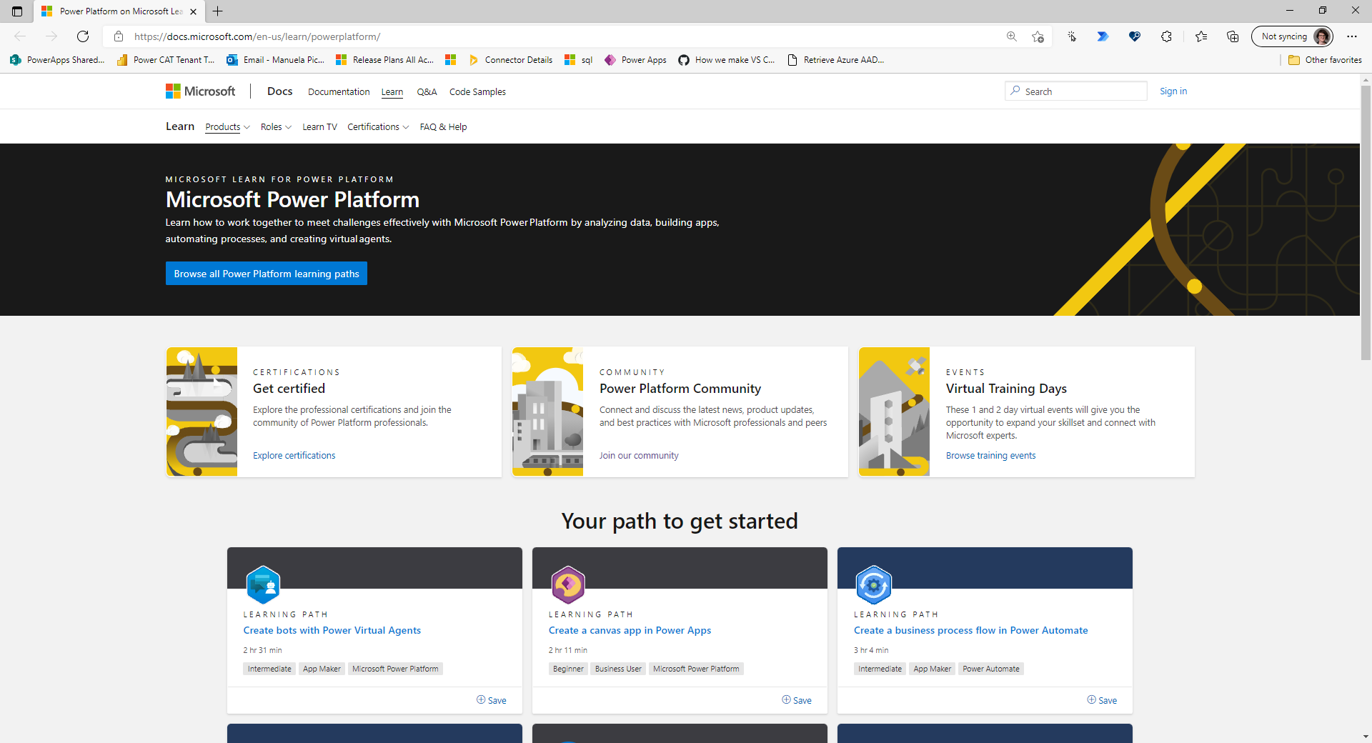
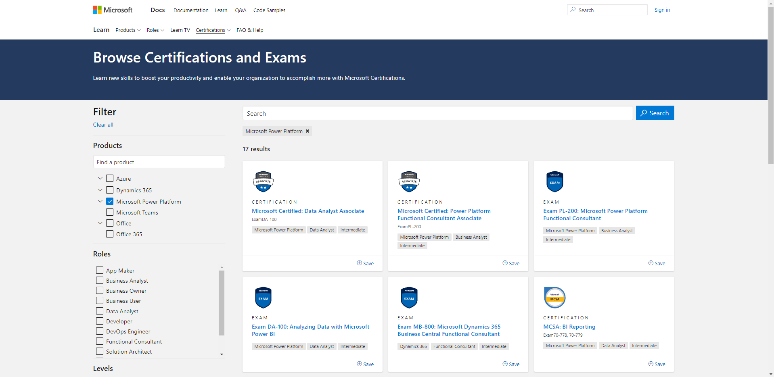
Get certified
Whether you're just starting or an experienced professional, the hands-on courses and learning paths available on Microsoft Learn help you arrive at your goals faster, with more confidence and at your own pace.
Earn certifications to advance your career and show how you are keeping pace with today’s technical requirements.
Browse Learning Paths and Certificates
Power Platform on Microsoft Learn
Get Certified

Slide 44
Onboard
This section will help discover the ways you can show leadership the business value of Microsoft Power Platform.

Slide 45
Build a sustainable champions community
Champions:
1
Should be formally trained to increase their depth and breadth of knowledge.
Champions help build, grow, and sustain your Microsoft Power Platform adoption by evangelizing and helping their peers with new solutions.
2
Should be encouraged and empowered to guide, teach, and train their peers.
3
Need consistent positive reinforcement that affirms the impact of their efforts.
4
Need a clear plan upon which to execute.
Customer stories:
Prolific app maker ignites low code revolution at Schlumberger
H&M Group enables citizen development at scale
Arm enables low-code adoption with a thriving Center of Excellence
Heathrow Airport inspires employee engagement with Microsoft Power Apps

Slide 46
Champions community
Set Team
At the heart of growth is a community, a place for people to collaborate, share ideas, and discover new ways to apply technology to achieve more. It is a safe place to ask questions, to share knowledge, and to expand skillsets.
Organizations that experience successful adoptions create a digital culture that fosters an environment of ongoing learning as well as provides tools such as forums, regular events, and speaking opportunities. They make sure that every person in the organization can come together at regular intervals to socialize, share their knowledge, and explore new possibilities.
Leaders who want to create a digital culture will put a framework in place for the community inside their organization to break down geographic and organizational silos.
Product Owner
App in a
Day Trainer
Project Manager
Microsoft Certified
Team Members
Citizen Developers
Specific
Skills*
Pro Developers
“It’s been particularly inspiring when makers can see apps developed by their colleagues that solve problems similar to their own.”
– Claes Söderström, Cross Delivery Coordinator, H&M Group

Slide 47
Community- finding champions
Take a look
Use the tenant-level analytics in the Power Platform Admin Center to identify your top makers.
Or go further by installing the CoE Starter Kit and get deeper insights into your organizations Power Platform usage.
Learn more
Create a champions program and support Power Platform Champions in your organization
If you have Microsoft 365 in your organization, it’s likely some individuals already have discovered Power Apps through exploration and Power Apps popping up in Microsoft Teams, SharePoint, and OneDrive.
Even without organic adoption, it’s likely you already have a good idea of who your champions will be. They are your Excel, Access, and SharePoint whizzes; or maybe they’re the troublemakers pushing the boundaries; or the ones who are first in line when there’s something new to learn. They question, they query, they encourage.
Train those people. Make them champions and help them train others — champions aren't only passionate about what they do but are also excited to evangelize and help their peers to learn more effective ways of working.

Slide 48
Rewards and recognition

Slide 49
Best practices for rewards and recognition
1
Motivate and reward a high-performance culture
2
Promote a close link between performance, reward, and recognition
3
Provide timely recognition
4
Provide rewards that are valued and meaningful
5
Be fair, apply standards consistently, and be transparent
6
Make a plan that is simple to understand and apply

Slide 50
Sample rewards and recognition model
Theme | And the winner is? | What’s the prize?
Champion of the week | The individual Champion who answered the most questions in the internal community. The individual Champion who created the most apps or flows that are used for production scenarios. | Highlight in internal Power Platform newsletter or intranet site Gift card ‘Thank you’ email from manager or Executive Sponsor Power Apps Premium licenses for a year
Solution of the week | The individual solution that solved the best business process, saved the most money, or increased productivity. | Gift card to makers ‘Thank you’ email from manager
Most active business area | The team with the most production apps or flows in use. | ‘Thank you’ email from Executive Sponsor Pizza party for the winning business area Feature on company intranet site
Most creative idea | Most creative idea submitted in the Innovation Backlog. | Lunch with Key Sponsor Gift card ‘Thank you’ email from Executive Sponsor

Slide 51
Rewards and recognition model
Fill this section out
Theme | And the winner is? | What’s the prize?
Champion of the week
Solution of the week |  | Gift card to makers ‘Thank you’ email from manager
Most active Business area |  | ‘Thank you’ email from Executive Sponsor Pizza party for the winning business area Feature on company intranet site
Most creative idea |  | Lunch with Key Sponsor Gift card ‘Thank you’ email from Executive Sponsor
Your theme

Slide 52
Communication and awareness

Slide 53
Awareness matters
Validates the importance of the change
Ensures everyone understands what’s happening
Helps generate enthusiasm
Gets everyone on board with using the new technology

Slide 54
Best practices to generate awareness and spark excitement
Communications
Focus on the “What’s in it for me?”
Tailor plan to company and culture
Engagement events
Kick-off event with Executive Sponsors
Hackathons
Training events, such as App in a Day or App in an Hour
Show & Tell sessions to showcase successful solutions
Virtual and in-person drop-in sessions for employees to learn more

Slide 55
Encourage ongoing engagement
Increase Power Platform adoption over time with ongoing awareness and training activity.
Create a Yammer or Teams group to continue the conversation on best practices and new features.
Share success stories about how people are using Power Platform in innovative and impactful ways.
Periodically host additional engagement events such as town hall meetings or lunch & learns to drive end user engagement.
Set challenges for people and run competitions to celebrate the best ways they’ve used Power Platform to do work differently.

Slide 56
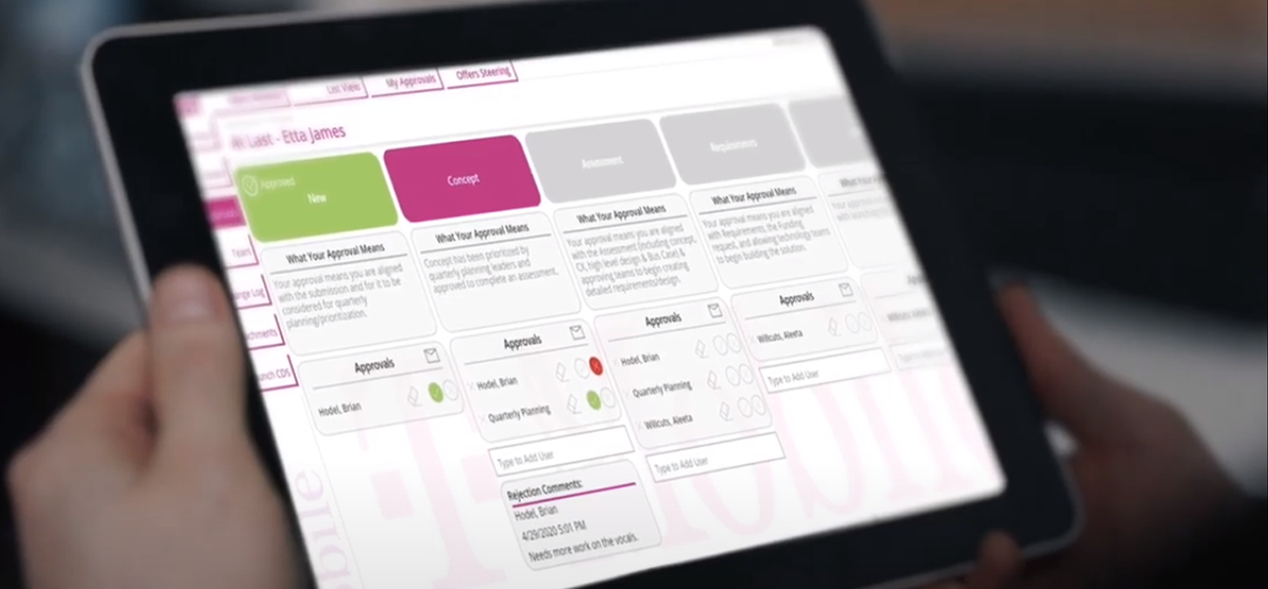
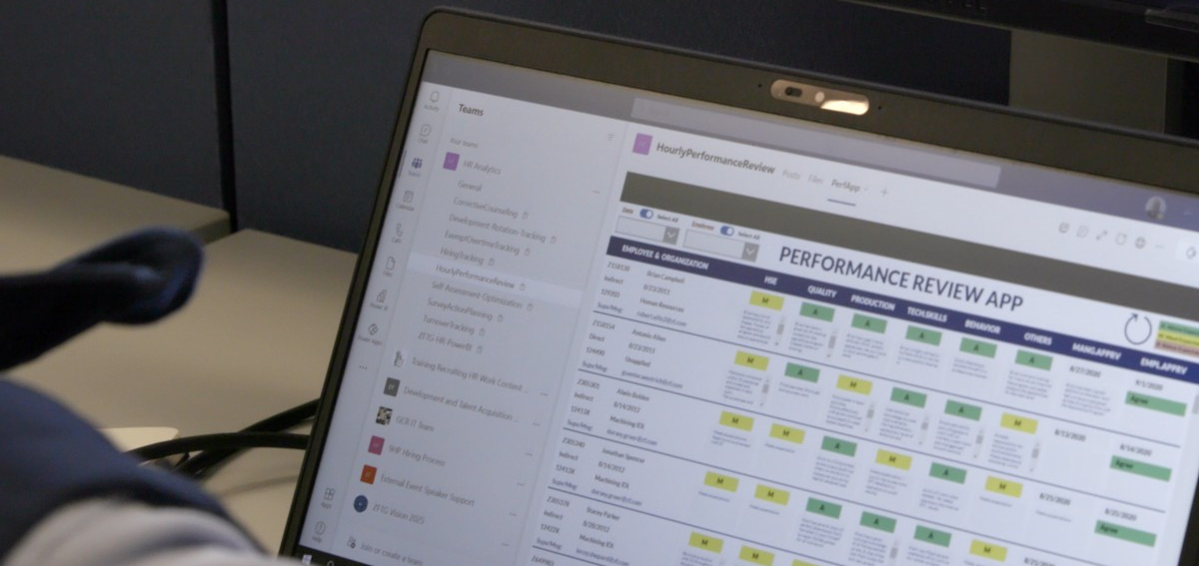
Incorporate success stories
What makes a good success story?
Include these three elements:
Human: Who was involved? How did the adoption journey and outcome impact their lives and careers?
Business: What was the qualitative and quantitative benefit to the business?
Technical: How were the different technologies used?
Make it visual: Include screenshots, photos of the solution in use, and pictures of the people involved.
For great tips on storytelling, see: 5 Ps of Storytelling
Get inspired by our customer stories
T-Mobile
Western States Caterpillar
ZF Group
Toyota
IKEA Sweden
Ecolab

Slide 57
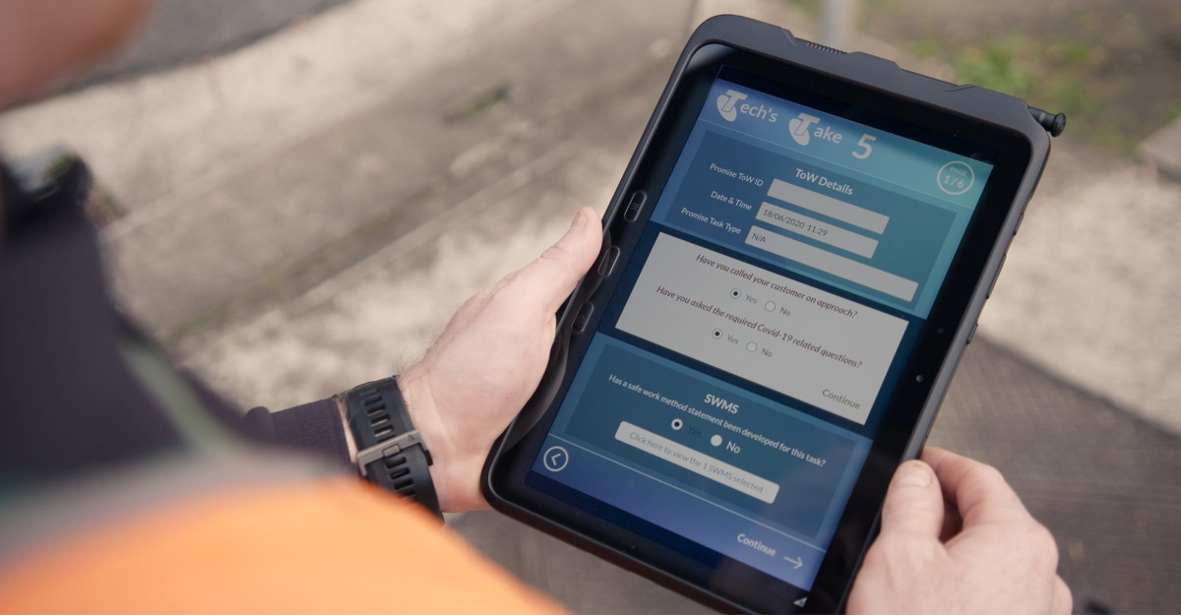
Incorporate success stories
How to structure a success story
Overview: Summary of what was accomplished at a high level.
Business scenario: Key problem to be solved.
“Before” process: Summary of business process, challenges, and opportunities.
Solution: Microsoft Power Platform solution that created a better process.
Impact and benefits: Bullet point summary of time, cost, productivity, and other benefits.
Solution architecture: Summary of screenshots of technologies used and how they all connect.
Meet the team: Highlight the team members who made this possible. (The best part!)
Get inspired by our customer stories
H&M
Schlumberger
Woodside
SNCF
Standard Bank
Telstra

Slide 58
Ideas to scale involvement across your organization
Lunch & Learn
A great way to spread the word inside your organization is to run regular “lunch and learn” sessions. They’re an opportunity for individuals to come together to share what they have learned about creating apps and automating processes.
Sometimes people don’t want to or can’t set aside a full day to learn something they know very little about. Often it just takes igniting the spark for champions within the organization to rise-up and inspire others.
Hosting lunch and learns is also a great way to form and nurture a Power Platform community. It provides an environment for teams to share resources, guidelines, and procedures. Lunch & learns should be fun and occur regularly. As more people across the organization become interested, they will have a place to learn if this is something they want to get involved with and a path for them to start skilling up on Power Platform.

Slide 59
Ideas to scale involvement across your organization
App Showcase
If you want to create a serious buzz in your organization and inspire more people to join your Power Platform community, an app showcase is where you do it.
Teams meet to demo what they have built, show problems that they have solved, and demonstrate the impact they have created on the organization by the apps they have made.
It’s an opportunity for teams and makers to come together with their creations and learn from each other.

Slide 60
Ideas to scale involvement across your organization
Hackathon
Take action
Download our Hackathon Planning workbook. This will walk you through planning and running a hackathon in your organization and provide you with email and form templates to get started.
A hackathon is a fun way to engage lots of people within your organization around a digital culture of change. The key objective is to develop sample apps and cultivate ideas to drive digital transformation.
Teams come together, at the line of business or at the global scale, from different roles and departments, to compete and create apps that address an organizational need. Each team should be resourced with Power Platform and Office 365. The more variety of skills and roles represented, the better. One or more facilitators should be involved to organize the hackathon and define the teams and rules for the hackathon.
Successful hackathons often include the following: team names, prizes, food, music, laughter, and competition.

Slide 61
Technology and IT internship
Some organizations that have truly embraced a digital culture have instituted what we would call “digital internships.” Employees within the business, whether that be in sales, facilities, HR or management, spend 3-6 months within IT completing a digital internship. This is a big commitment of time and learning on both sides, but it can have fantastic impact.
The intern has detailed knowledge of the business, customers, or their department and function, and while in IT, they learn about digital transformation, Power Platform, and a Center of Excellence. IT and the intern, as a part of the Power Platform community, jointly collaborate on digitizing processes within the realm of the digital intern’s business.
This fosters greater understanding and collaboration between IT and the business and leads to innovative and creative problem solving.

Slide 62
Ideas to scale involvement across your organization
Fill this section out
How are you going to scale within your organization?
Example: Organize weekly lunch and learn sessions

Slide 63
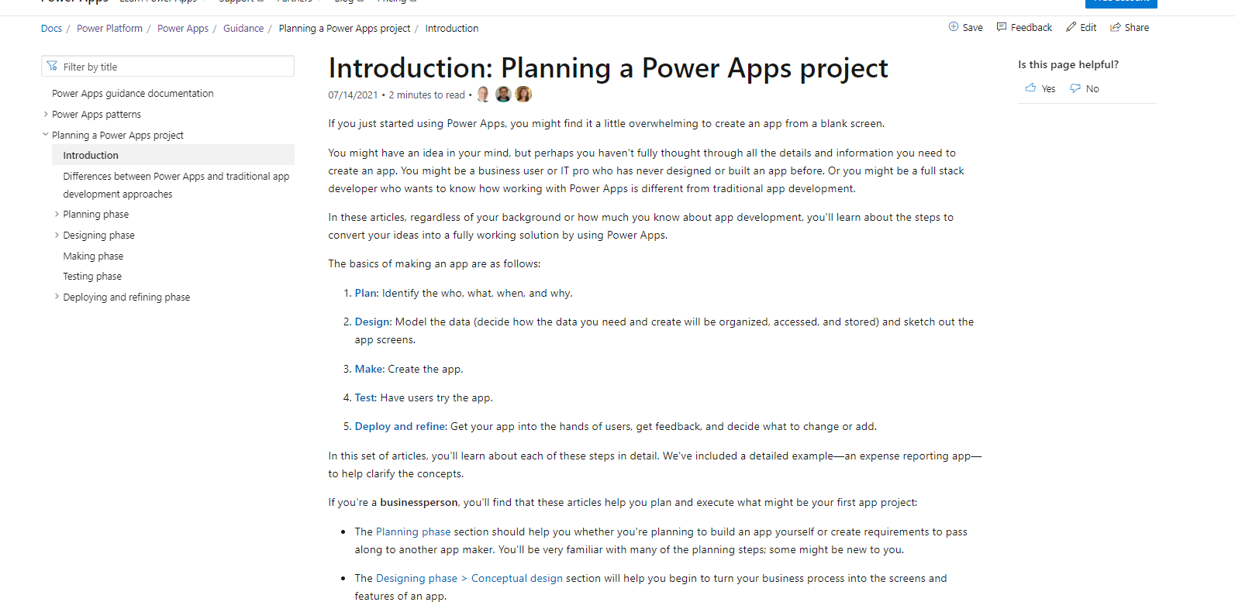
Envisioning workshop
Have you heard from colleagues who have attended a Microsoft Power Platform training event and now want to use Power Apps to solve a business problem but don’t know where to start?
Do they have an idea in mind, but perhaps haven't fully thought through all the details and information they need to create an app?
The articles in Planning a Power Apps project can teach you how to convert an idea into a fully working solution by using Power Apps.
Use the materials to organize solution envisioning workshops with makers and help them plan and execute their Power Apps projects. This could be a great add-on to an App in a Day event that you are running internally.
Further resources
Planning a Power Apps project
The Creator's Manual

Slide 64
Training plan
Fill this section out
Recommended activity | Frequency | Owner
App in a day event
Lunch & Learn
Envisioning workshop
Drop-in sessions

Slide 65
Scale
To achieve organization-wide change, seek out problems that you can solve, not only at scale but also at speed.
In this phase you’ll establish your Center of Excellence, creating the heart of a thriving digital culture. You will also understand the platform capabilities to create thousands of apps that solve myriad business challenges in a sustainable and secure way.

Slide 66
Creating a Center of Excellence
Establishing a Microsoft Power Platform Center of Excellence (CoE) means investing in and nurturing organic growth while maintaining governance and control. It’s a step towards fostering greater creativity and innovation across the organization by empowering business units to digitize and automate their business processes, while maintaining the necessary level of central oversight and governance.
A CoE is designed to drive innovation and improvement. As a central function it can break down geographic and organizational silos to bring together like-minded people with similar business goals to share knowledge and success, while at the same time providing standards, consistency, and governance to the organization. A CoE can be a powerful way for an organization to align around business goals rather than individual department metrics.
We recommend the following strategy for getting started with your journey of establishing a CoE:
Secure by establishing data loss prevention policies, managing licenses and access to data sources.
Evangelize by providing a community space on Teams, Yammer, or SharePoint, with a collection of links for people to start their learning.
Monitor your usage: see who is creating apps, what apps are being created, and how they are used.
Evolve your CoE strategy with those learnings.
Learn more:
Admin & Governance best practices
Nurture best practices

Slide 67
Assess your organisation’s maturity level
The Power Platform Adoption Maturity Model identifies consistent themes, patterns, practices, and behaviors applied by the most successful organizations as they implement digital transformations with Power Platform. This model can help you understand your capabilities along multiple dimensions and identify areas of focus to help advance further.
Initial
Pockets of success and experimentation with Power Platform.
Repeatable
Initial Power Platform controls implemented by a central team.
Capable
Efficient
No strategy or governance approach.
Apps are team-based and supported by the makers.
Organisation sees the potential of a strategic investment, but there is no clear path forward.
Start to identify applications that are broadly used in the organization.
These organizations sometimes believe that the use of the Power Platform is running “out of control.”
Defined
Standardizing repeatable practice.
Transformation may still reflect organic growth.
Standard processes for managing and monitoring Power Platform.
Power Platform capabilities are being used to transform the business broadly and used for enterprise-critical apps and integrations.
Platform Champions have established channels.
Organization has proven the capabilities of Power Platform to transform mission critical capabilities.
Established community of experts.
Fusion teams enable legacy capabilities and modern cloud architecture to be used easily.
Achieving measurable success to digitally transform their organization.
Defined Power Platform Center of Excellence team.

Slide 68
Digital guardrails
A Center of Excellence enabling development of thousands of apps at scale will require more robust guardrails than at earlier stages.
Initially, your focus was on setting up and securing the platform through establishing an environment strategy, setting up DLP policies, and ensuring appropriate security roles are assigned.
As you scale, you’ll look at automating some manual tasks and driving actions based on insights you gather from your adoption.
Here’s a few things you’ll be looking at:
Automate the creation of environments for developers by building a request and approval process for them to follow.
Implement Application Lifecycle Management by using Azure DevOps Build Tools or GitHub Actions.
Automate the clean-up of unused environments, apps, and flows.
Identify critical and production applications based on usage, and promote them to appropriate staged environments (development/test/production) to ensure changes made in development do not break end-users in production.
Establish an automated process to get more information from makers about their apps, such as business justification, impact of an outage, and risk assessment to allow you to get a better picture of what your makers are building.
Continue to measure the business value your makers and apps add, to showcase the impact Power Platform is adding to your organization.

Slide 69
Support processes
Support systems for the apps, including training and knowledge bases, should be implemented. End-user training for the apps being made should be designed and implemented.
You should start to see a change in the way people look at streamlining how they work, how to use apps to improve their jobs and create a better working experience.
Think about the progression of your makers, and be sure to offer beginner, intermediate and advanced training—this could be through leveraging content from the fantastic external community and curating link lists with blog posts and YouTube videos, as well as hosting internal training events to run App in a day, Advanced App in a day or App in an hour.
Many organizations use either a SharePoint Hub site or Teams to share resources, best practices and learnings with their makers. In addition to training resources, be sure to also share your success stories–highlight app makers and their stories, as well as the business value they have added through their apps to inspire other makers to do the same.
Using the Power Platform Admin Center, IT pros can monitor and provide guidance to app makers; they can support the apps that are published for use by other people in the organization.
Your Admin will want to use the insights you get through monitoring your usage to drive action–such as identifying critical, orphaned, or unused resources.

Slide 70
Skills development
Growing your pool of talented people should be front and center at this point in your journey.
You will have observed that the citizen developers of yesterday become the technologists of tomorrow. As their appetite to learn grows, they will become the leaders and trainers of your future citizen developers. Some may go on to specialize in specific areas on Power Platform, learning excellent technical skills that enable more advanced problem solving across your organization.
Across the whole team, talent gaps need to be identified and filled. Formal training programs should be implemented. You need to identify what skills are required to solve the challenges your organization is facing.
Look for people with skills and strengths in the following roles:
Citizen developers continue to bring their day-to-day experience of how their job is done.
Code-first developers will design advanced interfaces using PCF as well as building complex relationships or integrations with other applications, when the out-of-the-box limits have been reached and the app needs to be extended.
Architects will understand the strategy that the organization wants to achieve as well as using the best technology to achieve organizational outcomes. They will understand the big picture from a technology perspective and will provide guidance and technical leadership.
QA & Testing needs to be part of scaling app creation; quality and reliability will be expected.
IT Pros and Admins lead the governance, compliance, and supportability of apps across the organization.

Slide 71
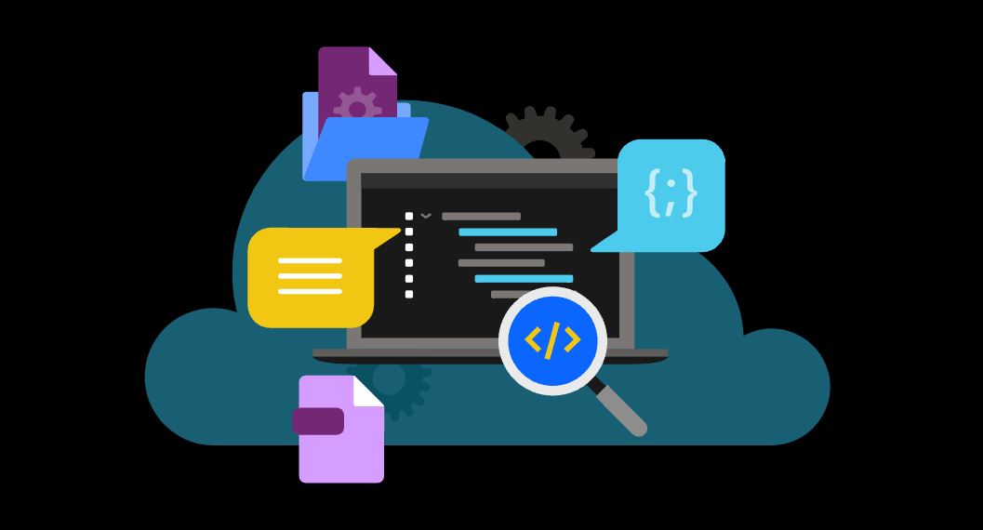
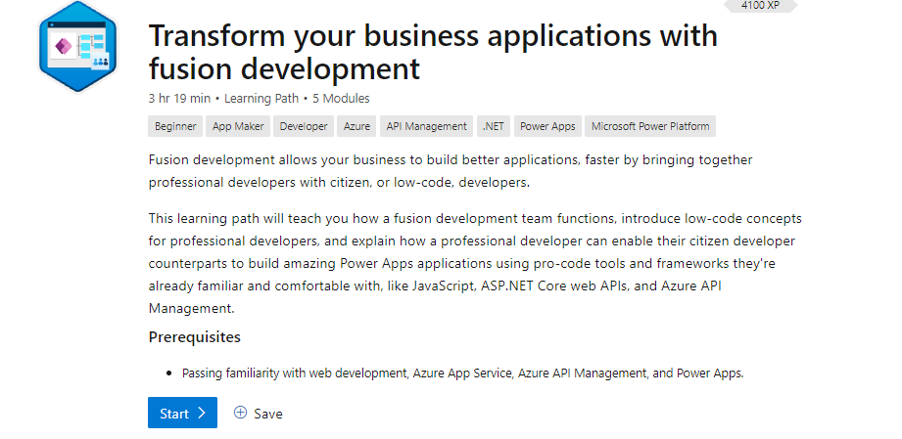
Fusion teams
Fusion development with Power Platform is about combining the worlds of the citizen developer, the code-first developer, and the other parties instrumental in building and using applications to further the objectives of the business. A citizen developer can express the business need quickly by building an app, and work with a professional developer to "fill in the gaps.“
Power Platform enables citizen developers to quickly innovate and experiment with ways to improve their business processes. Using Power Platform, citizen developers who understand the business requirements can quickly put together a solution, with a minimum of coding effort. But there will always be more complex situations that can't be satisfied using only low-code.
For example, your organization might have existing systems and databases with which the app needs to interact and for which no connector is currently available. There might be additional business logic that needs to be enforced to ensure that data remains consistent. An app might need to implement a complex, dynamic business flow. Fusion teams work together to create these solutions.
Achieve more together.
Fusion Dev Playbook
Transform your business applications with fusion development

Slide 72
Track success measures and maker adoption
Distribute surveys to gather data about your makers’ knowledge of and satisfaction with the new Power Platform services. The results will help you determine how successful the rollout has been and get you thinking about how to incorporate this feedback into actionable next steps.
When you make Power Platform initially available, circulate a survey to gather data about your users’ knowledge of Power Platform.
Conduct a survey six months after launch to gather data about your users’ experience with Power Platform.
Create new awareness or training content to address any outstanding needs that arise.
Release surveys in quarterly increments to help measure user adoption from a satisfaction and productivity standpoint.

Slide 73
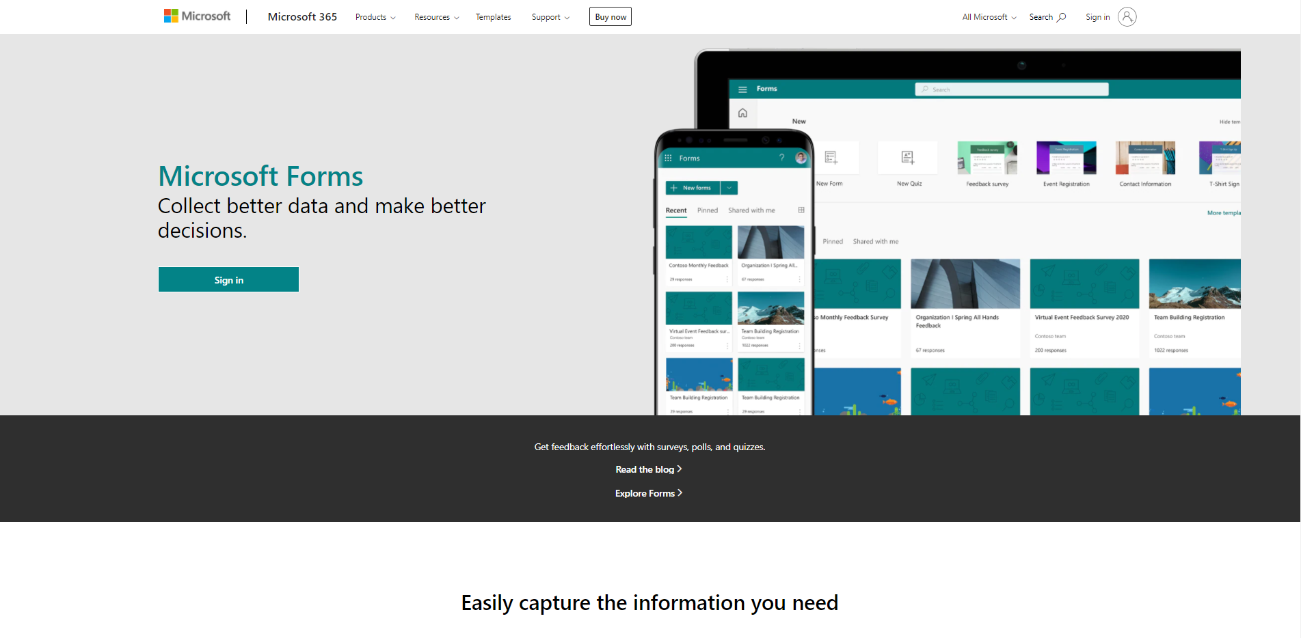
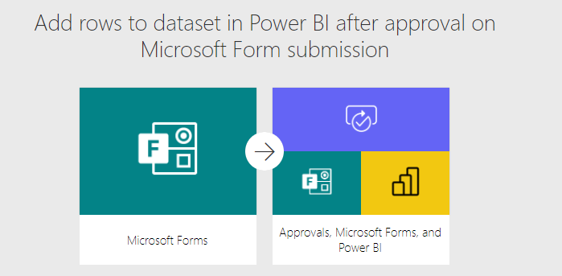
Sample survey
Have you heard of Microsoft Power Platform?
Yes, and I am a maker
Yes, but I am not a maker
No
Have you attended one of our internal training events, hackathons, or show & tell sessions?
Yes, and I am applying the new skills now
Yes, but I am not yet able to apply the new skills
No, not relevant to my role
Did not know about them
How satisfied are you with the internal Power Platform adoption program?
What else would you like to see as part of our Power Platform adoption program?
Get started
Create your own using Microsoft Forms
Stream responses directly into Power BI

Slide 74
Operation plan

Slide 75
Team touchpoints
Recommended meetings to host during the program for everyone involved stay updated on the progress:
Frequency | Agenda | Attendees
Weekly | Review current progress with the adoption What’s new/ upcoming Issues/ roadblocks | Working Team
Bi Weekly | Review reporting and metrics What’s new/ upcoming Issues/ roadblocks | Team Leads
Monthly | Review reporting and metrics Review any new features updates/announcements from Microsoft Outstanding issues/ concerns | Manager and Leads
Every Quarter | Status update to Leadership on adoption progress Success stories Plan next step in the roadmap | Managers and Leadership

Slide 76
Engagement Topics
Recommended types of topics to consider when planning activities:
Type of topics | Purpose | Examples
Community Engagement | Keeping employees updated and engaged in the program | Announcements: What’s new, new champions Monthly poll/questions
Continuous Training Programs | Providing training opportunities for employees to increase their knowledge on the platform | Ask an expert Show and tell Demo day Tips and tricks Lunch and learn Creating video content Brainstorming/innovation sessions
Success Stories | Continuously sharing successes with the business to showcase the wins being accomplished. This increases visibility and awareness to the program. | Intranet article Newsletter Video interview with a maker
Technical Sustainment | Keeping updated with the latest changes and ensuring the environment is current | Cleanup environments of unused apps Deploy Center of Excellence updates Review COE direction and new apps and templates Update data gateways Review environment strategy, development standards, DLP

Slide 77
Activities
Example activities your organization can leverage:
Frequency | Activities
Daily | Keep updated with latest Microsoft Power Platform news Respond to questions from Citizen Developers
Weekly | Welcome new members Host Show & Tell sessions Host Q&A Sessions or Lunch & Learns Post to your organization’s Power Platform community to keep users engaged: e.g., tips and tricks, use case examples, how to, praise etc.
Monthly | Create and update video content/ how to guides and training content. Create success stories to post and showcase Post about Power Platform updates in your Community: e.g., MS Teams/ Yammer/ Intranet Host monthly engagement event: e.g., innovation session, hackathon with specific departments etc. Extend knowledge with User Group meetup: e.g., invite an external speaker Reward program: praise and reward citizen developers
Yearly | Monthly meetings with Power Platform Admin Team to review adoption progress and new features Quarterly meetings with Leadership to show adoption progress

Slide 78
Managing team activities with a calendar
Creating a calendar for the team with these activities can assist in keeping everyone on track.
There will be two type of calendars:
Technical calendar with activities that the Power Platform Admin Team will be responsible for managing
Adoption calendar for the Adoption Team to keep the community engaged
Use the template provided in this section to define your own Adoption and Technical Sustainment calendars for your organization.

Slide 79
Sample technical calendar
Here is an example of a technical calendar of activities for the Power Platform Admin Team:
[Month] Sample
MONDAY | TUESDAY | WEDNESDAY | THURSDAY | FRIDAY | SATURDAY | SUNDAY
Clean up environments (quarterly) | Clean up unused applications (quarterly) |  |  | Review COE Reports
 |  |  | Deploy Center of Excellence Updates | Review COE Reports
 |  |  | Update Data Gateways | Review COE Reports
Review environment strategy, development standards, DLP | Review COE direction and new apps and templates |  | Post on Power Platform updates | Review COE Reports

Slide 80
Adoption calendar
These calendars shows examples of activities your team can execute over the course of one month.
We recommend a “crawl, walk run” approach to developing your adoption nurturing program.
Start small and pick a few items from the list to start with and add to your program as the adoption evolves.

Slide 81
Crawl - calendar example
Example of a team that is starting their adoption:
During the beginning phases of your journey, your goals will be focused on raising awareness, increasing knowledge, and providing opportunities for learning and growth.
Most Citizen Developers will be interested in learning what is possible, how to start, and where can they go to get help.
During the beginning phases of your journey, we recommend:
Welcoming new members to the community
Having many opportunities and avenues for Citizen Developers to be able to drop in and ask questions
Hosting as many Show & Tell sessions as possible to raise awareness and increase knowledge about what’s possible
Sharing Tips & Tricks to assist users when they are blocked
[Month] Sample
MONDAY | TUESDAY | WEDNESDAY | THURSDAY | FRIDAY
Announcements/ New Members |  |  | Ask an Expert | Function Friday/ Resources
 | Show and Tell / Video Post/ Demo Day |  | Ask an Expert | Function Friday/ Resources
 |  | Tips and Tricks / Art of the Possible/ Praise | Ask an Expert | Function Friday/ Resources
 | Show and Tell / Video Post/ Demo Day |  | Ask an Expert | Function Friday/ Resources

Slide 82
Walk - calendar example
After the community is established, Citizen Developers in the Community will be interested in strengthening their abilities technically. It’s also a good time to continue to reinforce excellence by providing opportunities to showcase apps or Citizen Developers to the organization.
In this example calendar, you can see a shift to offering more resources, Tips & Tricks sessions, and keeping the Community engaged with monthly polls to seeing what’s of interest in the Community.
[Month] Sample
MONDAY | TUESDAY | WEDNESDAY | THURSDAY | FRIDAY
Announcements/ New Members | Show-and-tell/Demo Session Power Apps Drop-in | Monthly Poll / Question |  | Function Friday/ Resources
 | PowerApps Drop-in | Show and Tell / Video Post/ Demo Day | Ask an Expert | Function Friday/ Resources
 | PowerApps Drop-in | Tips and Tricks / Art of the Possible/ Praise |  | Function Friday/ Resources
 | PowerApps Drop-in | Show and Tell / Video Post/ Demo Day | Ask an Expert | Function Friday/ Resources

Slide 83
Run - calendar example
In addition to continuing to accommodate new users, at this stage you may want to include more opportunities and topics each month to keep users engaged and focus more on increasing their technical capabilities. Draw on your growing community for speakers and community leadership.
[Month] Sample
MONDAY | TUESDAY | WEDNESDAY | THURSDAY | FRIDAY
Announcements/ New Members | Announcements | Monthly Poll / Question | Meet a Citizen Developer | Function Friday/ Resources
Power Apps | Power BI | Show and Tell / Video Post/ Demo Day | Ask an Expert | Function Friday/ Resources
Power Apps | Automate | Tips and Tricks / Art of the Possible/ Praise | Meet a Citizen Developer | Function Friday/ Resources
Power Apps | Power BI | Show and Tell / Video Post/ Demo Day | Ask an Expert | Function Friday/ Resources

Slide 84
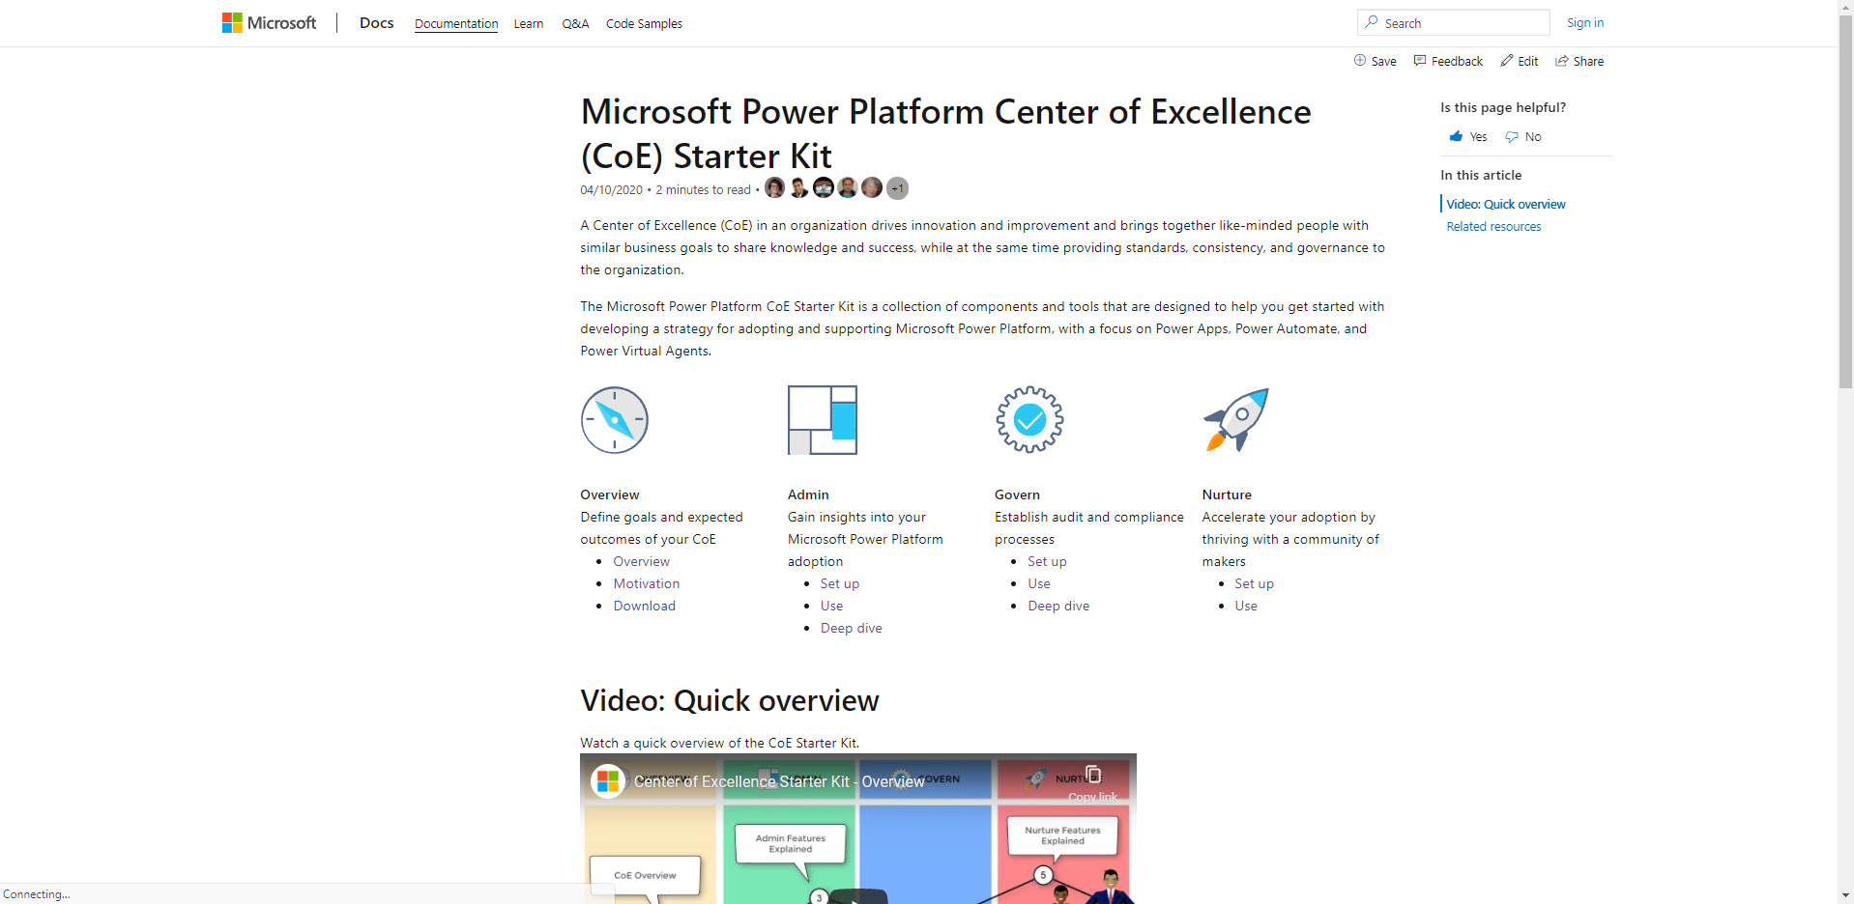
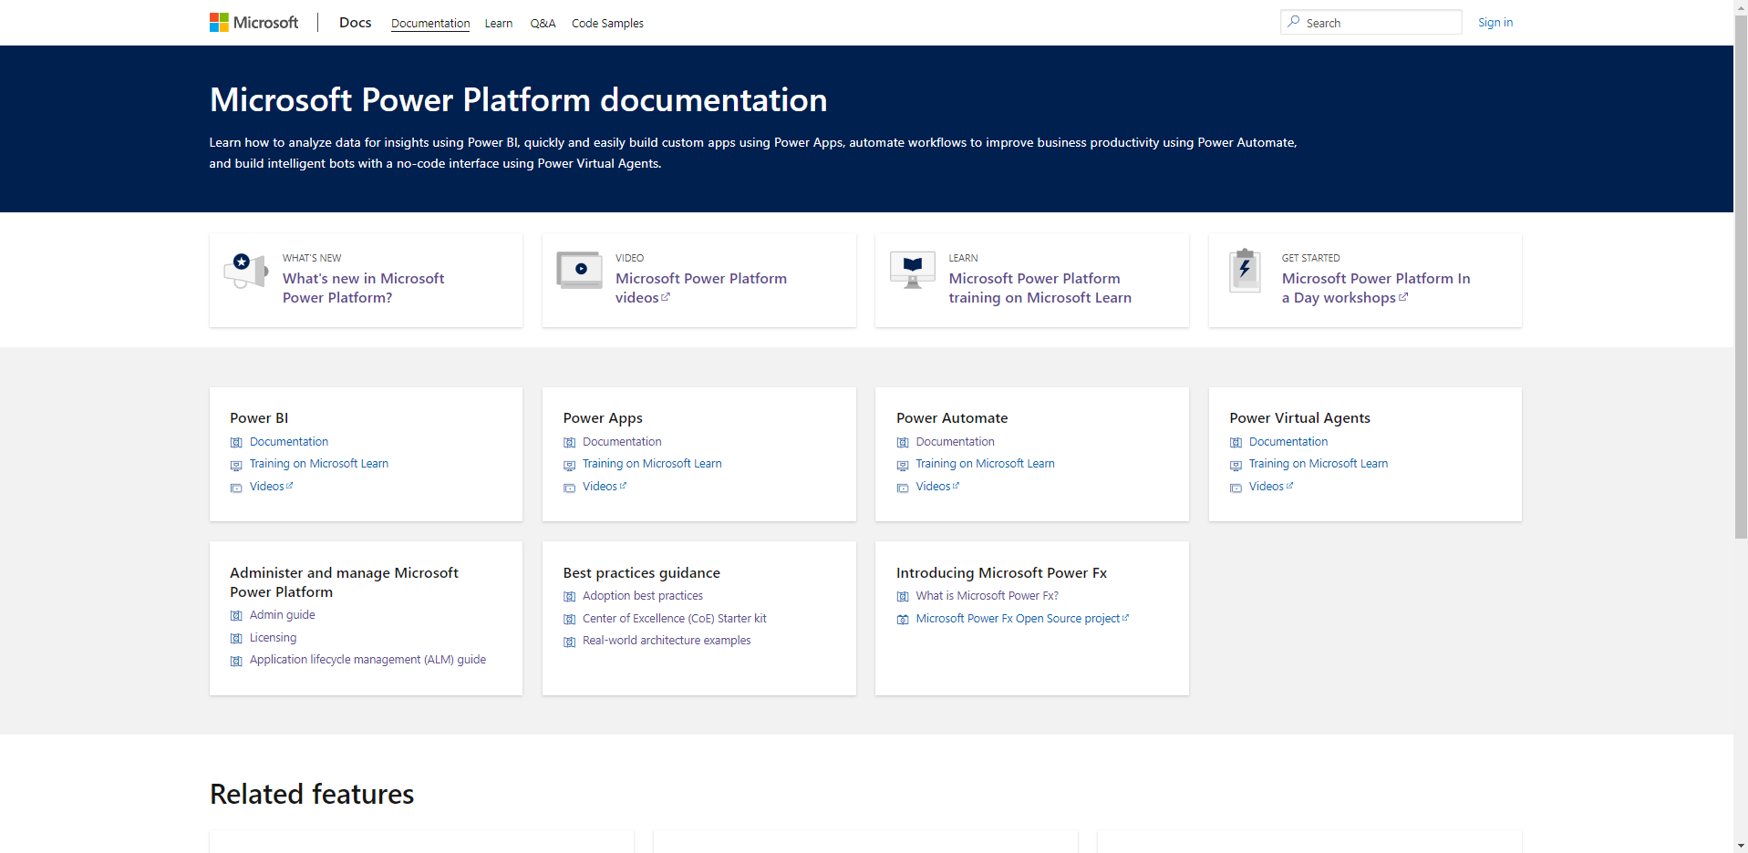
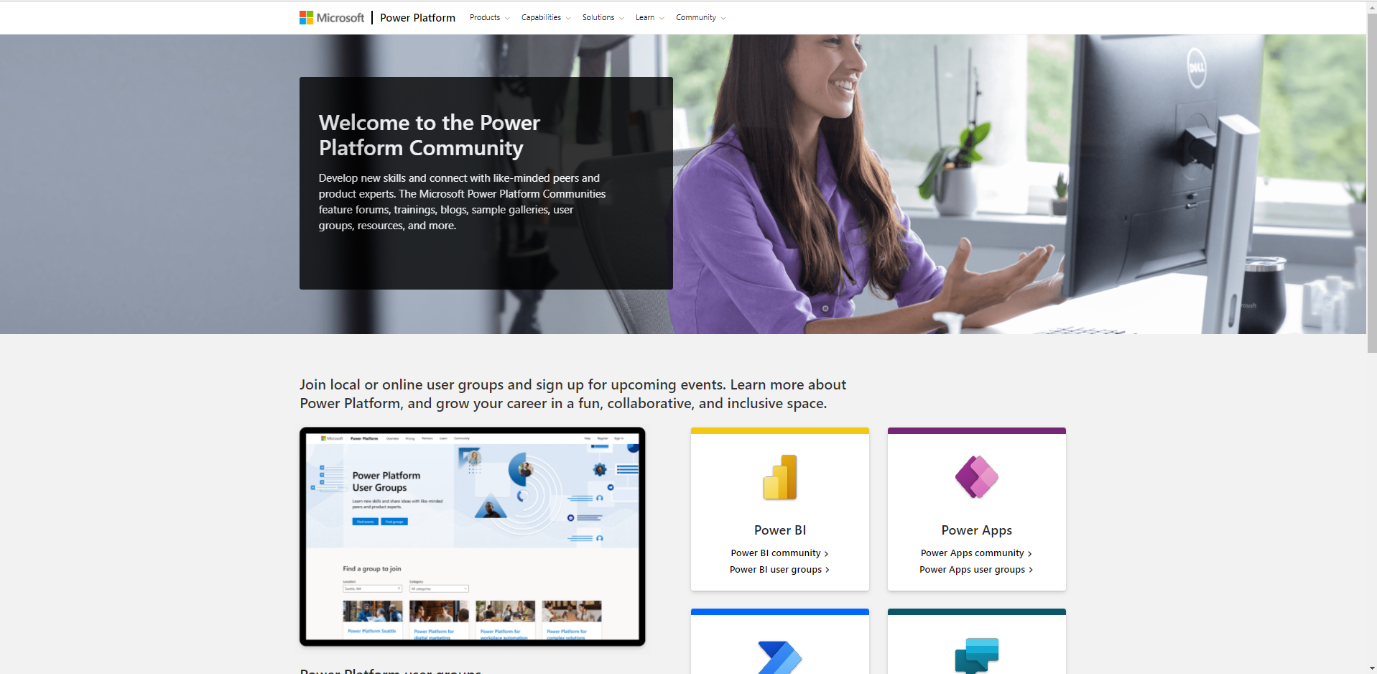
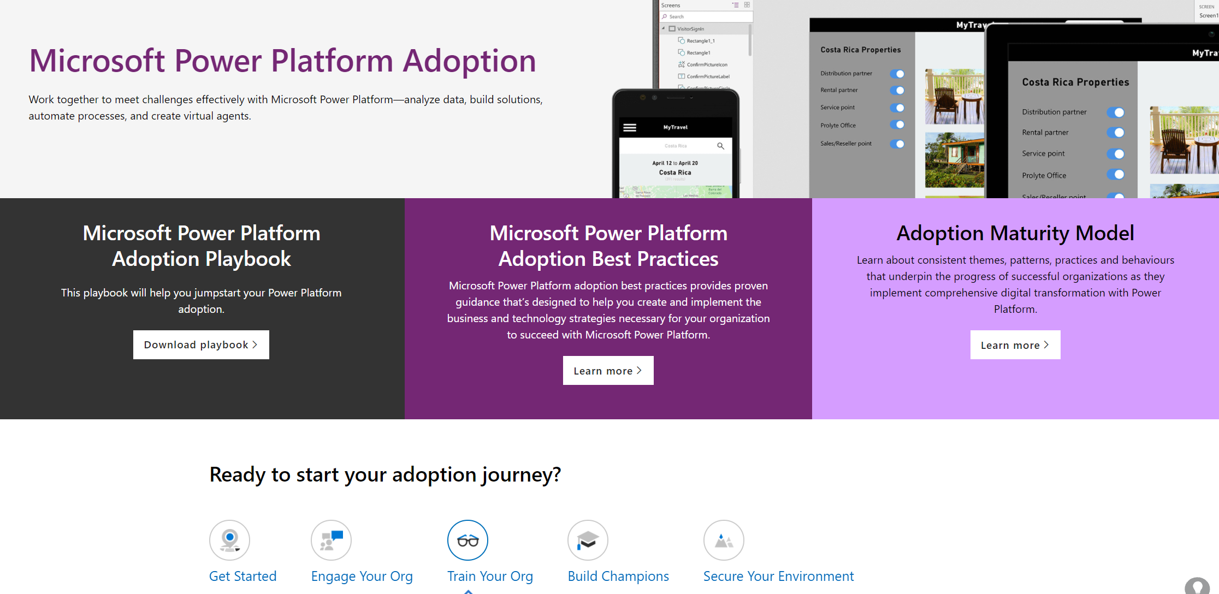
Microsoft is here to support you
Bookmark these resources to continue driving engagement throughout your adoption journey
Power Platform on Microsoft Learn
Get Certified
Go further with the CoE Starter Kit
Power Platform on Microsoft Docs
Power Platform Community
Power Platform Adoption

