Slide 1
Microsoft Sales Copilot Tip Time V2
Tip time once a week starting October 2023
(For Dynamics 365 & Salesforce CRM)
Amira Beldjilali from D365 FastTrack team

Slide 2
Productivity
Interactions
Flow of work
Administration
Monitoring
Sales Copilot

Slide 3
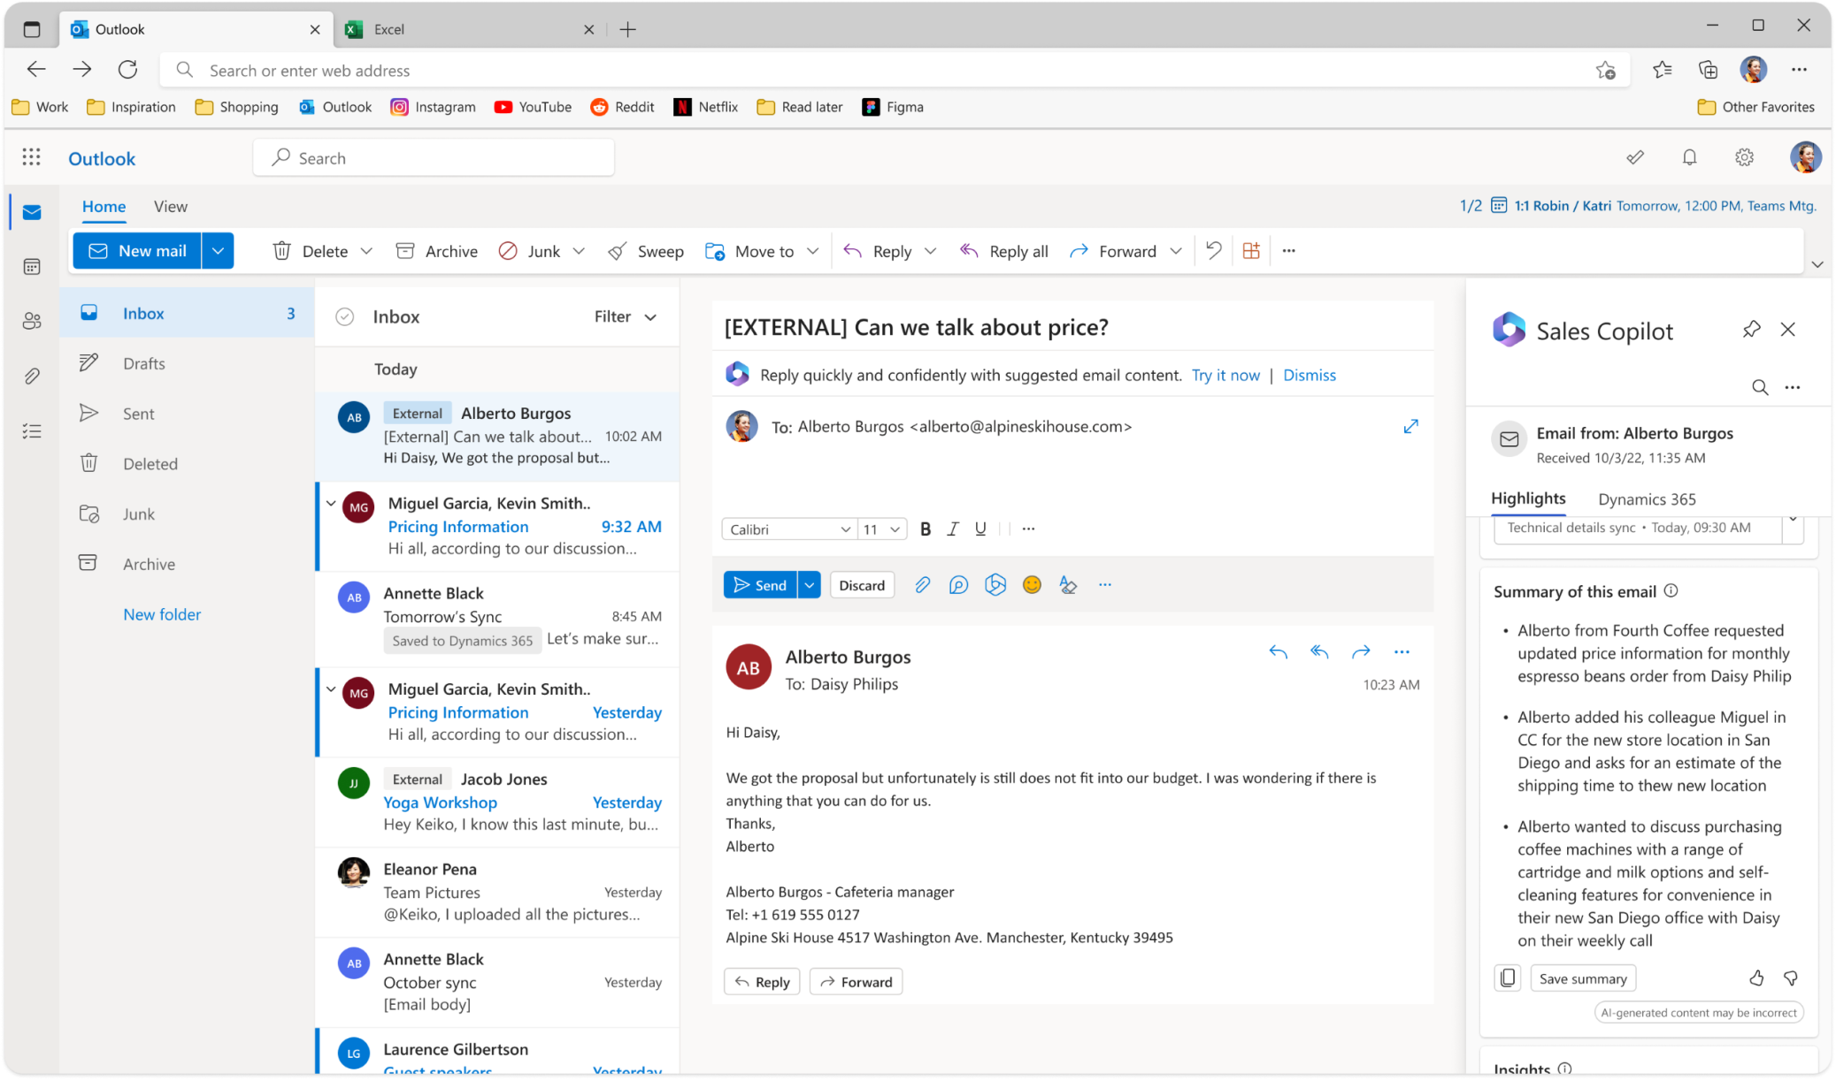
Read Me
This section emphasizes the topics addressed within these tips.
Productivity
Interactions
Flow of work
Administration
Monitoring
As a seller, I need to quickly catch up on emails by getting concise email thread summaries that I can save to the CRM, keeping both myself and the entire sales team up to date.
This section showcases tips, features, and quick wins through the use of screenshots.
This section outlines the user story and the requirements of the seller.
Copy the summary
Yuri
Save the summary
This section simply tells you what the feature is all about and gives a shout-out to its fun gamification style
Email-Burdened Seller
This section provides details about the feature and how it can be used by sellers
Yuri works as a seller at the coffee company and receives numerous emails daily. Sometimes, these emails are quite lengthy, and he doesn't have the time to delve into the details and update the CRM to keep his colleagues informed..
100
Credit

Slide 4
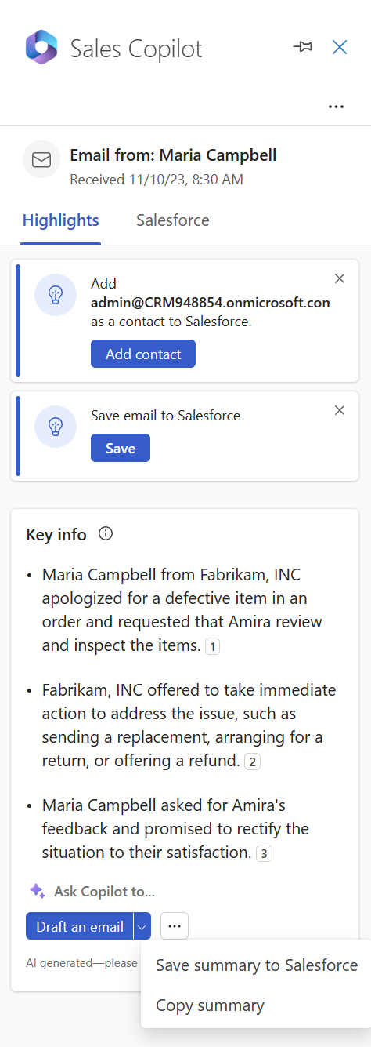
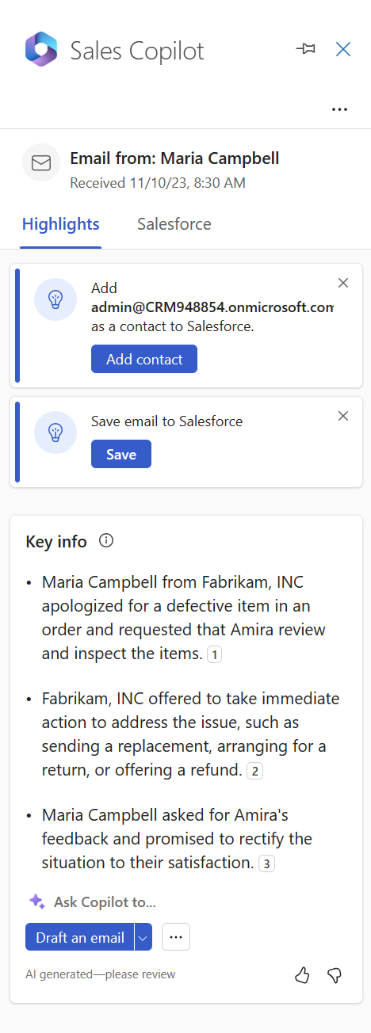
Updated
AI-Generated Sales Email Summary
Productivity
Interactions
Flow of work
Administration
Monitoring
As a seller, I need to quickly catch up on emails by getting concise email thread summaries that I can save to the CRM, keeping both myself and the entire sales team up to date.
Key info
Save the summary
Yuri
Evaluate the summary
Copy the summary
Email-Burdened Seller
Yuri works as a seller at the coffee company and receives numerous emails daily. Sometimes, these emails are quite lengthy, and he doesn't have the time to delve into the details and update the CRM to keep his colleagues informed..
Sales Copilot offers at-a-glance email summaries to help Yuri identify key issues efficiently. With one click, he can save summary data to the CRM, keeping it user-friendly. Additionally, he can share the summaries with colleagues and provide feedback by giving a thumbs-up or thumbs-down on the quality of the summary.
100
Credit

Slide 5
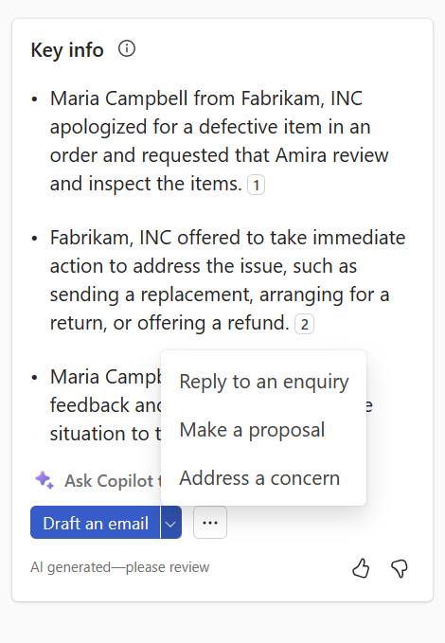
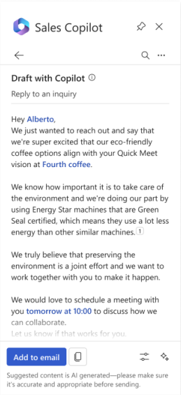
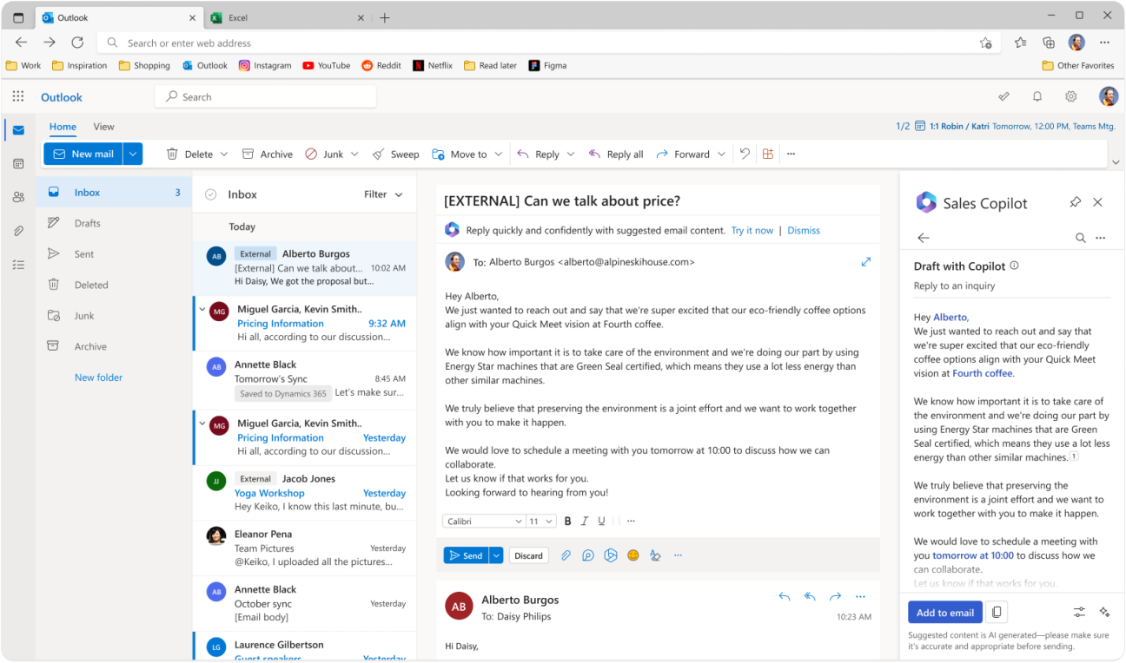
Updated
AI-Assisted Sales Email (1/2)
Prompts offered to the seller to reply
Email ready to be sent after seller’s review
Productivity
Interactions
Flow of work
Administration
Monitoring
As a seller, I need to answer my emails by pulling data from the CRM, keep track of my customer’s opportunities and their history, and respond to my high volume of emails efficiently
Reply draft with Data from the CRM
Yuri
Overloaded Seller
Yuri encounters time-consuming tasks when pulling data from the CRM due to constantly changing windows, menus, and navigation. Keeping track of customer opportunities and their history becomes increasingly challenging, especially when managing numerous accounts. Furthermore, the high volume of emails they receive can be overwhelming, potentially causing them to overlook crucial details.
Sales Copilot offers streamlined processes and support to help Yuri reply to emails more effectively by cross-checking office and CRM data, thereby improving communication, enhancing the customer experience, and increasing productivity.
200
Credit

Slide 6
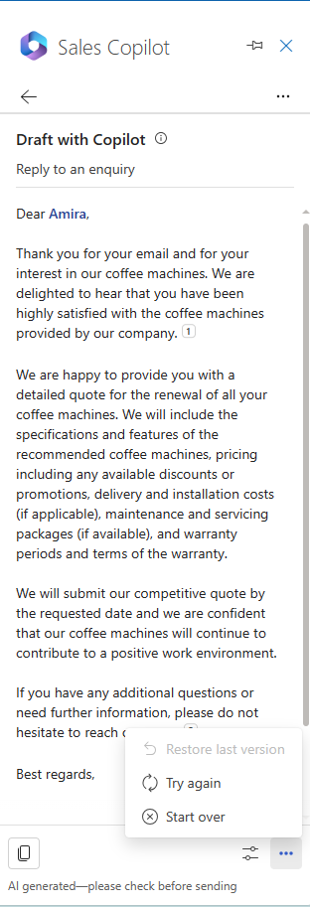
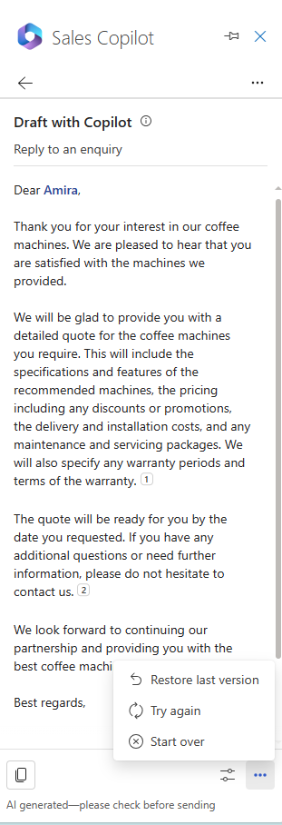
AI-Assisted Sales Email (2/2)
Productivity
Interactions
Flow of work
Administration
Monitoring
As a seller, I need to have the option to try again if the generated reply doesn't satisfy me, as well as the ability to restore the last version or completely start over
Restore the latest version or Start over
Yuri
Try again generating a new reply
Meticulous Seller
Yuri now has the option to try generating a new response or retain the last version of a reply to find the perfect response.
300
Credit

Slide 7
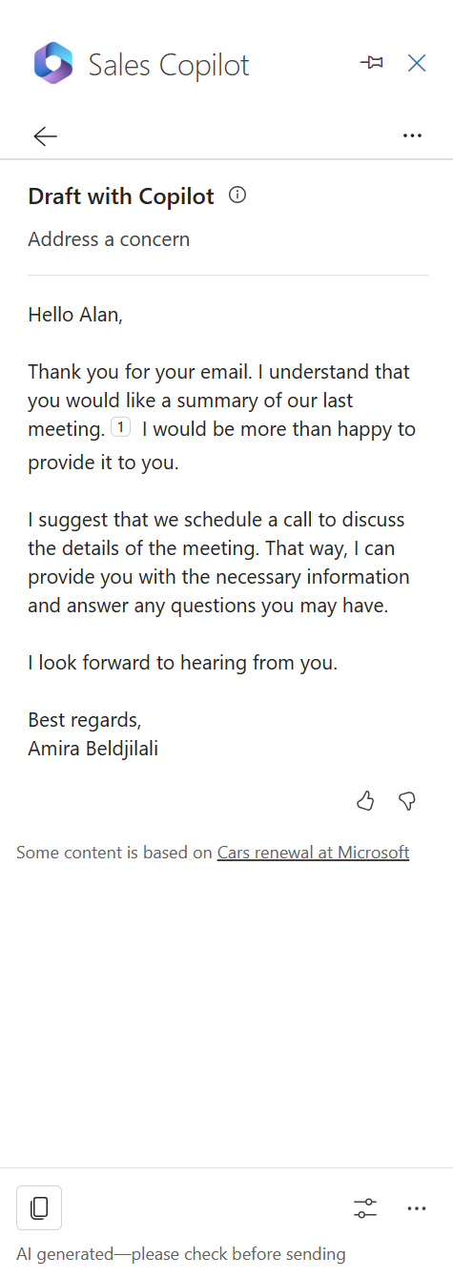
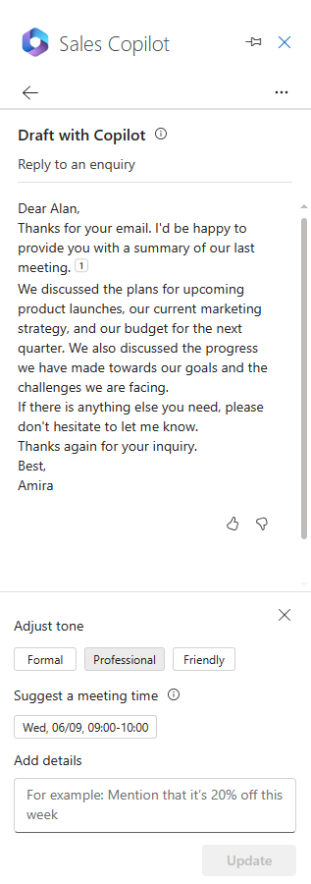
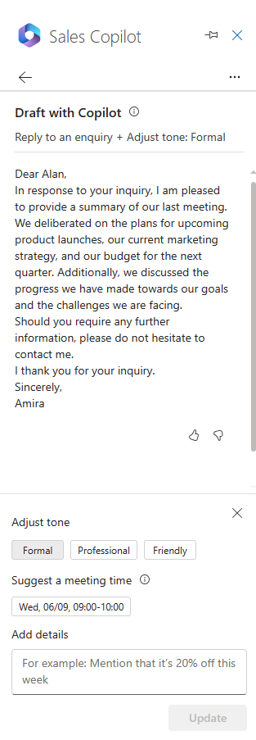
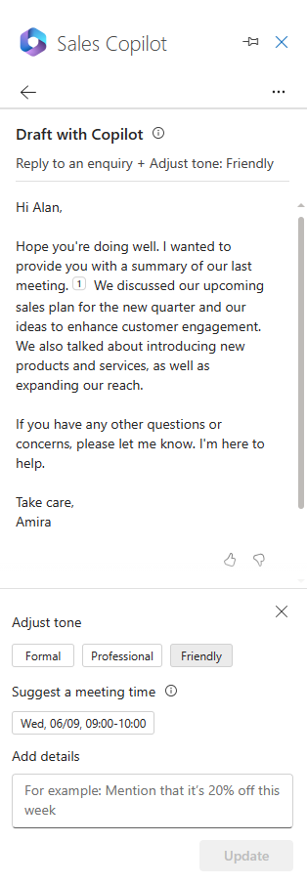
Adjust tone
Productivity
Interactions
Flow of work
Administration
Monitoring
As a seller, I need to adapt the style and tone of my emails depending on the customer and the stage of the opportunity. I adjust my communication based on the journey I've had with the customer, ranging from formal and professional to friendly.
Professional tone
Formal tone
Friendly tone
Yuri
Adjust draft
Adaptive Seller
Yuri can now choose between formal and informal email styles using tone knobs in the email suggestions. This helps in adjusting the communication based on the relationship and journey with the customer.
400
Credit

Slide 8
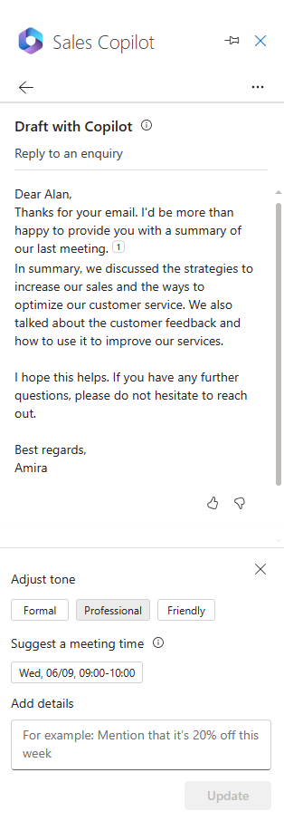
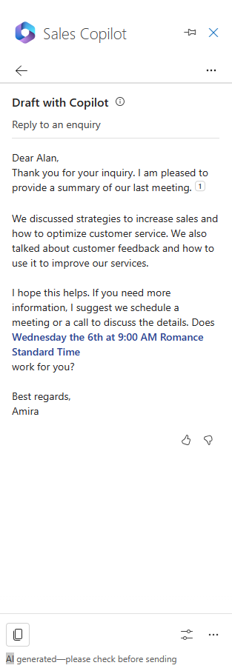
Suggest a meeting time
Productivity
Interactions
Flow of work
Administration
Monitoring
As a seller, I need to promptly suggest meeting times to customers based on my availability and my time zone, especially if there is an expressed meeting intent in the email.
The meeting time suggestion selected and added in the email
Yuri
A meeting time suggestion
Responsive Seller
500
Yuri can suggest meeting times based on his availabilities when the customer requests it. The meeting time displayed in the suggested content is in the seller’s time zone.
Credit

Slide 9
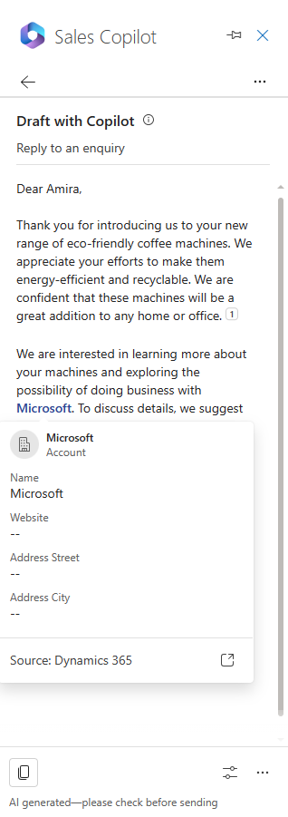
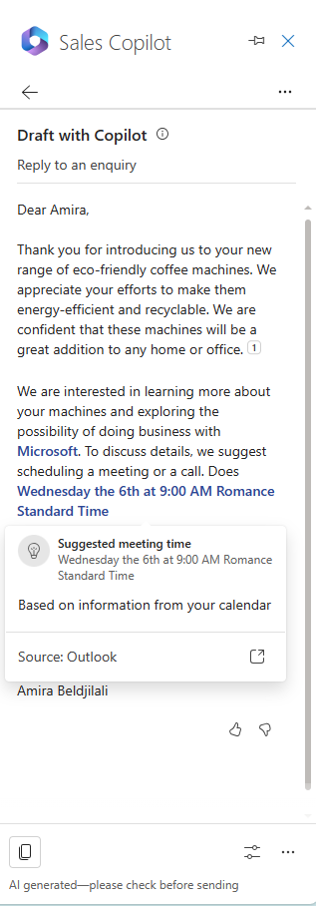
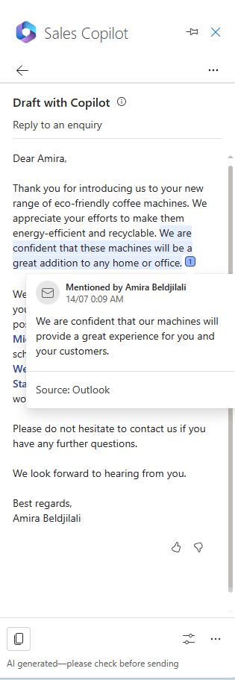
Data source in suggested content
Productivity
Interactions
Flow of work
Administration
Monitoring
As a seller, I need to know the source of the data when there is suggested content using Sales Copilot
Email data citation
Outlook data
CRM data
Yuri
Yuri can observe the mentioned data source for CRM data within the suggested content, which is visually highlighted in blue. He has the option to choose this content to access information regarding the CRM data. Furthermore, Yuri can also access comprehensive details of a CRM record by clicking on the "Open Record" button located on the CRM record card.
As for email data integrated into the suggested content, it is presented with citation numbers for reference. To access details about the email content in question, one can simply select the respective citation number.
From CRM: Contact, Account, Opportunity, Product, Activity
From Office 365: Availability, Email
Curious Seller
600
Credit

Slide 10
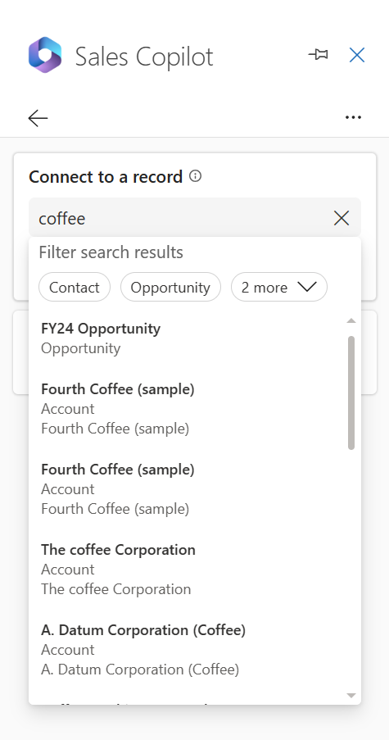
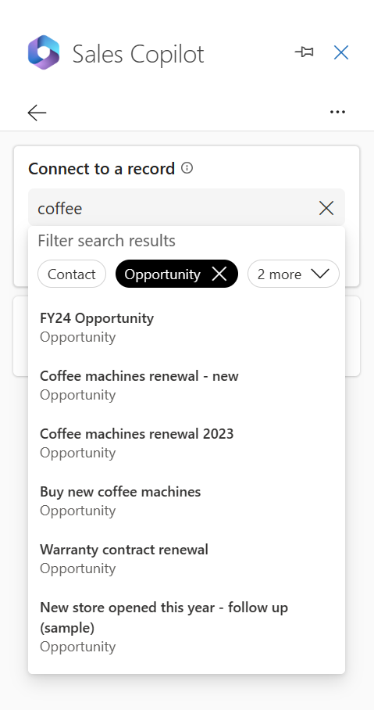
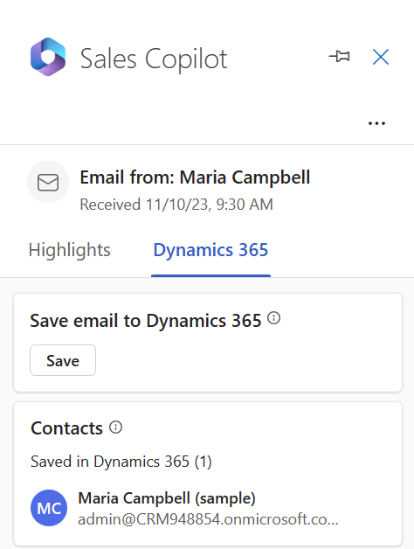
Record search with record type filter
Productivity
Interactions
Flow of work
Administration
Monitoring
As a seller, I need to filter search results by record type to quickly and conveniently locate the record I need
Selected filters are highlighted
Filter by Object
Yuri
Save Email to CRM
Time-pressed Seller
Yuri can filter by objects available in Sales Copilot to efficiently find the record he is looking for. The objects appearing here are the ones configured by the admin.
700
Credit

Slide 11
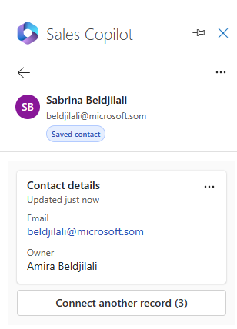
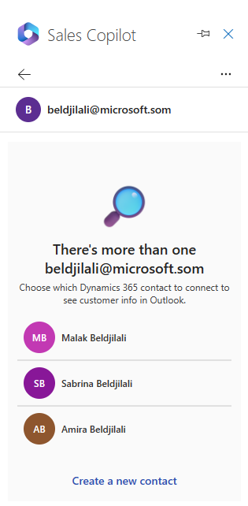
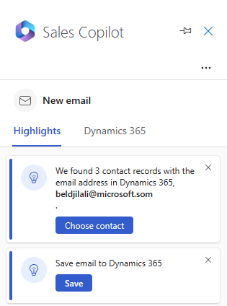
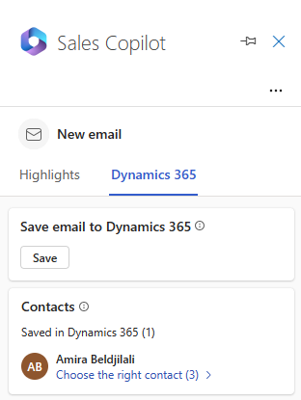
Duplicate contacts in the CRM
Productivity
Interactions
Flow of work
Administration
Monitoring
Connect to another record
Select the right Contact
As a seller, I need the ability to select the correct CRM contact when there are multiple matches, as our CRM data may not always be free from duplicates
Yuri
Choose Contact when there are multiple matched
Choose the right contact from the CRM tab
Or Create a new contact
Assisted Seller
If the email address Yuri entered matches multiple CRM contacts, he must manually select the correct one. Sales Copilot notifies him with a message on the Highlights card when multiple matches occur. If none of the matches are correct, choose 'Create a new contact' to add a new CRM contact.
If you've accidentally linked an external contact to the wrong CRM contact, you can make changes to the connected record.
800
Credit

Slide 12
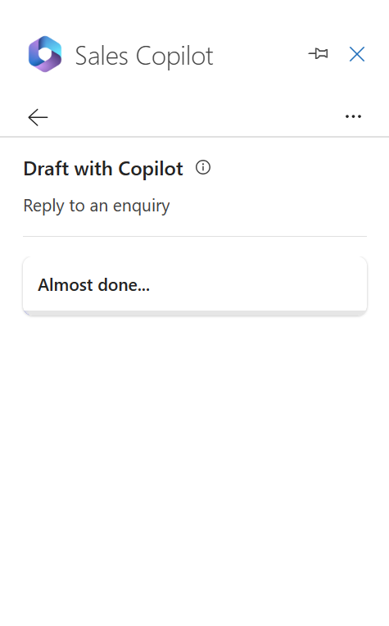
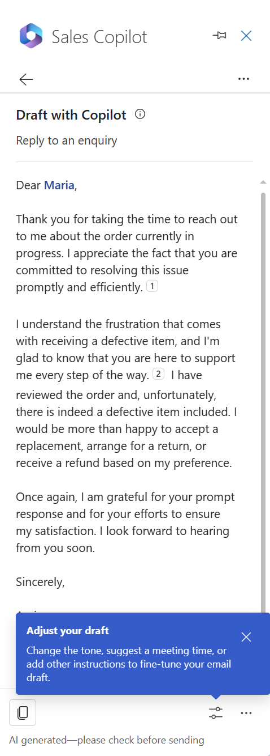
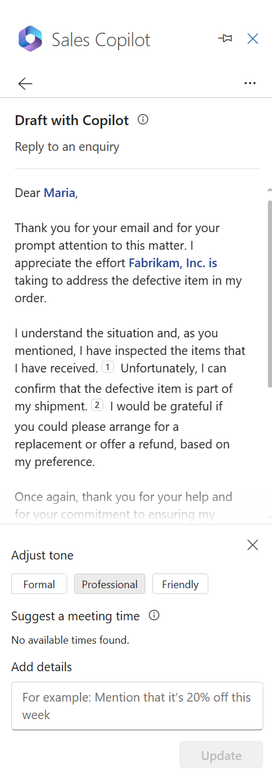
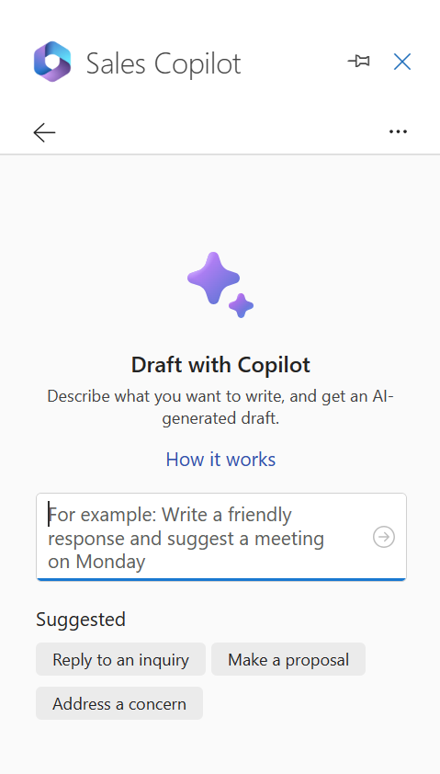
Generate content experience
Productivity
Interactions
Flow of work
Administration
Monitoring
4th message appearing while waiting for the generation
As a seller, I require an enhanced content generation experience that offers richer features to improve my overall user experience
Yuri
Hint Text
Assisted Seller
900
Credit
Discoverability Bubbles
No slots available note

Slide 13
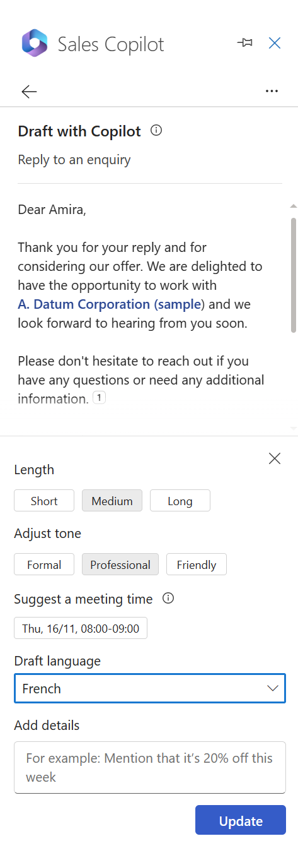
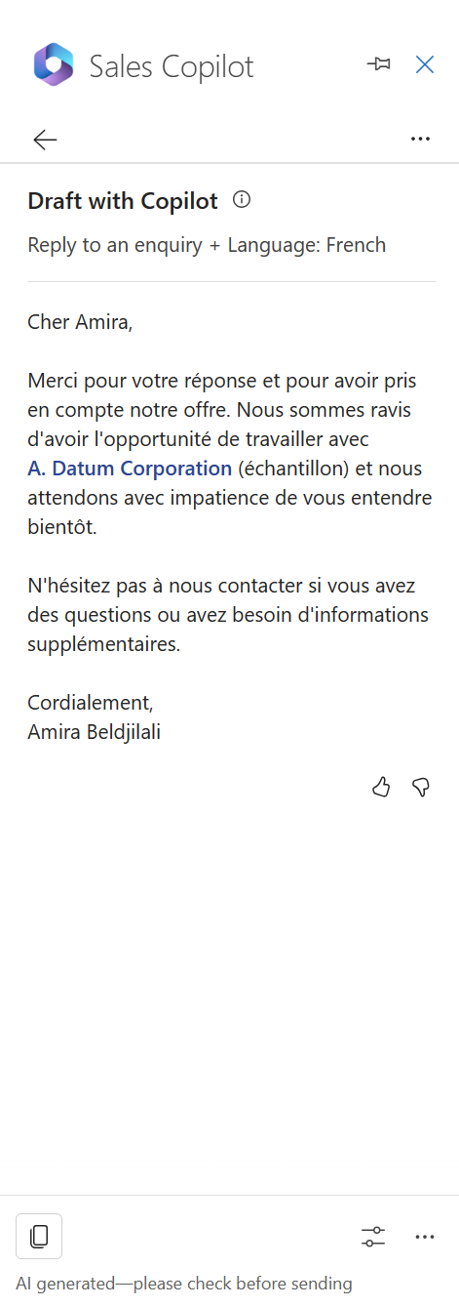
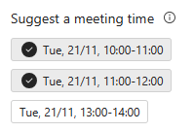
Refine enhancemenets
Productivity
Interactions
Flow of work
Administration
Monitoring
Adjust the length of your reply
As a seller, it's crucial for me to generate responses in diverse languages to reach a broader audience. Additionally, there are instances where I may need to furnish more comprehensive replies, often incorporating multiple schedule slots.
Reply in French as requested
Yuri
Schedule up to 3 slots
Flexible Seller
1000
Credit
Pick the language that you prefer for the reply (English, Spanish, French German)

Slide 14
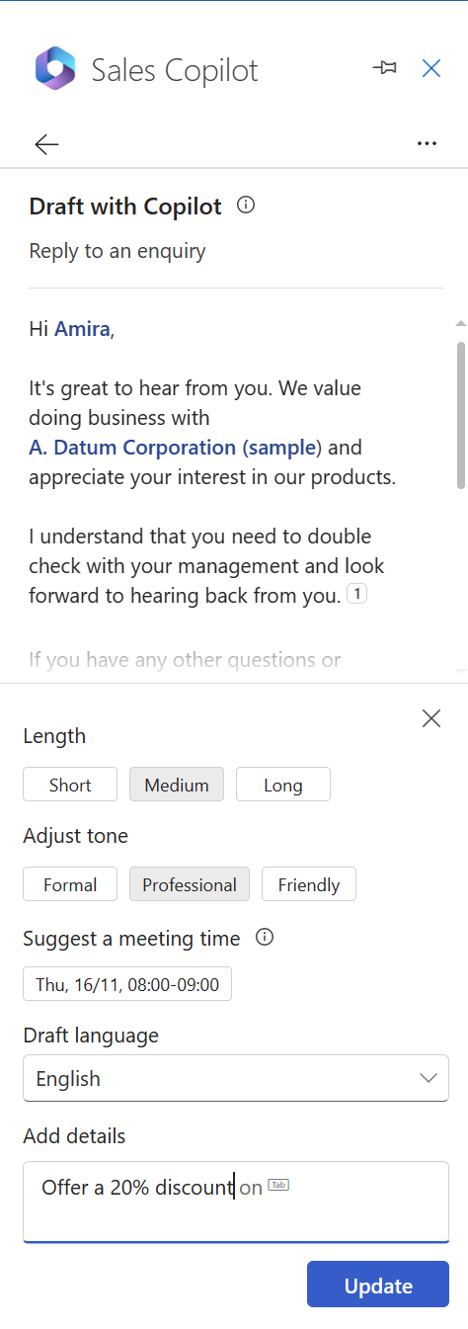
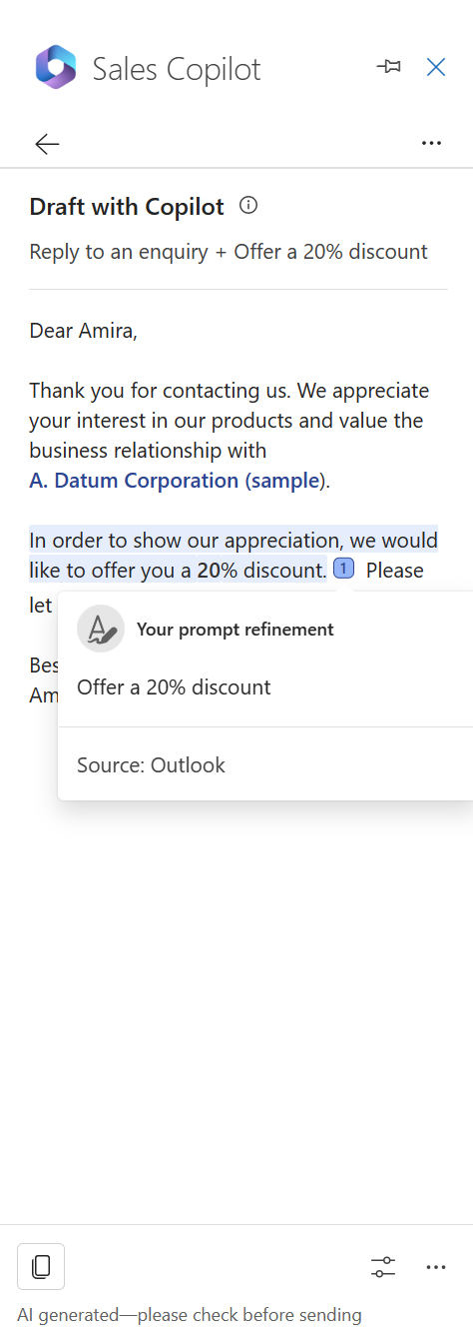
Explanations for seller prompts
Productivity
Interactions
Flow of work
Administration
Monitoring
As a seller, it's crucial for me to generate responses in diverse languages to reach a broader audience. Additionally, there are instances where I may need to furnish more comprehensive replies, often incorporating multiple schedule slots.
Understanding the origin from the prompt
Yuri
Add details – My own prompt
Flexible Seller
1100
Credit

Slide 15
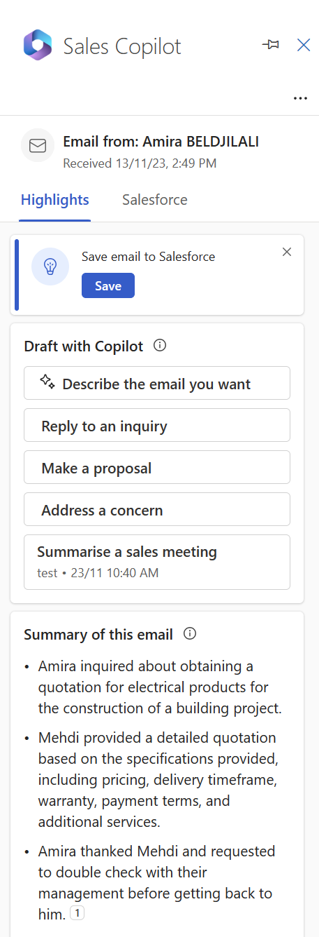
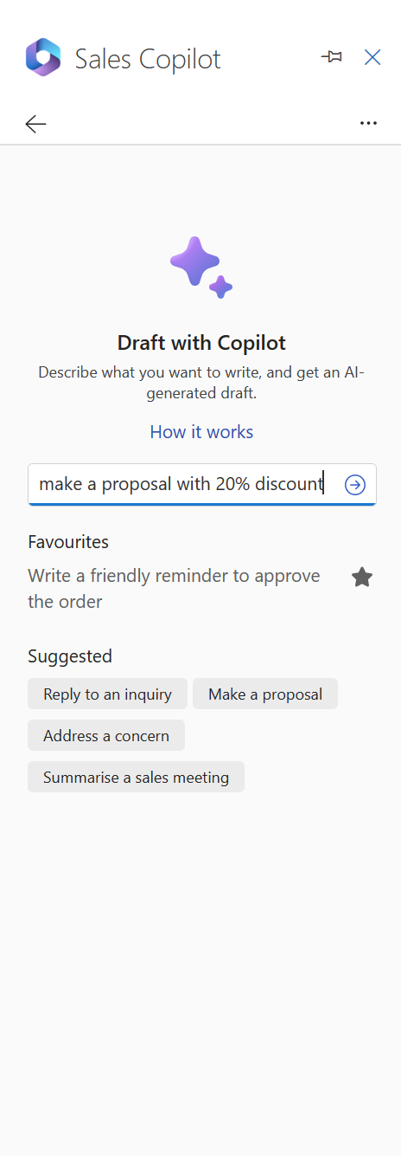
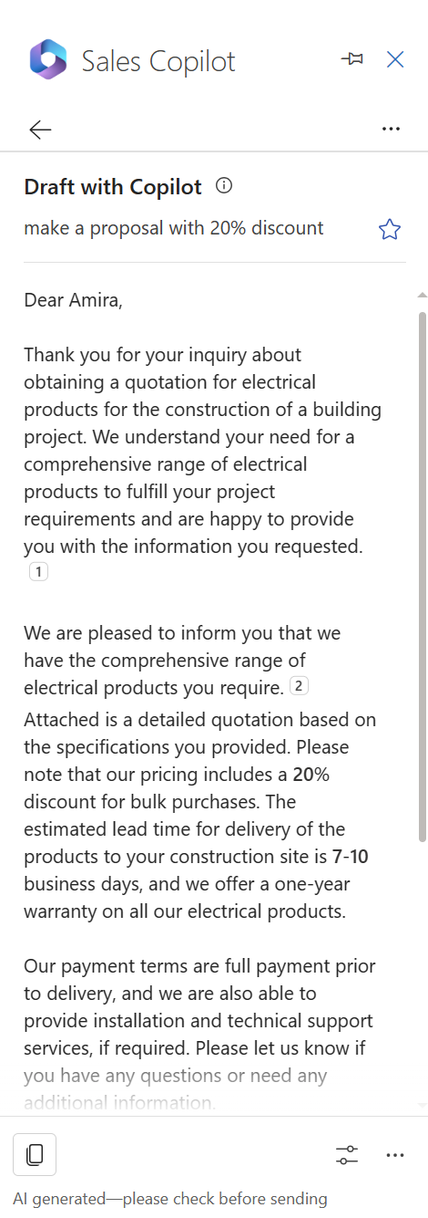
Save and reuse custom prompts
Productivity
Interactions
Flow of work
Administration
Monitoring
As a seller, I maximize efficiency by saving custom email prompts for future use, allowing me to easily send similar messages to multiple recipients and save time.
Define custom prompt
Add a new custom prompt to my list
Yuri
Reuse/remove my favourite custom prompts
Efficient Seller
1200
Credit

Slide 16
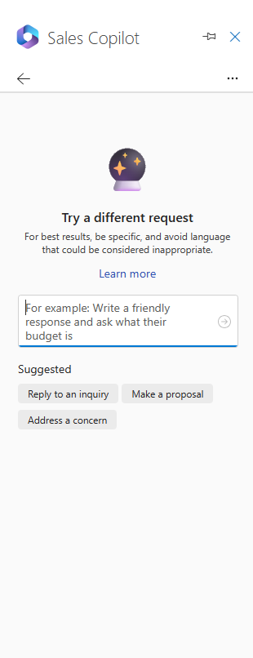
Text moderation
Productivity
Interactions
Flow of work
Administration
Monitoring
As a seller, I rely on Sales Copilot's text moderation to automatically identify and reject potentially inappropriate content, ensuring a respectful and controlled communication environment.
Sales Copilot highlights when there is inappropriate content
Yuri
Caring Seller
1300
Credit

Slide 17
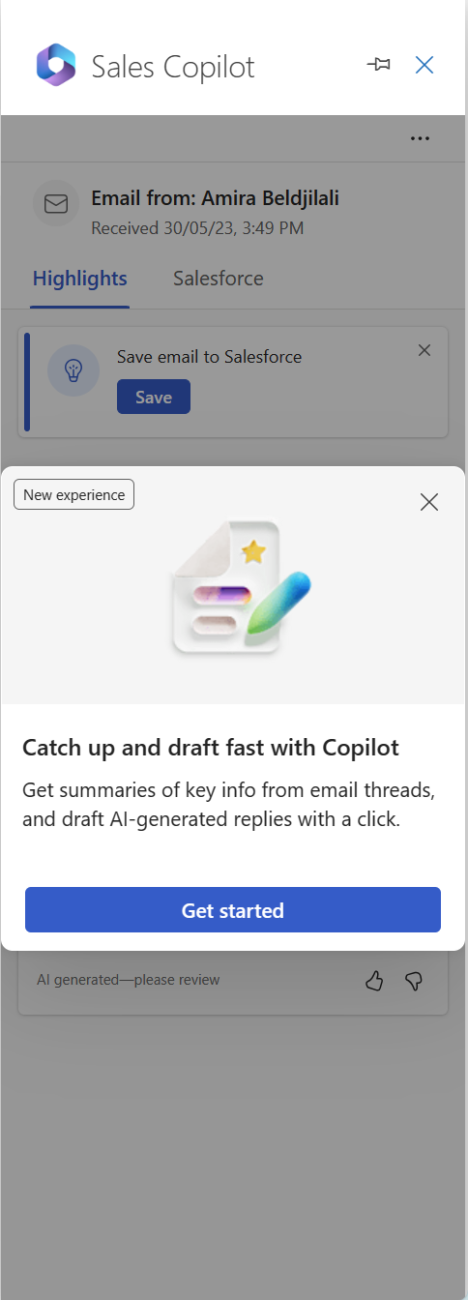
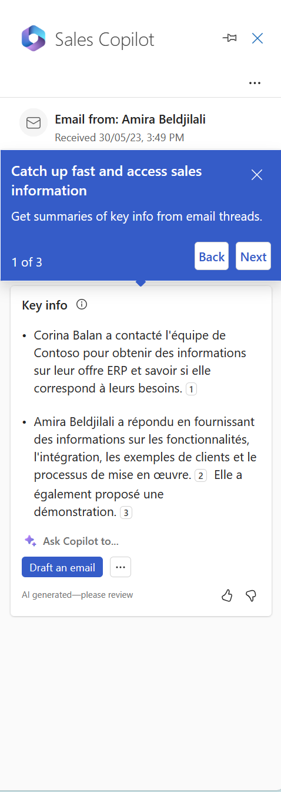
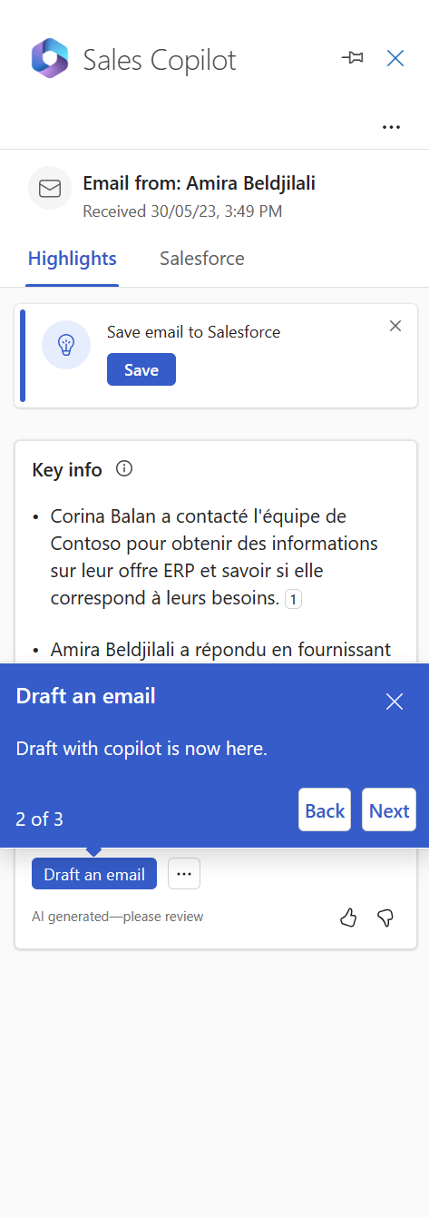
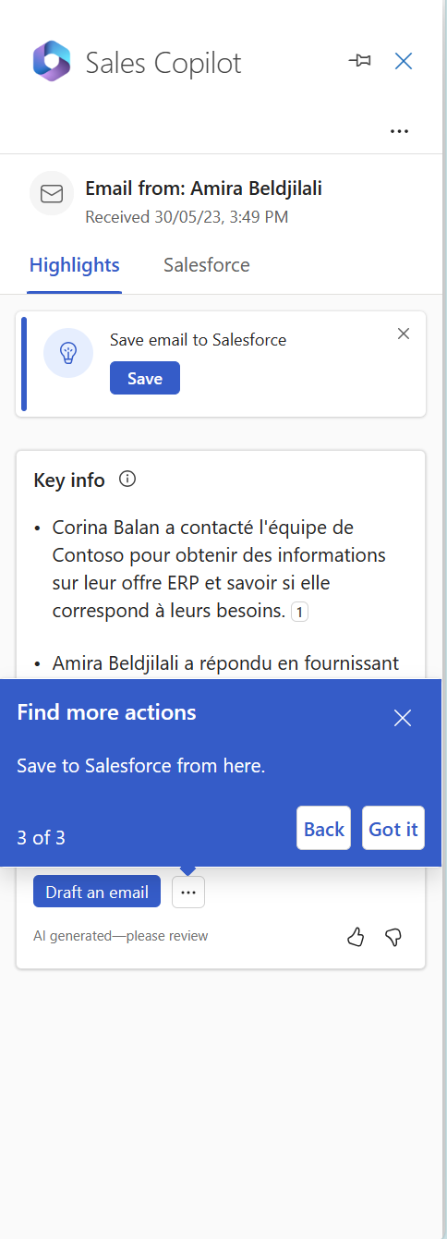
New
Catch up & draft fast
Productivity
Interactions
Flow of work
Administration
Monitoring
As a seller, I thrive on discovering new features. I need an experience that effortlessly guides me through the latest enhancements in the solution, enhancing my overall selling experience.
Yuri
Exploratory Seller
1400
Credit
Click on Get Started to discover the new experience

Slide 18
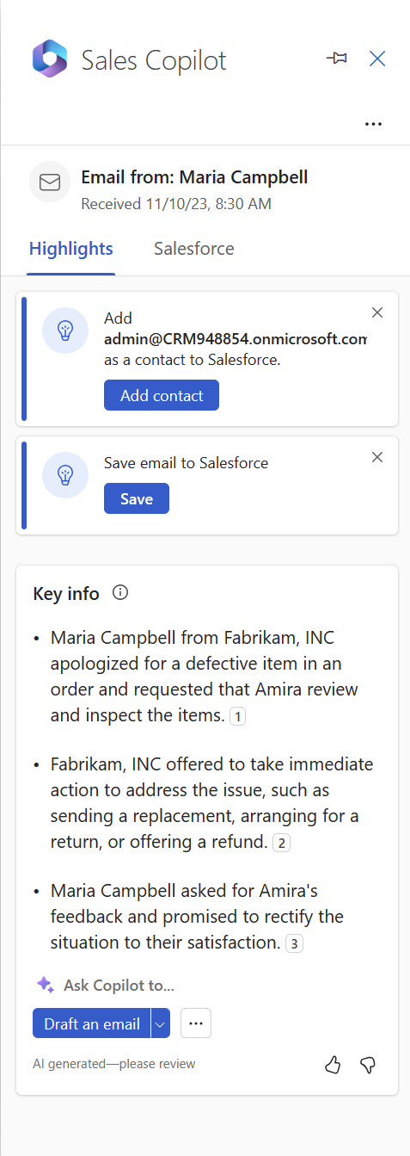
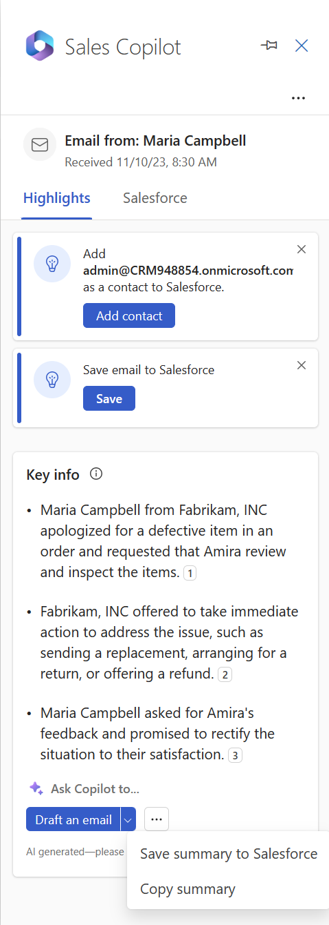
New
Catch up, Draft emails & take actions
Productivity
Interactions
Flow of work
Administration
Monitoring
As a seller, I want to quickly see important info in my emails, easily write messages with ready-to-use suggestions, and smoothly save summaries to my CRM.
Catch up & see Key Info
Yuri
Quick Seller
Take more actions
1500
Credit
Draft the email with Custom Prompt
Draft an email

Slide 19
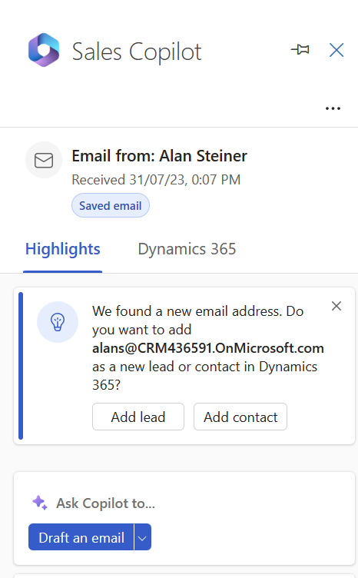
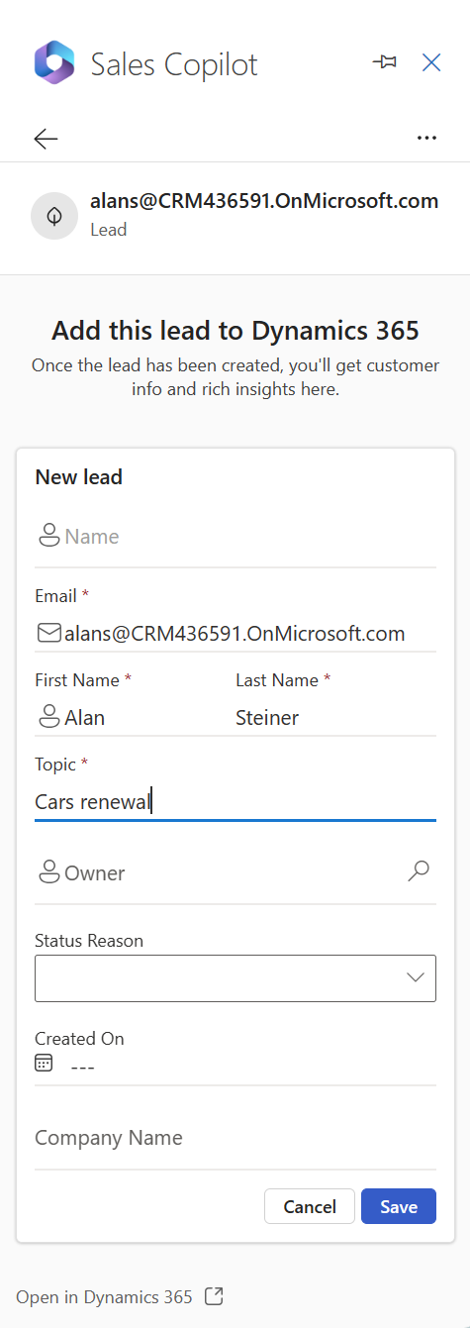
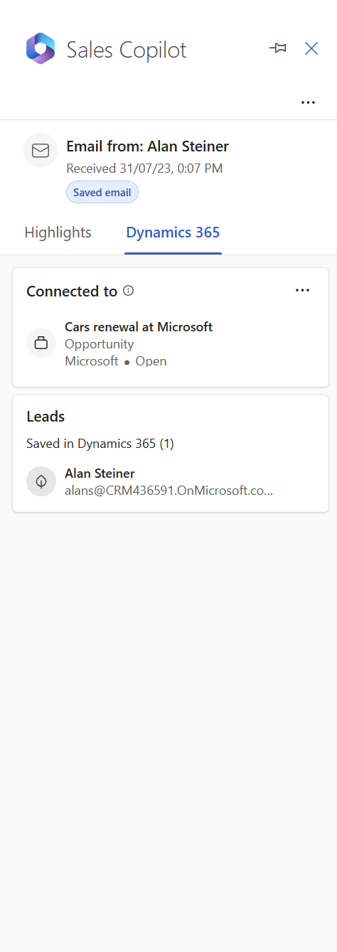
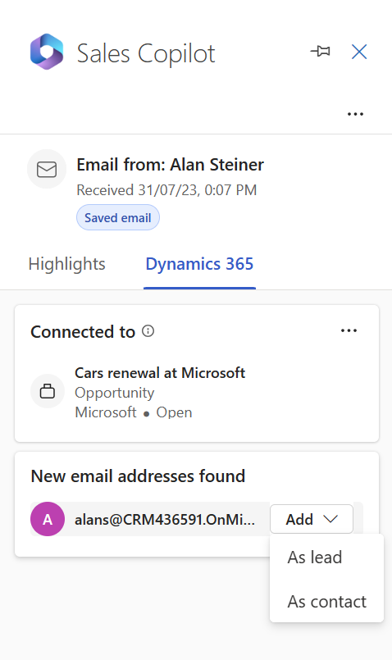
New
Create Lead
Productivity
Interactions
Flow of work
Administration
Monitoring
As a seller, I require the ability to effortlessly create leads directly from emails.
Add a record as Lead
Yuri
Fill the lead’s information
Visualize the newly created Lead
Efficient Seller
1600
Credit

Slide 20
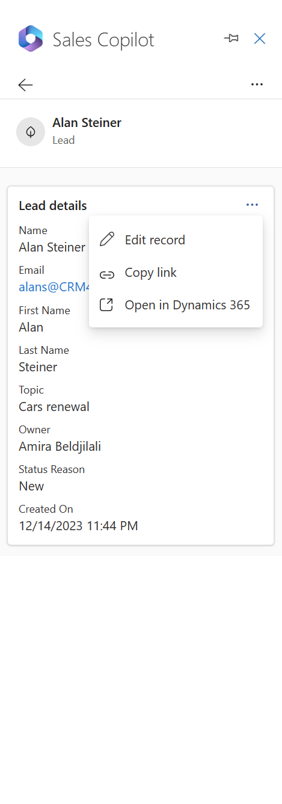
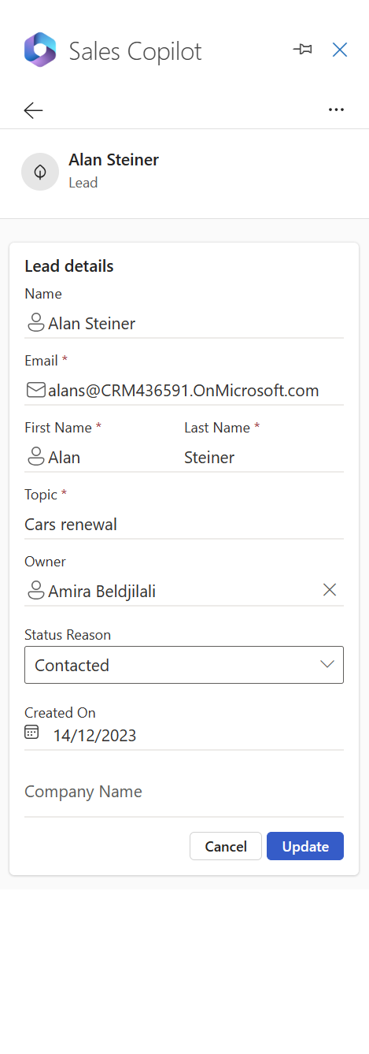
New
View and Edit Lead
Productivity
Interactions
Flow of work
Administration
Monitoring
As a seller, I require the ability to effortlessly edit leads. Additionally, I want to easily access information on related accounts and other associated entities.
Actions available on Lead
Yuri
Read Lead details
Efficient Seller
Edit the Lead information, once contacted for Example
1700
Credit
Learn how to configure leads support (preview) and register for the public preview.

Slide 21
Updated
Unlocked
Productivity
Interactions
Flow of work
Administration
Monitoring
1700

Slide 22
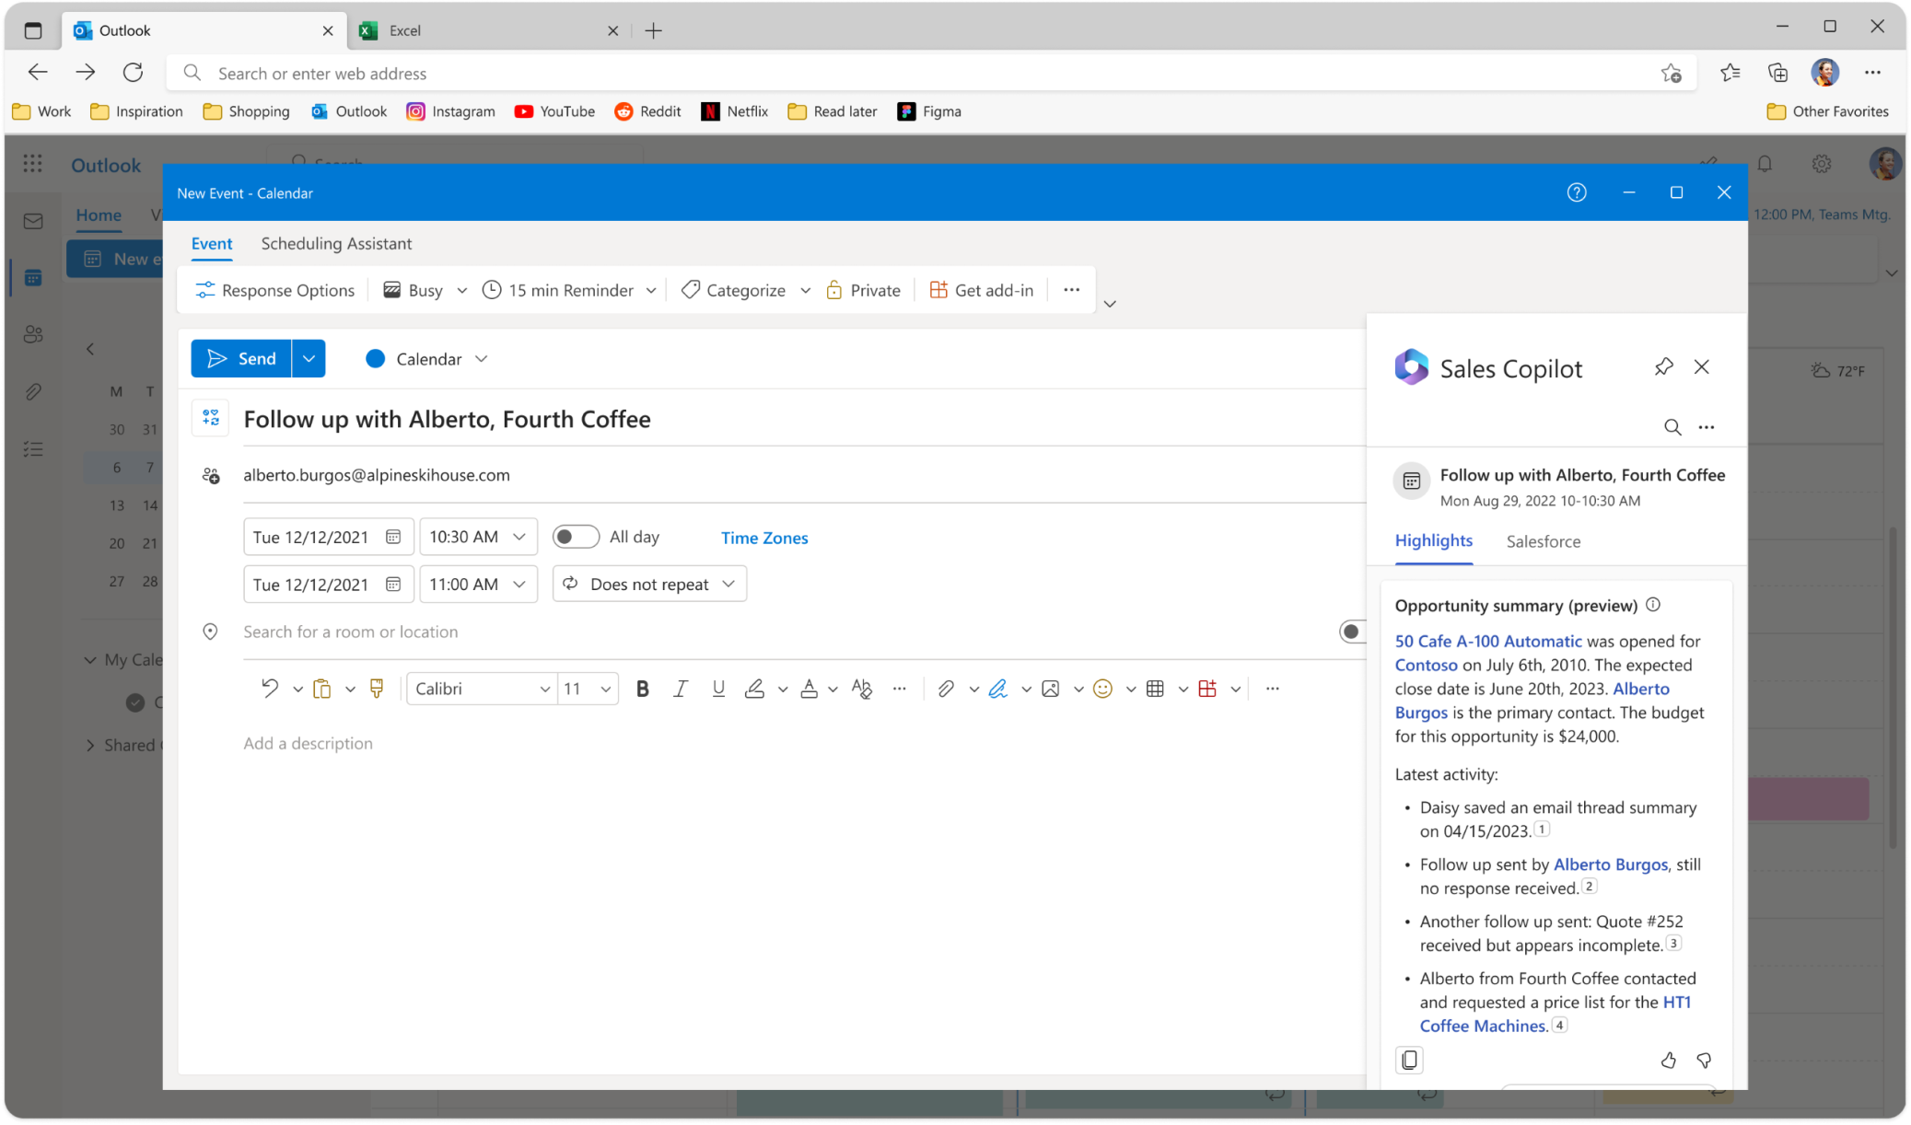
Pre-meeting preparation
Productivity
Interactions
Flow of work
Administration
Monitoring
As a seller, I need to quickly obtain a summary of the opportunity to be well-prepared for my meeting before engaging with the customer. This helps me build trust with my customers by being informed and having a 360-degree view.
Opportunity summarisation to prepare the meeting
Julia
Active Seller
Julia has several meetings during the day. She uses Sales Copilot to effortlessly ensure that every customer feels like the most important one.
Sales Copilot saves time by providing a quick overview of what's new and important regarding her customers before each meeting.
100
Credit

Slide 23
Real-time tips during the meeting (1/2)
A brand is mentioned during the meeting, details appear in real-time to the seller from Bing
References are highlighted and seller can get more details by clicking on it
Productivity
Interactions
Flow of work
Administration
Monitoring
As a seller, I need to confidently overcome objections, address competitors, and answer product-related questions to build trust with customers and close deals.
Julia
A competitor is mentioned during the meeting, details appear in real-time to the seller from the CRM
Efficient Seller
Julia is a new recruit, and she is very busy. She needs to feel confident and quickly overcome objections, address competitors, and answer product questions.
She needs to have the right data at the right time, and Sales Copilot is a powerful tool to help her increase her productivity
200
Credit
References are highlighted and seller can get more details by clicking on them

Slide 24
Real-time tips during the meeting (2/2)
Productivity
Interactions
Flow of work
Administration
Monitoring
As a seller, I need to confidently overcome objections, address competitors, and answer product-related questions to build trust with customers and close deals.
Welcome message when using the feature for the first time
Remove the tip from the list
Opportunity summary displayed automatically to help the seller with an overview
Julia
Copy the tip
When there is not or not enough data in the CRM concerning the Competitor, this message appears
Efficient Seller
300
Credit
Evaluate the tip

Slide 25
Access CRM data during the meeting (1/3)
CRM tab
Click on record to see details below
Productivity
Interactions
Flow of work
Administration
Monitoring
As a seller, I need seamless access to CRM data during meetings, directly within the customer context. This ensures that I can easily update important information in opportunities without the risk of forgetting any updates.
Connected record to the Meeting event
Actions available: Copy Link and Open in the CRM
Julia
Details displayed with fields configured in the customizations
Helped Seller
400
Credit
Julia goes through several meetings per day, where she gathers vital data. She needs to quickly view and update the connected record to the call directly during the meeting in real-time to avoid forgetting or wasting time switching between windows and searching for the right record to update.

Slide 26
Access CRM data during the meeting (2/3)
Productivity
Interactions
Flow of work
Administration
Editable fields displayed with fields configured in the customizations
As a seller, I need seamless access to CRM data during meetings, directly within the customer context. This ensures that I can easily update important information in opportunities without the risk of forgetting any updates.
Julia
Sellers can Update or Cancel the operation
Available actions:
Edit Record
Copy Link
Open in CRM
Helped Seller
500
Credit

Slide 27
Access CRM data during the meeting (3/3)
Productivity
Interactions
Flow of work
Administration
Monitoring
As a seller, I need seamless access to CRM data during meetings, directly within the customer context. This ensures that I can easily update important information in opportunities without the risk of forgetting any updates.
As a customer participating in the meeting, you can see that the organizer is using Sales Copilot
to take notes
Seller can Remove and the Sales Copilot Add-in
Julia
As a customer participating in the meeting, you can see in the chat when the organizer adds Sales Copilot to the meeting
Helped Seller
600
Credit

Slide 28
Post-meeting sales summary (1/4)
Meeting title
Productivity
Interactions
Flow of work
Administration
Monitoring
Recap tab with call Highlights and follow-up action items
Call transcript
As a seller, I need to be supported and assisted to fully engage with my customers while also tracking essential highlights and key follow-ups during meetings for post-call communication.
Sentences in a bulleted list that summarize each section of the conversation
Highlights won't be generated if the meeting recording duration exceeds 70 minutes
Action items in a bulleted list
Julia
Playback capability, available only to the meeting organizer and call recorder
Sentiments detected in the conversation
Supported Seller
Julia requires assistance in her meetings to automatically generate a call report, detect questions, conduct sentiment analysis linked to the transcript, calculate conversational KPIs, extract action items, and create tasks in CRM. By capturing these key moments, she can concentrate on meaningful interactions with customers and experience reduced stress.
700
Credit

Slide 29
Post-meeting sales summary (2/4)
Productivity
Interactions
Flow of work
Administration
Monitoring
As a seller, I need to be supported and assisted to fully engage with my customers while also tracking essential highlights and key follow-ups during meetings for post-call communication.
Data is pre-filled from the meeting summary
Create a task based on a follow-up
Julia
Supported Seller
800
Credit

Slide 30
Post-meeting sales summary (3/4)
Productivity
Interactions
Flow of work
Administration
Monitoring
As a seller, I need to be supported and assisted to fully engage with my customers while also tracking essential highlights and key follow-ups during meetings for post-call communication.
Data is pre-filled from the meeting summary
Create a task based on a follow-up
Julia
Supported Seller
900
Credit

Slide 31
Post-meeting sales summary (4/4)
Productivity
Interactions
Flow of work
Administration
Monitoring
As a seller, I need to be supported and assisted to fully engage with my customers while also tracking essential highlights and key follow-ups during meetings for post-call communication.
Names of the people who participated in the meeting
Julia
Supported Seller
1000
Credit

Slide 32
Post-meeting ready sales summary (1/3)
Copy to clipboard and then paste the data into an email, Teams chat or any other tool you like
Productivity
Interactions
Flow of work
Administration
Monitoring
As a seller, I need to make follow-ups effortlessly, prioritizing next steps to expedite deal closures and maintain strong customer relationships.
Julia
The summary appears as following and is ready to be shared
Efficient Seller
1100
Julia needs to promptly send follow-ups and actions to customers after calls, but she often misses this because she has to take notes and double-check certain data with the CRM.
Without Sales Copilot, she used to frequently miss these crucial follow-up tasks.
Credit

Slide 33
Post-meeting ready sales summary (2/3)
Productivity
Interactions
Flow of work
Administration
Monitoring
As a seller, I need to make follow-ups effortlessly, prioritizing next steps to expedite deal closures and maintain strong customer relationships.
Julia
Most recent transcribed Teams meeting with your sales contacts
Select the down arrow to see up to five recently transcribed meetings
Efficient Seller
Julia needs to promptly send follow-ups and actions to customers after calls, but she often misses this because she has to take notes and double-check certain data with the CRM.
Without Sales Copilot, she used to frequently miss these crucial follow-up tasks.
1200
Credit
The suggested content is ready, you can adjust it if needed

Slide 34
Post-meeting ready sales summary (3/3)
Productivity
Interactions
Flow of work
Administration
Monitoring
As a seller, I need to make follow-ups effortlessly, prioritizing next steps to expedite deal closures and maintain strong customer relationships.
Change the meeting used to create a summary
Hover over a meeting and select the button to open the meeting summary in Teams
Julia
Create a new draft to see the new meeting summary
Efficient Seller
1300
Credit

Slide 35
Unlocked
Productivity
Interactions
Flow of work
Administration
Monitoring
1300

Slide 36
AI-Suggested contact creation (1/2)
Productivity
Interactions
Flow of work
Administration
Monitoring
As a seller, I'm often very busy and require assistance with two important tasks: keeping CRM records up to date and predicting when it's time to add new contacts, and automatically map the important data.
New Email to send
Add contact suggestion automatically displayed when multiple contacts are in the “To” of your email
Received Email
Add contact suggestion automatically displayed
Ravi
Overwhelmed seller
Ravi requires assistance when he receives emails from new contacts not yet stored in the CRM. He needs to be promptly notified to create these contacts in the CRM. The same applies when he sends emails to new contacts not in the CRM. With Sales Copilot, he can even be helped to automatically map different fields from the email signature of the sender.
100
Credit

Slide 37
AI-Suggested contact creation (2/2)
Filters per object are available when looking for the company
Productivity
Interactions
Flow of work
Administration
Monitoring
As a seller, I'm often very busy and require assistance with two important tasks: keeping CRM records up to date and predicting when it's time to add new contacts, and automatically map the important data.
Sales Copilot prefills the contact details based on the signature
Ravi
Overwhelmed seller
Ravi requires assistance when he receives emails from new contacts not yet stored in the CRM. He needs to be promptly notified to create these contacts in the CRM. The same applies when he sends emails to new contacts not in the CRM. With Sales Copilot, he can even be helped to automatically map different fields from the email signature of the sender.
200
Credit

Slide 38
Collab spaces creation
Collaborate on account related activities
Productivity
Interactions
Flow of work
Administration
Monitoring
As a seller, I need to efficiently create organized teams and channels using templates to bring the right people, data, and apps together, allowing me and my colleagues as sellers to focus on customer engagement and business goals.
Collaborate in teams section appears if the customer contact is saved in the CRM and is linked to an account
Collaboration Spaces section in Sales Copilot
Ravi
Collaborate on opportunity related activities
Organized seller
Ravi needs to use a sales template that streamlines the setup of a team and channel in Microsoft Teams, with CRM records linked for easy access to business data within the workflow.
These templates come with pre-defined channels and pre-pinned apps. He can create a collaboration space using either an account team template or a deal room template.
300
Credit

Slide 39
Collab spaces creation – Account (1/4)
Default name is the Account’s name
Productivity
Interactions
Flow of work
Administration
Monitoring
Chanel includes the following
As a seller, I want to ability to collaborate on account-related activities using the Account Team template.
Icon for Account Template
Select your colleagues to add to the General channel (Internal collaboration)
Sensitivity show up if it has been set if by your tenant admin
Ravi
Create a new team or use an existing one
A shared channel is automatically created for collaborating with customers
Hover the account name to select “Set up account team”
Icon for Deal Template
Learn more about Collaboration Spaces
Organized seller
400
Credit
Ravi needs to create a team using Account team template designed for seamless collaboration within account teams and with customers. Applied at the team level and linked to a CRM account, this template provides a comprehensive solution. It comes equipped with predefined channels and pre pinned apps, ensuring a smooth and efficient workflow for effective collaboration.

Slide 40
Collab spaces creation – Account (2/4)
💡 The recommended team members are suggested based on the following logic:
Dynamics 365:
CRM account owner
Members with whom the account is shared
Members of the access team
If the account owner is a group, the list of users from this group is displayed
Salesforce CRM:
CRM account owner
Members who are part of the account team
Productivity
Interactions
Flow of work
Administration
Monitoring
As a seller, I want to the ability to collaborate on account-related activities using the Account Team template.
Ravi
Organized seller
Teams ready to be used
500
Quick access to the teams if you have many 😉
Credit

Slide 41
Collab spaces creation – Account (3/4)
Internal channel to collaborate with sellers
Pre-pinned apps
Productivity
Interactions
Flow of work
Administration
Monitoring
Welcome message to get started with teams
As a seller, I want to the ability to collaborate on account-related activities using the Account Team template.
External channel to collaborate with the customer
CRM related files folder will not be created in the Files tab of the Shared channel to protect sensitive data
Welcome message to get started with teams
Ravi
Organized seller
CRM account will not be pinned in the Shared Channel to protect sensitive organization data from being shared with customers
600
Credit
Sellers without required permissions in the CRM will not see CRM data

Slide 42
Collab spaces creation – Deal (4/4)
Click to search for a Team
Productivity
Interactions
Flow of work
Administration
Monitoring
Default name is the Opportunity’s name
As a seller, I want to the ability to collaborate on opportunity-related activities using the Account Team template.
Select the team already connected to the account or a different one
Standard channel comes with AI-powered capabilities
Ravi
It’s recommended to create a deal room channel if the parent account for the opportunity is already linked in the Teams app
Shared channel is optional
Hover the opportunity name to select “Set up deal team”
Organized seller
700
Credit
Ravi needs to create a team using Deal room template designed for collaboration with people within his organisation. An option is provided to create a separate shared channel to collaborate with people outside his organization. Furthermore, pre-pinned apps, including files with starter folders, links to existing CRM storage locations, and OneNote, are readily available to enhance the productivity.

Slide 43
Collab spaces creation – Deal (1/2)
Productivity
Interactions
Flow of work
Administration
Monitoring
As a seller, when collaborating in a teams channel, I would like to see a summary of the opportunity related to the deal room I'm working on in teams and share it with my colleagues.
@Sales Copilot show summary
Ravi
Latest activity section is generated from the summary of the last three notes added to the opportunity record
A generated summary of the opportunity
Communicative seller
Ravi needs to quickly see updates on opportunities he is working on, the summary is a perfect way to stay informed and updated, it is generated using the following CRM fields from the opportunity record: Opportunity name, Opportunity ID, Created On, Estimated close date, Sales stage, Budget amount, Description, Parent Account name, Primary contact name.
800
Credit

Slide 44
Collab spaces creation – Deal (2/2)
Get the help of Sales copilot to keep your colleagues updates
Productivity
Interactions
Flow of work
Monitoring
Filter by objects configured by your admin
Administration
As a seller, I prioritize keeping my team updated, especially when working on important opportunities. I consistently share updates and invite my colleagues to quickly check and stay informed about the status via Teams.
Search for a CRM record in a teams channel
Ravi
Card info with fields configured by your admin
Communicative seller
900
Credit
Ravi loves sharing news and updates about what he's working on to keep his team informed. He can search for various records using the advanced search feature.

Slide 45
Share in a teams conversation (1/2)
Select Sales Copilot app in Teams Apps
Productivity
Interactions
Flow of work
Administration
Monitoring
Advanced Find
As a seller, I need to share an adaptive card with my colleagues in Teams channels or Teams chat or paste a link to a record that will unfurl into a rich adaptive card.
recently accessed records are displayed
Ravi
Proactive seller
1000
Filter by configured objects set by your admin
Credit

Slide 46
Share in a teams conversation (2/2)
Updates in the CRM are not updated in Adaptive Card – Click on Refresh to get updates
Productivity
Interactions
Flow of work
Administration
Monitoring
As a seller, I need to share an adaptive card with my colleagues in Teams channels or Teams chat or paste a link to a record that will unfurl into a rich adaptive card.
Fields are configured by your admin
Adaptive card when you don’t have access to CRM record
Ravi
💡Copy the record link from Sales Copilot app in outlook and paste it here to get the Adaptive Card added
Proactive seller
1100
Credit
Ravi is assured that if he makes a mistake and shares a record that his colleague is not supposed to see, the colleague won't be able to access it. Instead, they will receive a message prompting them to review their access roles.

Slide 47
People.ao Integration – Salesforce only
Insights from People.ai
Productivity
Interactions
Flow of work
Administration
Monitoring
As a seller, I require access to relationship insights for the COA entities in Sales Copilot to help identify and respond to potential issues. I also need to make real-time calls to People.ai to obtain these relationship insights
Insights from People.ai
Ravi
Informed seller
Ravi receives engagement info from People.ai in the detailed view of the contact, account, opportunity entities. He will see insights for:
Engagement level
Engagement trend
Total number of emails & meetings for the record
Total time spent
1200
Credit

Slide 48
Viva Topics integration
Productivity
Interactions
Flow of work
Administration
Monitoring
As a seller, I want to be assisted in leveraging an organization's internal knowledge base like Viva Topics
Viva Topics information
Ravi
Informed seller
1300
Credit
Ravi receives Topic cards on topics discussed during a Teams meeting. (scan transcript and identify topics)

Slide 49
Duplicate contacts
Productivity
Interactions
Flow of work
Administration
Monitoring
As a seller, I want to be assisted when creating new contacts to avoid having duplicates
The same contact exists already in the CRM
Sales Copilot highlight it’s a duplicate
Ravi
Alerted seller
1400
Credit
Ravi receives a clear error message when there is a server-side check (Duplicate detection rules) in the CRM

Slide 50
DocuSign integration
Productivity
Interactions
Flow of work
Administration
Monitoring
As a seller, I want to track DocuSign agreement updates, like signed contracts, in Sales Copilot within the opportunity summary. I also need to view DocuSign agreements related to CRM accounts.
Ravi
DocuSign agreements related to the account
DocuSign agreements updates in the opportunity summary
Integrated seller
If you are a Microsoft customer and would like to try the integration of Sales Copilot and DocuSign, sign up for the preview here - https://aka.ms/SalesCopilotDocuSignPreview
If you are a Microsoft partner building applications for sales teams and would like to extend Sales Copilot – please register here: https://aka.ms/SalesCopilotPartnerSignUp
1500
Credit

Slide 51
New
DocuSign integration
Productivity
Interactions
Flow of work
Administration
Monitoring
Users who are signed out will see adaptive cards load seamlessly
As a seller, I appreciate the seamless experience when sharing cards with colleagues in different environments within our team.
Ravi
Users signed into a different environment will also see adaptive cards load straight away + a visual indicator
Adaptable seller
1600
Credit

Slide 52
Updated
Unlocked
Productivity
Interactions
Flow of work
Administration
Monitoring
1600

Slide 53
Admin settings Landing Page
Settings to customize Sales Copilot Outlook & Teams experiences
Landing Page
Provide your feedback
Productivity
Interactions
Flow of work
Administration
Monitoring
Details about the app
As a CRM admin, I need to customize Sales Copilot to business needs. I can manage environment-specific settings from a central location and control the Sales Copilot experience across Outlook and Teams.
Alex
Adaptive card when you don’t have access to CRM record
Attentive admin
100
Credit
Alex requires access to the Sales Copilot settings section to make the changes requested by the business team. He gains access through the Sales Copilot add-in in Teams.

Slide 54
Admin settings Copilot
Productivity
Interactions
Flow of work
Administration
Monitoring
As a CRM admin, I need to enable AI features to assist sellers in composing more effective emails, maintaining comprehensive notes, and staying informed about their deals through AI-driven insights.
Copilot section
Switch environment to perform changes in a different environment
Alex
Turn On or Off the AI features in Sales Copilot
Try our new features
Cautious admin
200
Credit
Alex can enable AI features and check technical details in the architecture guide Sales Copilot architecture | Microsoft Learn.

Slide 55
Admin settings Forms (1/3)
Productivity
Interactions
Flow of work
Administration
Monitoring
As a CRM admin, I need to customize the CRM information that is displayed in Sales Copilot to give sellers a more relevant view.
Refresh to get recent changes from CRM (new field, view,..)
Forms section
You cannot select a view for the Contact record type
Alex
Add new custom or out-of-the-box record types – Maximum of 10 record types
The view determines column display, default sorting, and applied filters.
Account and opportunity records don't require a view selection; default is used
Adaptive admin
300
Alex needs to adjust forms and fields that are environment-specific. Each environment has its own set of configurations. Contact, opportunity, and account record types are available by default. He can add other out-of-the-box and custom record types and remove them when they are not required.
Credit

Slide 56
Admin settings Forms – Add object (2/3)
Add new record type (or a salesforce object)
Productivity
Interactions
Flow of work
Administration
Monitoring
Displayed if the record type you selected in the previous step relates to more than one record type or field
Only record types that are related to a currently available record type are displayed
As a CRM admin, I need to customize the CRM information that is displayed in Sales Copilot to give sellers a more relevant view.
Only one record type at a time
Alex
Adaptive admin
Public and personal views are displayed
400
Credit

Slide 57
Admin settings Forms – Settings (3/3)
Control editing behaviour at object level
Change the view used
Productivity
Interactions
Flow of work
Administration
Monitoring
Control editing behaviour at field level
As a CRM admin, I need to customize the CRM information that is displayed in Sales Copilot to give sellers a more relevant view.
view the source query that's used to filter records in a view, this helps to have a clear understanding
Refresh data to get latest changes from CRM and apply them in Sales Copilot
Alex
Mark a field as required for Sales Copilot only (if it’s already required in CRM then it will be for sure required in Sales copilot and you cannot make it optional)
Select Key fields to help sellers get relevant context at glance
Adaptive admin
500
Credit
Key field settings impact search results in Dynamics 365 and Salesforce. Ensure selected key fields exist in quick find views for display.

Slide 58
Sales Copilot for M365 apps
Productivity
Interactions
Flow of work
Administration
Monitoring
As a tenant admin, I need to configure Sales Copilot for Microsoft 365 apps
This helps users in finding Sales Copilot when interactive with external customer emails with providing a notification banner
Alex
Notification banner at the top of incoming emails
Displayed on a limited number of emails per day when either the incoming email is from an external email domain, or an external email address is included in the To or Cc field
Notifier admin
600
Credit
When disabling the feature, notifications are not removed from the existing emails that are in the inbox, but no further incoming emails will be processed to display the banner.

Slide 59
Exposure of Copilot capabilities
Productivity
Interactions
Flow of work
Administration
Monitoring
As a tenant admin, I possess the capability to enable Copilot, progressively extending its functionality to specific groups based on evolving requirements.
Enable Copilot for the entire organisation, only a group or all except a group
Alex
Vigilant admin
Non-admin users will see that this is managed by a tenant admin
700
Credit

Slide 60
Unlocked
Productivity
Interactions
Flow of work
Administration
Monitoring
700

Slide 61
Check usage data in M365 steps
Productivity
Interactions
Flow of work
Administration
Monitoring
As an administrator, I need to monitor and share the usage of Microsoft Sales Copilot with sales managers.
Anne
Settings -> Integrated Apps -> Check usage data
Admin supervisor
Anne needs to access the M365 admin centre, open settings, navigate to Integrated apps, and then check the usage data to assess the adoption and usage of Microsoft Sales Copilot
100
Credit

Slide 62
Check usage data in M365 results
Productivity
Interactions
Flow of work
Administration
Monitoring
Adjust the Date range 7days, 30 days or 90 days
As an administrator, I need to track Sales Copilot usage by users, monitor the number of active users per host product, and analyse usage data within specific date ranges.
Select the Host Product Outlook or Teams
Download the usage report in Excel format
Anne
Time chart based on Active users
Admin supervisor
Anne needs to download the report in Excel format for sharing with sales managers. She also needs to analyse the time chart based on host product and date range to assess whether sellers are actively using it and determine if any adoption improvements are necessary.
200
Credit

Slide 63
Unlocked
Productivity
Interactions
Flow of work
Administration
Monitoring
Unlocked
200

Slide 64
Thank You.

